Slide 1
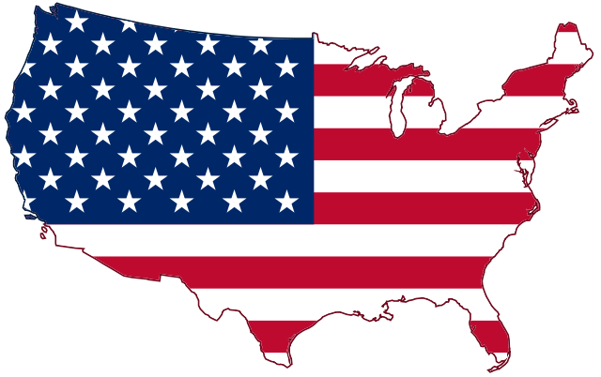
Presenting America’s Unknown Known History
By: Marcia A. Lennick

Slide 2
Welcome!
Prayer
Pledge of Allegiance
Thank you to Veterans
Explain exhibits – some may appear to be missing or out of order.
I will need your email address if you like to send you some of the exhibits or all of the exhibits.
Why I named this series “America’s Unknown Known History” is because there was once a time in American History that history was taught, and now it is not taught. It was once known, now it is unknown.

Slide 3
Welcome!
Introudction how I got in to this
Greatest day in history will always be the cross

Slide 4
Disclaimer: I do not work for Wallbuilders. I am simply a supporter of Wallbuilders and have permission to use their information.
Who is Wallbuilders and David Barton? America’s top Christian Historian who was a former principal and found that history was not being taught and now he has the world’s largest, privately owned collection on America’s founding. www.wallbuilders.com
Where the bathroom is
Drinks
Silent phones
My goal is to go to other churches and do this presentation. I am willing to travel. If you know someone that would be interested, lets chat afterwards.
If you also know any Vietnam or Korean veterans I would love to sit down and have a cup of coffee with them and interview them. I have not been told much about the Vietnam or Korean wars.

Slide 5
What to expect during this lecture series?
I want you to be able to look at exhibits. I plan on lecturing for 45 to 60 minutes so you have time to indulge.
I will focus on America’s Founding and we are slowly eroding from our founding to modern history.
Find out why we put “Under God” in the pledge.
What is the truth behind Separation of Church and State?
What is the Bible that influenced America?
And more!

Slide 6
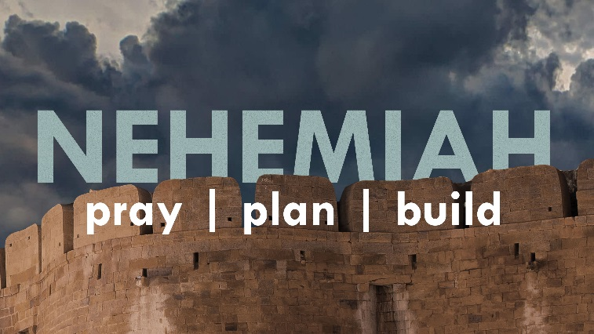
Called by God
I feel called to be a Nehemiah – to help rebuild the walls of America Biblically, Historically and Constitutionally.
I feel called to be an Esther – to help America understood her Judeo-Christian roots and to stand up for the Jewish people.
“My people are destroyed for lack of knowledge.” – Hosea 4:6
Where there is no vision, the people perish. – Proverbs 29:18

Slide 7
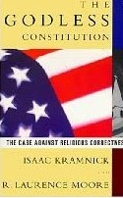
What has happened in modern history?
We take items out of context:
For example, those who knew me in high school vs. today would know me in a different light. In high school, before my belief in God, I was pro-choice. So, someone could put a quote I said in high school out on a billboard for folks to see.
We simply just do not talk about our historical figures. Without us talking about them, then we can make up stories about them.
We just talk about a few folks, and forget everyone else.
The Church is just as guilty on this account; we talk about Paul and a few of the greats and forget everyone else.
We must remember the Holy Spirit did not waste ink when he pressed it upon 40 different authors to draft the Bible within 1500 years.

Slide 8
How should we review The Bible and/or history?
Look at the good, the bad, the ugly, and get the truth.
Look at the hermeneutics – who, why, where, and what was going on at the time? Look at the event/Scripture in alignment with all of these, as well as the Chapter, Book, and the Bible as a whole when reading.
We do not need to change the facts of The Bible or history to align with our viewpoints. Truth is still truth.
Look at the FULL picture of the who, why, what, when, how, where (the hermeneutics) .
When we take items out of context we are CONNED by the TEXT.
I am originalist – I treat the Bible as the authoritative Word of God and founding documents in “original context” – not as a living, breathing document.

Slide 9
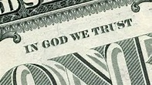
How should we view America today?
God is still on the throne and some of where America is at today, I am excited about.
For example, “The In God We Trust Movement”:
How about with a Caleb heart. We look at our nation on the basis of what God can do as He is still on the throne. We must be faithful to what He has called us to.
Caleb, along with Joshua, was one of the original twelve spies sent into the Promised Land to scout the area. While everyone else was too afraid to conquer Canaan, Caleb and Joshua announced that there would be no trouble for the Israelites. All of this goes down in Numbers 13-14.

Slide 10
Why History Matters? Is this billboard historically accurate? Why or why not?

Slide 11
Why History Matters?
If we do not know history, we are doomed to repeat the mistakes of the past.
-Ancient Israel was always in this boat until a righteous person would rise up and tell the King or Law Giver about the Book of the Law. Once the nation turned back to God, His blessings prevailed.
-Look at your sphere of influence
-Look at the righteous people in the Bible and their sphere of influence (Nehemiah and Queen Esther)

Slide 13
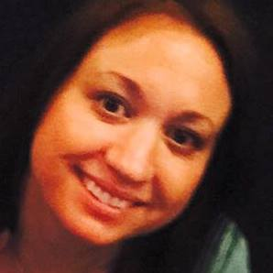
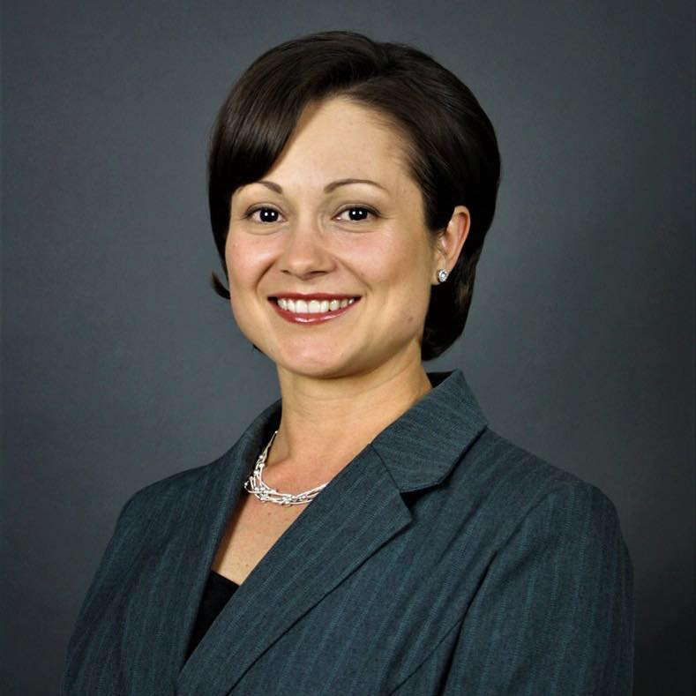
What makes America beautiful?
What other country are these three scenarios possible?
Anna – born and raised in the USA, now a missionary in Africa.
Monica – born and raised in socialist Romania and won the American lottery and came to America. Former dental assistant, now realtor, and her family has appeared on the television show: “The Righteous Gemstones.”
Gloire – a legal immigrant from Africa, whose book Grow Up Church was # 1 on Amazon in Church growth.

Slide 14
What makes America Beautiful?
We get the beauty of choice. In Israel they have to join the military when the government says so.
In WWII we actually let the folks of Hiroshima know we were going to bomb them before we bombed them. What other superpower would do that?
What ever your idea of the American dream is if America ceases to exist so will your American dream.
I never want America to turn socialist or communist. In fact, the Pilgrims tried socialist and did not work. When they used the Biblical mandate of “you don’t work, you don’t eat” that is when the Pilgrims started to succeed.

Slide 15
What makes America Beautiful?

Slide 16
What makes America Beautiful?
Did you know the Pilgrims tried socialism?
The colony's leaders identified the source of their problem as a particularly vile form of what Bradford called "communism." Property in Plymouth Colony, he observed, was communally owned and cultivated. This system ("taking away of property and bringing [it] into a commonwealth") bred "confusion and discontent" and "retarded much employment that would have been to [the settlers'] benefit and comfort.“
On the brink of extermination, the Colony's leaders changed course and allotted a parcel of land to each settler, hoping the private ownership of farmland would encourage self-sufficiency and lead to the cultivation of more corn and other foodstuffs. As Adam Smith would have predicted, this new system worked famously. "This had very good success," Bradford reported, "for it made all hands very industrious." In fact, "much more corn was planted than otherwise would have been" and productivity increased. "Women," for example, "went willingly into the field, and took their little ones with them to set corn." The famine that nearly wiped out the Pilgrims in 1623 gave way to a period of agricultural abundance that enabled the Massachusetts settlers to set down permanent roots in the New World, prosper, and play an indispensable role in the ultimate success of the American experiment.
When the Pilgrims went to the Biblical approaches of understanding personal property and the Biblical mandate of “you don’t work, you don’t eat.”

Slide 17
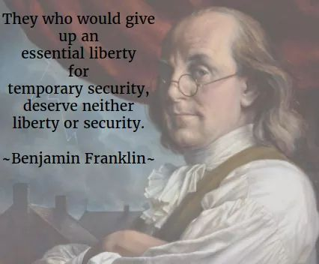
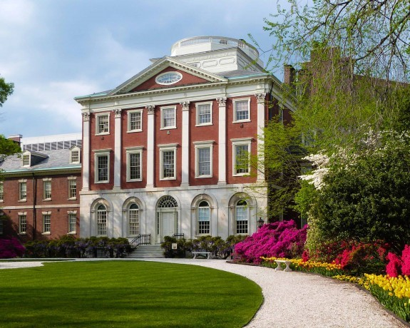
Benjamin Franklin
-Least religious founding father.
-1 of 6 to sign both The Dec. of Independence and The Constitution.
America’s First Hospital.
The Pennsylvania Hospital.
Founded by Benjamin Franklin, 1751.
The Logo was taken from the account of The Good Samaritan and reads: “Luke 10:35 ‘Take care of him and I will repay thee.”

Slide 18
Benjamin Franklin at The Constitutional Convention
Exhibit A: Franklin’s Appeal at the Constitutional Convention
Madison’s Journal originally contained a summary of Franklin’s words. However, in a later revision, he inserted the speech as written in Franklin’s own handwriting. It is the authoritative source concerning the Convention.
There were six signers that signed both The Constitution The Declaration of Independence. Franklin was one of these guys! In the second paragraph of his speech, the least religious founding father is asking for prayer!

Slide 19
Benjamin Franklin at The Constitutional Convention
In this situation of this Assembly, groping as it were in the dark to find political truth, and scarce able to distinguish it when presented to us, how has it happened, Sir, that we have not hitherto once thought of humbly applying to the Father of lights to illuminate our understandings? In the beginning of the Contest with G. Britain, when we were sensible of danger we had daily prayer in this room for the divine protection. ”Our prayers, Sir, were heard, and they were graciously answered. All of us who were engaged in the struggle must have observed frequent instances of a Superintending providence in our favor. To that kind providence we owe this happy opportunity of consulting in peace on the means of establishing our future national felicity. And have we now forgotten that powerful friend? I have lived, Sir, a long time, and the longer I live, the more convincing proofs I see of this truth- that God governs in the affairs of men. And if a sparrow cannot fall to the ground without his notice, is it probable that an empire can rise without his aid? We have been assured, Sir, in the sacred writings, that “except the Lord build the House they labour in vain that build it.”

Slide 20
Benjamin Franklin at The Constitutional Convention
How many Bible references can you choose from this one paragraph?
How many Bible references from the whole speech? I want to say 13 references, if my memory serves me correctly.
There used to be a time in American culture where we had sayings that came from the Bible. Well, today, these sayings exist, but folks may need understand or recognize they come from the Bible like:
“A birdie told me”.
“The writing is on the wall”.
How about the Golden Rule?
Good Samaritan Laws.

Slide 21
Who recognizes this Church?

Slide 22
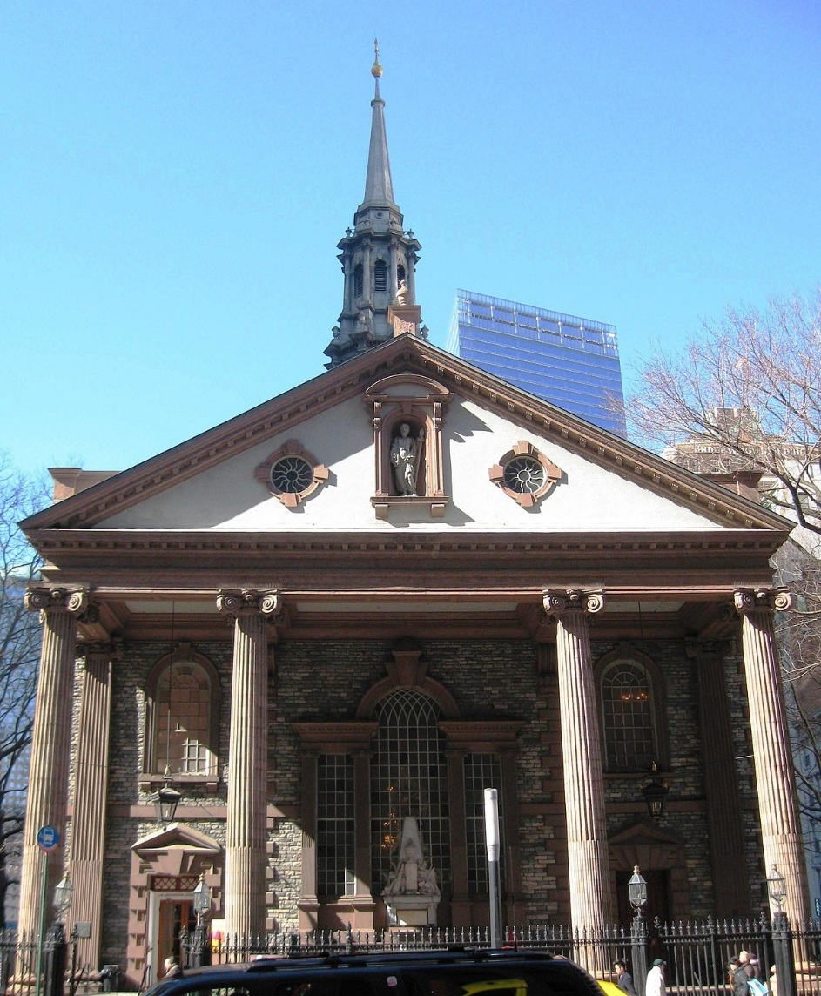
Who recognizes this Church?
Very historical Church as it survived 9/11. Hit national news for doing so.
It is also the Church where George Washington was inaugurated.
Lets talk about this Church, does anyone know what happens at this Church today? The Interfaith Movement – where Muslims and Christians come together to worship the same God. We do not serve the same God. This is how far we have come as a nation. Recommend the www.tilproject.com

Slide 23
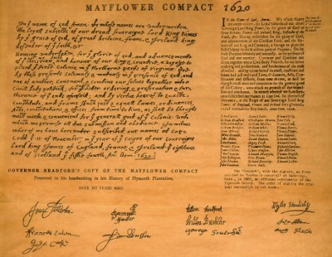
The Mayflower Compact
First governing document in America by 1620.
The reason the Pilgrims came to America was to advance the Christian faith.
See the replica for yourself.

Slide 24
More Information on the Pilgrims
Website: plymrock.org and Dr. Paul Jehle.
Did you know when the pilgrims were here, that they were once fined twelve pence for not bringing their gun to Church? Also, if you did not have a gun, the government would purchase one for you?

Slide 25
More info from Kirk Cameron (side note)
Kirk Cameron does a fabulous job in this movie Saving Christmas about the truth behind the traditions we celebrate today as well as the true St. Nicholas. Did you know the true St. Nicholas actually influenced the Christian Church’s Nicene Creed?

Slide 26
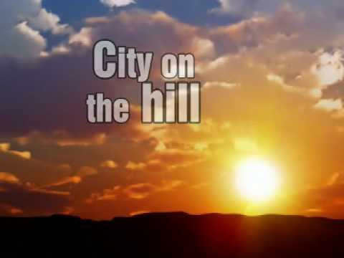
City on a Hill
Throughout America’s history, President’s reference that America will continually be a “City on a Hill.” Where did they get this idea?
Exhibit B – “A Model of Christian Charity”– City on a Hill -1630

Slide 27
City on a Hill – 1630 – “A Model of Christian Charity”
John Winthrop, first governor of Massachusetts Bay In the spring of 1630, Winthrop sailed for Massachusetts aboard the Arbella. By the end of 1630, seventeen ships in all had carried about 1,100 settlers to the Puritan settlements in and around Boston. In the decades ahead, the “plantation,” as it was known, survived disease, Indian warfare, political and religious dissent, and the return migration of many clergymen and homesick settlers to flourish as a populous and prosperous colony in the slowly expanding empire of British North America. At some point, whether before or during the voyage is not known, Winthrop wrote “A Model of Christian Charity.” Drawing heavily from The Old and New Testaments, he exhorted his fellow colonists to strengthen the “bonds of affection” that would enable the Puritan community to fulfill its divine mandate. He offered them a “model,” or template, after which they ought to pattern their lives as Christian brothers and sisters. The document makes clear that Winthrop thought the stakes of failing to do so were very high. Over the past fifty years, the “Model of Christian Charity” has become one of the most frequently quoted documents in American history. But it remained unpublished from 1630 until 1838 and only gradually thereafter made its way into textbook accounts of America’s origins. No copy of the discourse in Winthrop’s handwriting survives. The earliest manuscript copy, held in the archives of the New York Historical Society, includes a cover page that provides almost all of the evidence we have linking the document to Governor Winthrop and to the Arbella’s voyage.

Slide 28
Thanksgiving!
Does anyone know when Thanksgiving used to be celebrated in America?
Why do we celebrate Thanksgiving?
Please come and see these Thanksgiving Proclamations replicas.
Which President made it an actual Holiday?
Exhibit G – File Folder of various Thanksgiving Proclamations.

Slide 29
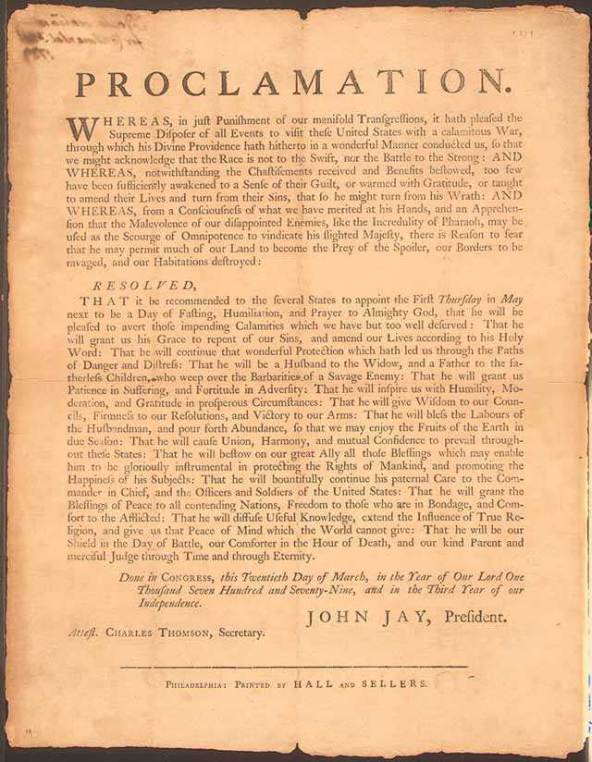

Slide 30
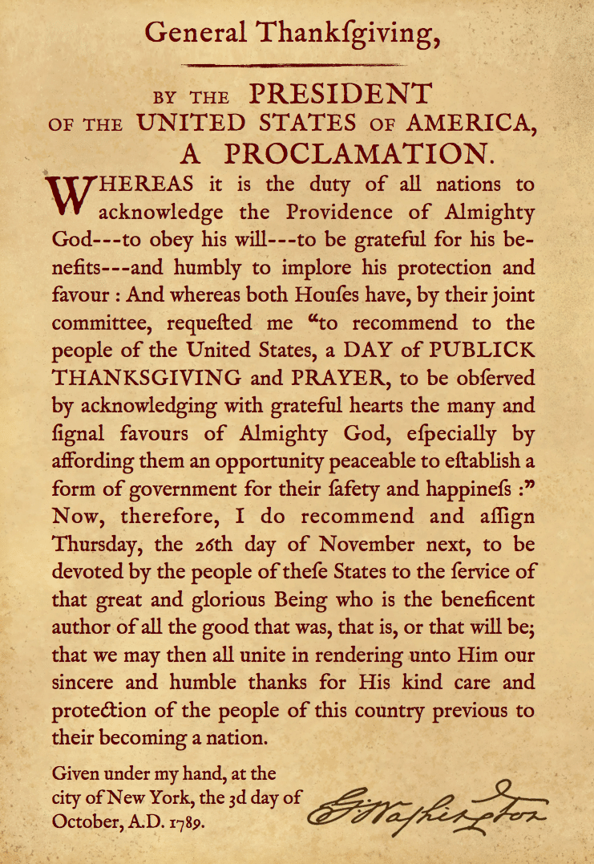

Slide 31
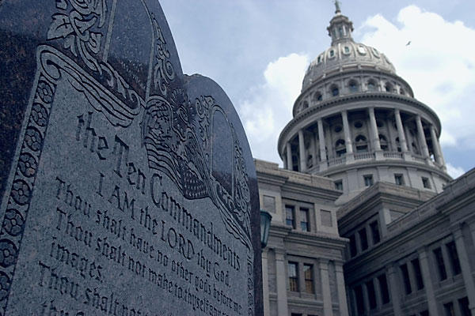
The Ten Commandments
Is it Constitutional or un-Constitutional to display the Ten Commandments outside of a Courthouse today?

Slide 32
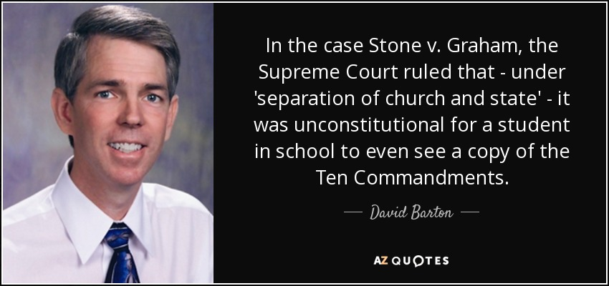
The Ten Commandments
One item I do like about David Barton of Wallbuilders is that he is considered an expert in this field of the Ten Commandments. David Barton was known for taking these kinds of cases to the US Supreme Court and show historical evidence of why the Ten Commandments SHOULD remain at our Courthouses.
David Barton does an excellent Affidavit in Support of the Ten Commandments. See -Exhibit C – Affidavit in Support of the Ten Commandments.

Slide 33
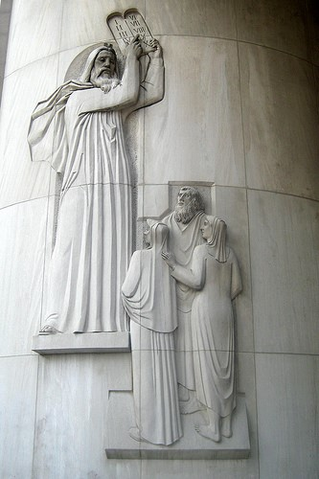
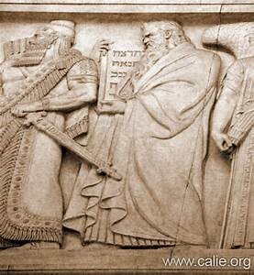
The Ten Commandments
Did you know it was more common to find The Ten Commandments outside of Courthouses than Churches at one point in American Government? Why? This is how we got our Civil Law of government
ON THE LEFT;
The Ten Commandments pictured at the US Supreme Court.
ON THE RIGHT:
Moses giving the Israelites the Ten Commandments New York Supreme Court.

Slide 34
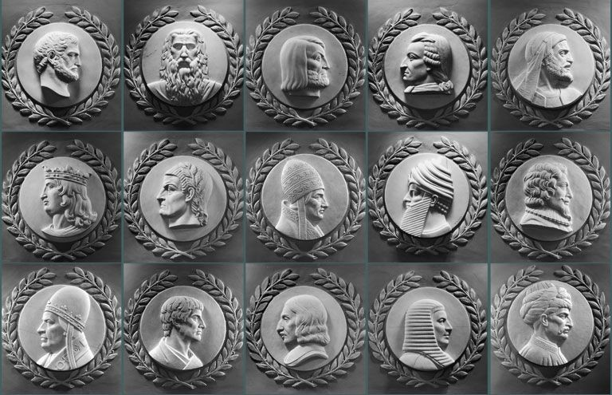
Many great lawgivers throughout time are shown here; however, Moses is the only one facing the Speaker of the House in the rotunda in our nation’s capitol.
This part of the rotunda was built in the 1920’s and here we are 100 years later. What has changed in our country?

Slide 35
The Ten Commandments in American History
Have No Other Gods
First incorporated into the first written code of laws in America, Virginia Colony 1610, and Massachusetts of 1641, Connecticut 1642.
If any man after legal conviction shall have or worship any other god but the Lord God, he shall be put to death. Deut. 13:6 & 10; 17:2 & 6; Ex. 22:20.
Have No Idols
1680 law of New Hampshire.
It is enacted by ye Assembly and ye authority thereof, yet if any person having had the knowledge of the true God openly and manifestly have or worship any other god but the Lord god, he shall be put to death. Ex: 22:20, Deut. 13:6, 10.

Slide 36
The Ten Commandments in American History
Honor the Sabbath
During the American Revolution, the Commander in Chief, George Washington ordered the Sabbath be observed: “The Commander in Chief directs that Divine service be performed every Sunday at 11 o’clock … it is expected that officers of all ranks will be their attendance set an example to their men.”
Following the Revolution, the states continued to Honor the Sabbath:
-Vermont, 10 part Sabbath Law, 1787 -Massachusetts, 11 part Sabbath Law, 1794 -Virginia, 8 part Law, written by Thomas Jefferson, 1792 -New Jersey, 21 part Sabbath Law, 1798 -New Hampshire, 14 part Sabbath Law, 1799 -Maine, 13 part Sabbath Law, 1821

Slide 37
The Ten Commandments in American History
Honor Your Parents
Connecticut, 1642.
“If any child or children above sixteen years old and of sufficient understanding shall curse or smite their normal father or mother; he or they shall be put to death unless it can be sufficiently testified that the parents have been very unchristianly negligent in the education of children, or so provoke them by extreme and cruel correction that they have been forced thereunto to preserve themselves from death or maiming.” Ex. 21:17, Lev. 20, Ex. 20:12.

Slide 38
The Ten Commandments in American History
Do Not Murder
Massachusetts, 1641.
“Ex. 21:12, Numbers 35:13,14,30,31. If any person commit any willful murder, which is manslaughter committed upon premeditated malice, hatred, or cruelty not in a man’s necessary and just defense, not by mere casualty against his will, he shall be put to death. Ex. 21:14. If any person shall slay another through guile, either by poisoning or other such devilish practice, he shall be put to death.”

Slide 39
The Ten Commandments in American History
Do Not Commit Adultery
Massachusetts, 1641.
If any person committeth adultery with a married or espoused wife, the adultery and adulteress shall surely be put to death. Ex. 20:14.
Do Not Perjure Yourself
Connecticut,1642.
If any man rise up by false witness, wittingly and of purpose to take away any man’s life, he shall be put to death. Deut. 19:16, 18, 19.

Slide 40
The Ten Commandments in American History
Sundays Excepted Clause
The US Constitution, 1787, Article 1, Section 7, the President has ten days to sign a law, “Sundays excepted”
Article 1 - The Legislative Branch Section 7 - Revenue Bills, Legislative Process, Presidential Veto
All bills for raising Revenue shall originate in the House of Representatives; but the Senate may propose or concur with Amendments as on other Bills.
Every Bill which shall have passed the House of Representatives and the Senate, shall, before it become a Law, be presented to the President of the United States; If he approve he shall sign it, but if not he shall return it, with his Objections to that House in which it shall have originated, who shall enter the Objections at large on their Journal, and proceed to reconsider it. If after such Reconsideration two thirds of that House shall agree to pass the Bill, it shall be sent, together with the Objections, to the other House, by which it shall likewise be reconsidered, and if approved by two thirds of that House, it shall become a Law. But in all such Cases the Votes of both Houses shall be determined by Yeas and Nays, and the Names of the Persons voting for and against the Bill shall be entered on the Journal of each House respectively. If any Bill shall not be returned by the President within ten Days (Sundays excepted) after it shall have been presented to him, the Same shall be a Law, in like Manner as if he had signed it, unless the Congress by their Adjournment prevent its Return, in which Case it shall not be a Law.
Every Order, Resolution, or Vote to which the Concurrence of the Senate and House of Representatives may be necessary (except on a question of Adjournment) shall be presented to the President of the United States; and before the Same shall take Effect, shall be approved by him, or being disapproved by him, shall be repassed by two thirds of the Senate and House of Representatives, according to the Rules and Limitations prescribed in the Case of a Bill.

Slide 41
The Ten Commandments in American History
Mississippi, 1950:
“The Sunday laws have a Divine origin… after six days of creation, the Creator Himself rested on the seventh. Genesis, Chapter 2, verses 2 and 3. Thus, the Sabbath was instituted as a day of rest. The original example was later confirmed as a commandment when the law was handed down from Mt. Sinai “Remember the Sabbath day, to keep it holy” [Exodus 20:8]
Pennsylvania, 1967:
“Remember the Sabbath day to keep it holy; six days shalt thou labor and do all thy work; but the seventh day is the Sabbath of the Lord thy God. In it thou shalt not do any work” [Deuteronomy 5:12-14]. This Divine pronouncement became part of the Common Law inherited by the thirteen American colonies and by the sovereign states of the American union.”
Florida Supreme Court, 1950:
“A people unschooled about the sovereignty of God, the Ten Commandments, and the ethics of Jesus could never have evolved the Bill of Rights, the Declaration of Independence, and the Constitution. There is not one solitary fundamental principle of our democratic policy that did not stem directly from the basis moral concepts as embodies in the Decalogue and the ethics of Jesus.”

Slide 42
The Geneva Bible
How many have heard of this Bible?
Bible used in the Reformation.
Breeches Bible (1560 Version).
Bible used during the American Revolution.
Why people claim our FF were deists as it refers to God as Providence.

Slide 43
The Geneva Bible

Slide 44
How has America changed?
I am not going to discuss The Civil War; not that the war was not important. I am not saying that.
I want to really dive in to where America started changing in the late 1800’s, mid-1900’s and how we got here today in 2020.
Federal Reserve Starting.
When we quit using the New England Primer.
How we Got “Under God” and “In God We Trust” in the Pledge of Allegiance.

Slide 45
How has America changed?
Deuteronomy 14:22 “You shall surely tithe all the produce from what you sow, which comes out of the field every year.”
The tithe= 10% of the annual income of every citizen, and it functioned as a tax or levy on the people. From the tithe, officials were pad and social programs were funded.
Under this Biblical mandate, rich and poor, paid the same tax rate.

Slide 46
How has America changed?
Matthew 5:45 “He causes His sun to rise on the evil and the good, and sends rain on the righteous and the unrighteous.”
Evil or good, just or unjust, rich or poor, God was impartial. This Biblical tax was “capitation taxation” – an assessment levied by the government upon a person at a fixed rate, regardless of income or worth” which is in the US Constitution under Article 1, Section 9: “No capitation or other direct tax shall be laid unless in proportion to the census or enumeration herein before directed to be taken.”
The Founders required that the federal taxes be applied evenly to every person, based on the census population. The Constitution also said in Article 1, Section 8: “The Congress shall power to lay and collect taxes, duties, imposts, and excises . . . but all duties, imposts, and excises shall be UNIFORM throughout the United States.”
Money is amoral. One can be rich and mean or poor and mean. One can do good with money.
Brad and Julie Duncan from Great Falls who now live in Seattle. Every Christmas they do Duncan’s toy chest.

Slide 47
How has America changed?
In the 1800’s this started changing under progressivism and poststructuralism – where people do not look at themselves as part of the country, but rather a group – male, female, black, white, gay, straight.
America once was characterized by the following:
-E Pluribus Unum “out of many, one”
America is now characterized by the following:
-E Unum Pluribus, “out of one, many”
Under the second characterization, in 1894, Congress passed a tax that singled out the wealthy and treated them differently. In 1895, the Supreme Court struck down this law.

Slide 48
How has America changed?

Slide 49
How has America changed?
In 1913, an amendment occurred to change the Biblical approach, the 16th amendment:
“The Congress shall have power to lay and collect taxes on incomes, from whatever source derived, without apportionment among the several States, and without regard to any census or enumeration.”
The more the government grows, the more our rights are taken away.
The Constitution, The Declaration of Independence, and The Bill of Rights were put in place to limit the federal government, NOT THE PEOPLE.
-WWI happens (we will not discuss in detail this war; not saying it is not important).

Slide 50
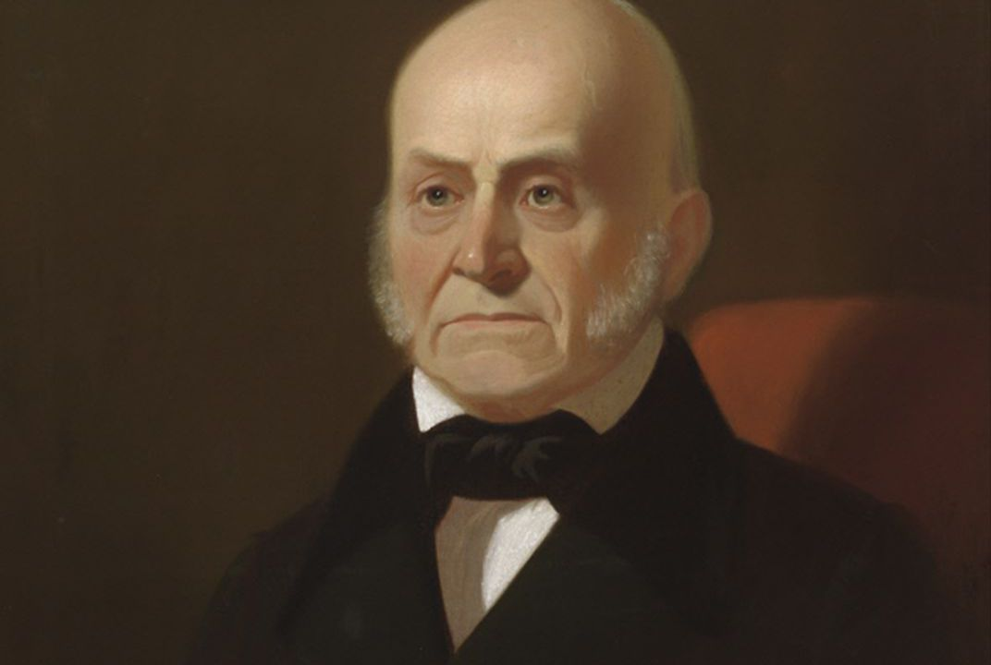
“Duty is ours, results are God’s” -John Quincy Adams

Slide 51
WWII happens – actual WWII planes in Great Falls at Holman Aviation – Summer 2019

Slide 52
Fun facts of WWII
Properly designated as the 1st Special Service Force, the Devil's Brigade was a joint World War II American-Canadian commando unit trained at Fort Harrison near Helena, Montana in the United States. Many modern American and Canadian Special Forces units trace their heritage to this unit. For the movie of the same name, see The Devil's Brigade.

Slide 53
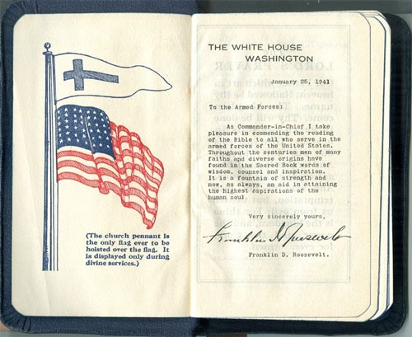
FDR Bible of WWII
Some will get upset that the Christian Flag is above the American Flag. Well, hold on. We have always been a nation of “God, Country, Family.” Our Founding Fathers understood that God is a God of order: In order for our families to be protected, we as a country need to be right with God. So the order God has set for nations is “God, Country, Family.”

Slide 54
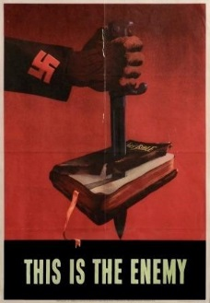
We knew who the enemy was
Actual government printed WWII Bond Poster
Unfortunately much AP History today does not teach the Holocaust; however, there have been state laws to enact the teaching of the Holocaust.

Slide 55
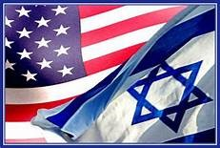
American Israeli Relations
Romans 11:16-18 “…remember that it is not you who supports the root, but the roots supports you.”
America has always understood the relationship between the Jews and Christians and God’s Covenant.
-Romans 11:18 -Genesis 12;1-3 -Luke 1:67-68, 72 -73

Slide 56
American Israeli Relations
Synagogues were a part of the American Christian Colonies (below are the colonies that were Christian, but were permitted synagogues):
-1658 –Newport, Rhode Island founded Baptist Minster Roger Williams -1659 – Savannah, Georgia founded by Methodist Leader James Olgethorpe and Methodist Ministers Charles and John Wesley -1719 – Richmond, Virginia -1750 – Charleston, SC

Slide 57
American Israeli Relations
Elias Boudinet (President of Congress and Framer of the Bill of Rights) made it a personal provision to bring persecuted Jews to America as “asylum of safety.”
Signer of the Declaration of Independence John Witherspoon understood Christians were blessed because of the Jews as we would not have the Scriptures without the Jews:
“To the Jews were first committed the care of the Sacred Writings . . . Yet was the providence of God particularly manifest in their preservation and purity. The Jews were so faithful to their important trust that when copies of the law or the prophets were transcribed, they observed the most scrupulous exactness. They not only diligently compared the one with the other but even counted the number of letters in each book, and compared and recorded the numbers.”

Slide 58
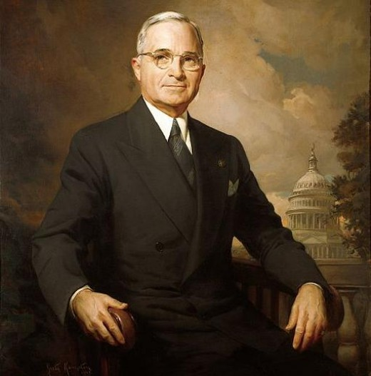
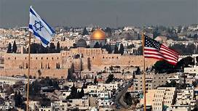
American Israeli Relations
Is the Israel mentioned today, the same mentioned in the Bible? Yes or No?
May 14th, 1948/May 14th, 2018.
What would happen if either POTUS Truman or POTUS Trump had a different worldview of Israel?

Slide 59
American Israeli Relations

Slide 60
Aren’t we repeating history here?
Policy in America vs. Policy in Israel
Jews in America are different than the Jews in Israel
I would encourage anyone to read The NAZI platform from WWII:
14. We demand profit-sharing in large enterprises.
20. In order to make higher education – and thereby entry into leading positions –available to every able and industrious German, the State must provide a thorough restructuring of our entire public educational system. The courses of study at all educational institutions are to be adjusted to meet the requirements of practical life. Understanding of the concept of the State must be achieved through the schools (teaching of civics) at the earliest age at which it can be grasped. We demand the education at the public expense of specially gifted children of poor parents, without regard to the latters’ position or occupation.
21. The State must raise the level of national health by means of mother-and-child care, the banning of juvenile labor, achievements of physical fitness through legislation for compulsory gymnastics and sports, and maximum support for all organizations providing physical training for young people.

Slide 61
Aren’t we repeating history here? Continuing The Nazi Platform of WWII
23. We demand laws to fight against deliberate political lies and their dissemination by the press. In order to make it possible to create a German press, we demand:
a) all editors and editorial employees of newspapers appearing in the German language must be German by race;
b) non-German newspapers require express permission from the State for their publication. They may not be printed in the German language;
c) any financial participation in a German newspaper or influence on such a paper is to be forbidden by law to non-Germans and the penalty for any breach of this law will be the closing of the newspaper in question, as well as the immediate expulsion from the Reich of the non-Germans involved. Newspapers which violate the public interest are to be banned. We demand laws against trends in art and literature which have a destructive effect on our national life, and the suppression of performances that offend against the above requirements.
24. We demand freedom for all religious denominations, provided that they do not endanger the existence of the State or offend the concepts of decency and morality of the Germanic race. The Party as such stands for positive Christianity, without associating itself with any particular denomination. It fights against the Jewish-materialistic spirit within and around us, and is convinced that a permanent revival of our nation can be achieved only from within, on the basis of: Public Interest before Private Interest.

Slide 62
Aren’t we repeating history here? Continuing The Nazi Platform of WWII
Totally recommend this movie by Dinesh D’Souza

Slide 63
WWII Resources and Resources After WWII
Exhibit E: Platform of the National-Socialist German Workers’ Party
Exhibit F: Dwight Eisenhower’s Bill of Responsibilities
As we all know our rights come with responsibilities
Preamble to the Bill of Responsibilities:
Freedom and responsibility are mutual and inseparable; we can ensure enjoyment of the one only by exercising the other. Freedom for all of us depends on responsibility by each of us. To secure and expand our liberties, therefore, we accept these responsibilities as individual members of a free society.
www.freedomsfoundation.org

Slide 64
How has America changed?
In the 1920’s we quit using The New England Primer.
In the 1930’s Keynesian Economics started taking over and being taught in schools:
Keynesian Economics is an economic theory of total spending in the economy and its effects on output and inflation developed by John Maynard Keynes.
This was developed in the 1930’s to understand The Great Depression
This is why modern education would say that the reason we left Great Britain was “taxation without representation”.
I would encourage all folks to read The Declaration of Independence and look at all the clauses of why we left Great Britain
How many were taught anything besides “Taxation without Representation?”
1960’s -Prayer and The Bible taken out of public education.

Slide 65
God bless America, land that I love, Stand beside her and guide her Through the night with a light from above. From the mountains, to the prairies, To the oceans white with foam, God bless America, My home sweet home.
While the storm clouds gather far across the sea, Let us swear allegiance to a land that's free. Let us all be grateful for a land so fair, As we raise our voices in a solemn prayer:

Slide 66
The History of God in America
Yet the public acknowledgement of God was more than just a pleasant practice in early America; it actually formed the basis of our government philosophy – a philosophy set forth in eighty-four simple words in the Declaration of Independence.
The Declaration of Independence lists God four times.

Slide 67
The History of God in America
“We hold these truths to be self-evident: that all men are created equal, that they are endowed by their Creator with certain unalienable rights; that among these are life, liberty and the pursuit of happiness; that to secure these rights, governments are instituted among men, deriving their just powers from the consent of the governed. That whenever any form of government becomes destructive of these ends, it is the right of the people to alter or to abolish it and to institute new government.”
-The Declaration of Independence

Slide 68
The History of God in America
Thus, five immutable principles constitute the heart and soul of American government:
1. Government acknowledges that there is a Creator
2. Government acknowledges that the Creator gives specific inalienable rights to man
3. Government acknowledges that it exists to protect God-given rights
4. Government acknowledges that below the level of God-given rights, government powers are to be operated only with the permission of citizens – i.e., with the “consent of the governed”
5. If government fails to meet the four standards above, the people have an inalienable right to abolish that government and institute a new one that does observe the four criteria above.

Slide 69
The History of God in America
Every State mentions an attribute of God in their preamble or Constitution
Montana Constitution Preamble:
“We the people of Montana grateful to God for the quiet beauty of our state, the grandeur of our mountains, the vastness of our rolling plains, and desiring to improve the quality of life, equality of opportunity and to secure the blessings of liberty for this and future generations do ordain and establish this constitution.”

Slide 70
The History of God in America - Know Your Rights
Montana Code Annotated 2017 TITLE 1. GENERAL LAWS AND DEFINITIONS
CHAPTER 1. GENERAL PROVISIONS Part 5. State Symbols -- Official Designations Display Of Historical Writings Or Documents In Or On Public Buildings Or On State Land -- Definitions
1-1-540. Display of historical writings or documents in or on public buildings or on state land -- definitions. (1) Subject to the provisions of subsection (3), a state agency or unit of local government may display the national motto, "in God we trust", as adopted by congress in 1998 (36 U.S.C. 302), in or on public buildings or state-owned land occupied by a state agency or unit of local government. For purposes of this section, the use of the word "God" is not intended to further the establishment of any specific religion or set of religious beliefs or to dissuade the free exercise of any religion or set of religious beliefs.
(2) In addition to the national motto, the legislature encourages the display of other historical documents in or on public buildings and state-owned land, including but not limited to: (a) the Declaration of Independence; (b) the United States constitution; (c) the pledge of allegiance; (d) the national anthem; (e) the Mayflower Compact; (f) the writings, speeches, documents, and proclamations of the founders and the presidents of the United States; (g) writings from United States supreme court decisions; (h) organic documents from the precolonial, colonial, revolutionary, federalist, and post federalist eras; (i) acts of the United States congress, including the published text of the Congressional Record; (j) United States treaties; and (k)any other writings, documents, or proclamations that are permanently displayed in a historic context in the United States capitol.
(3) The content of any writing, document, or record described in subsection (2) may not be censored solely because the writing, document, or record contains religious references, nor may any writings, documents, or material be selected for display in order to advance a particular religious, partisan, or sectarian purpose.
(4) As used in this section, the following definitions apply: (a) "Local government" has the meaning provided in 1-2-116. (b) "State agency" has the meaning provided in 1-2-116.
History: En. Sec. 1, Ch. 372, L. 2005; Sec. 1-1-520, MCA 2011; redes. 1-1-540 by Code Commissioner, 2013.

Slide 71
The History of God in America - Know Your Rights
Did you know that there is a federal conscience law on the books? For example, if you are a nurse and do not want to partake in an abortion, you are protected under this law?
Did you know your public school can lose federal funding if they do not permit your child to pray?
Organization I recommend: https://www.catholicsforfreedomofreligion.org/

Slide 72
The History of God in America - Know Your Rights
Why is having God in items important like “One Nation Under God” or “In God We Trust”? So we do not turn communistic – as the more we take God out of items, the more we will turn communistic/socialistic.
This is the reason why we put “Under God” in the pledge and made “In God We Trust” our motto.
In fact, the Democratic Party has removed God from their platform
Keep Faith in America is a great organization combatting the anti-God agenda in America.

Slide 73
The History of God in America
See Exhibits H1 and H2 – One Nation Under God, One Nation Under God Part 2
See Exhibit H3 -The Sermon that influenced One Nation Under God
See Exhibit I – Church in the US Capitol

Slide 74
The History of God in America
Did you know Capitol Hill used to be where the largest Church service occurred? You can read the journals of John Quincy Adams for supporting evidence.
A practice still today is that we have chaplains open daily with prayer. In our founding, chaplains had two jobs: open in prayer and prepare the Sunday sermon.

Slide 75
The History of God in America

Slide 76
Fun Facts on American History -How the Liberty Bell got its name

Slide 77
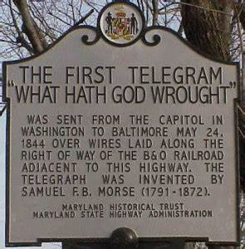
Fun Facts on American History -Numbers 23:23 – The First Message Sent via Morse Code
See Exhibit J – Morse Code

Slide 78
Fun Facts on American History -Our Form of Government was inspired by Scripture
Our Republican form of government:
Exodus 18:21-22 (NASB):
²¹ Furthermore, you shall ^{[a]}select out of all the people able men who fear God, men of truth, those who hate dishonest gain; and you shall place these over them as leaders of thousands, ^{[b]}of hundreds, ^{[c]}of fifties and ^{[d]}of tens.
Thousands, hundreds, fifties and of tens are our different levels of government (city, county, state, federal).

Slide 79
Fun Facts on American History -Our Form of Government was inspired by Scripture
Our three branches of government:
Isaiah 33:22 (NASB):
²² For the Lord is our judge, The Lord is our lawgiver, The Lord is our king; He will save us—
Judge (judicial); lawgiver (legislative); king (executive).
Separation of Powers:
Jeremiah 17:9 (NASB):
“The heart is more deceitful than all else And is desperately sick; Who can understand it?
The founders wanted each branch to keep each other accountable because to much power wielded to the wrong person/branch can lead to disaster. The heart is deceitful.

Slide 80
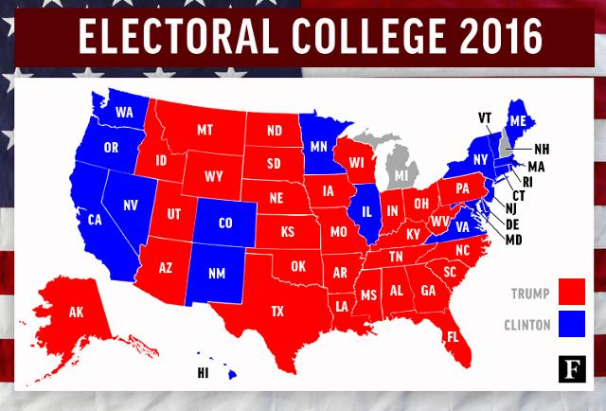
I love our Republican form of government!
How many representatives does each state have? Depends on population.
How many senators does each state have? 2

Slide 81
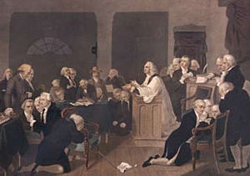
First Prayer in Congress
Read from Psalm 35.
Would last over two hours.
Occurred in Carpenter's Hall (behind Independence Hall).
Different denominations showed up to pray that day!
See Exhibit M – Letter from John Adams to his wife about the first prayer in the Continental Congress.

Slide 82
Early American Textbooks in the Classroom
See for yourself on the table
Noah Webster’s Book – History of the United States
(this was actually taught in American Education)
Section 1. Of the first man. In the beginning God created the heaven and the earth, and the sun, moon, and stars. He created also grass, and other plants ; and various animals for the use of man. And last of all he created the first man, called Adam, endowed him with rational faculties, and gave him dominion over the earth, and over the beasts of the field, the fishes of the sea, and fowls of the air. 2. Of the first woman. The first woman, called Eve, was made by God as a helper to Adam. Being taken from Adam's body, she was presented to him, and received as his intimate companion, to share with him the toils and the felicities of life. These were the progenitors of all the human race.

Slide 83
Early American Textbooks in the Classroom
Noah Webster drafted the following as well:
-Noah Webster Dictionary (1828). He learned 26 different languages.
-Webster Bible (1833).
Why?
He wanted to ensure the American people would NEVER went back to their British ways.
Exhibit N – Webster Bible (will be sent via email)
Exhibit O – Webster’s History of the US (will be sent via email)
The Webster’s Dictionary (on table)

Slide 84
Pastors in the American Revolution
Should Pastors be involved in politics?
Why or why not?
Black Robe Regiment
These were Pastors who would speak up from the pulpit during The American Revolutionary War.
Still exists today. Wallbuilders is trying to rebuild the Black Robe Regiment and inform Pastors on current topics and what to address from the pulpit.

Slide 85
Pastors in the American Revolution
Reverend Jonas Clark
His words would be known as the primer in the guns on the Lexington-Green.
Minutemen actually attended his Church.
-Exhibit Q – Reverend Jonas Clark on the Battle of Lexington.
This is a sermon given one year AFTER the “shot heard around the world.”
-Exhibit R – History of the Black Robe Regiment.

Slide 86
Pastors in the American Revolution
The Hancock-Clark House:
The Hancock-Clark House is 1/4 mile from Buckman Tavern, on Hancock Street. On the evening of April 18, 1775, John Hancock and Samuel Adams, prominent leaders in the colonial cause, were guests of the Reverend Jonas Clarke in the parsonage. Fearing that they might be captured by the British, Dr Joseph Warren of Boston sent William Dawes and Paul Revere to Lexington with news of the advancing British troops. Arriving separately, they stopped to warn Hancock and Adams, then set off for Concord. Today Dawes is all but forgotten, but Paul Revere's midnight ride has been immortalized by Longfellow.

Slide 87
Pastors in the American Revolution
The Hancock-Clark House was the home of the Reverend John Hancock and the Reverend Jonas Clark - two ministers who served the spiritual and secular needs of Lexington for 105 years. Soon after coming to Lexington in 1698 the Reverend Mr. Hancock built a small parsonage on this site and in 1738 his son Thomas, a wealthy Boston merchant, enlarged his parents' home. The Reverend Hancock's grandson John, a frequent visitor to this house, was the first signer of the Declaration of Independence and the first Governor of Massachusetts. Succeeding Hancock as minister in 1752, the Reverend Jonas Clark, who reared twelve children in this parsonage, was an eloquent supporter of the colonial cause. The Reverend Clark's fervent sermons were a source of inspiration to the citizens of Lexington during the crisis with Britain. This house is of particular interest because it contains furnishings and portraits owned by the Hancock and Clark families and an exhibit area that includes William Diamond's drum and Major Pitcairn's pistols - treasured relics of April 19, 1775.

Slide 88
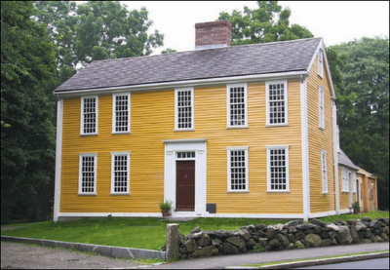
Pastors in the American Revolution
Information on The Hancock-Clark house are courtesy of: https://www.bostoncentral.com/activities/landmarks/p1496.php

Slide 89
Pastors in the American Revolution
Muhlenberg Brothers.
Samuel Davies – Patrick Henry’s Pastor.
Did you know that Patrick Henry’s famous speech “Give Me Liberty or Give Me Death” was preached in a Church?
John Wise – his words influenced The Declaration of Independence. The Sons of Liberty would redistribute Reverend John Wise’s words and would preserve the seeds of liberty.
Exhibit P – A Vindication of the Government of the New England Churches
See Patrick Henry’s Speech.

Slide 90
Separation of Church and State
Different types of government:
totalitarianism: communistic/socialistic and led by a dictator or a czar (Emperors – Lk: 2:1; Caesars – Mk 12:17; Pharaohs: Ex:1-14).
monarchy: king or queen get to dictate.
republic and constitutional republic (Ex. 18:21; Deut. 1:15-16; 16:18)
Oligarchy: power is in elite few (Sanhedrin Lk. 22:66).
anarchy or revolutionary: government without laws and power is in each individual and we all do what is right in our own eyes (Deut. 12:8; Judges 17:6; 21:25).
democracy: majority rules (Matt. 27:21).
theocracy: where representatives say they here from God and these are His direct steps – without a proper view of Separation of Church and State. This is the reason why we left Great Britain.

Slide 91
Separation of Church and State
America is Republic form of Government:
Article 4, Section 4, of the US Constitution: The United States shall guarantee to every State in this Union a Republican Form of Government, and shall protect each of them against Invasion; and on Application of the Legislature, or of the Executive (when the Legislature cannot be convened) against domestic Violence.
"When you become entitled to exercise the right of voting for public officers, let it be impressed on your mind that God commands you to choose for rulers just men who will rule in the fear of God. The preservation of a republican government depends on the faithful discharge of this duty”.
Noah Webster, 1832, History of the United States.

Slide 92
Separation of Church and State
Lets talk about Separation of Church and State. It is not what modern folks think it is – that the Church can DOMINATE the government, but it also is not the idea that folks cannot express their religious views in the public square.
We are not a theocracy. We are not an oligarchy or a monarchy or an anarchy. We believe in the people’s right to choose their leaders, and there should not be a special group of people in charge either. Anarchy would be purely scary – so government has a job to establish rule and order.
Deuteronomy 15:11 tells us that the poor will always be among us. God gave certain instructions for the Israelites and how to care of the poor. For example, if the owner of the land gleaned a field, and they forgot certain produce, they were to leave it for the poor to come and get it.

Slide 93
Separation of Church and State
The individual and the Church are responsible to assist the poor with food, clothing, physical effects of this nature. The priest could grant proportional relief to an individual after determining the need of an individual.
Individually: Deuteronomy 15:7-8, 10-11; Matthew 25:34-40.
Church: Leviticus 27:8; Acts 4:34-35.
The government's job is to provide justice to the poor and to maintain the rights of the poor.
Exodus 23:3,6; Leviticus 19:15; Proverbs 29:14.

Slide 94
Separation of Church and State
Truth behind Separation of Church and State
When drafting the First Amendment – and Separation of Church and State:
there is nothing in legislative intent with the journals.
Jefferson paid the Marine Marching band to play hymns.
Jefferson funded Bible Studies.
Jefferson had his own Bibles printed (1804 and 1820 versions).
Jefferson actually attended Church on Capitol Hill two days AFTER drafting Separation of Church of and State letter.

Slide 95
Separation of Church and State
Since this was Jefferson’s view concerning religious expression, in his short and polite reply to the Danbury Baptists on January 1, 1802, he assured them that they need not fear; that the free exercise of religion would never be interfered with by the federal government. As he explained:
“Gentlemen, – The affectionate sentiments of esteem and approbation which you are so good as to express towards me on behalf of the Danbury Baptist Association give me the highest satisfaction. . . . Believing with you that religion is a matter which lies solely between man and his God; that he owes account to none other for his faith or his worship; that the legislative powers of government reach actions only and not opinions, I contemplate with sovereign reverence that act of the whole American people which declared that their legislature should “make no law respecting an establishment of religion or prohibiting the free exercise thereof,” thus building a wall of separation between Church and State. Adhering to this expression of the supreme will of the nation in behalf of the rights of conscience, I shall see with sincere satisfaction the progress of those sentiments which tend to restore to man all his natural rights, convinced he has no natural right in opposition to his social duties. I reciprocate your kind prayers for the protection and blessing of the common Father and Creator of man, and tender you for yourselves and your religious association assurances of my high respect and esteem.”

Slide 96
Separation of Church and State
In 1947, in the case Everson v. Board of Education, the Supreme Court declared, “The First Amendment has erected a wall between church and state. That wall must be kept high and impregnable. We could not approve the slightest breach.” The “separation of church and state” phrase which they invoked, and which has today become so familiar, was taken from an exchange of letters between President Thomas Jefferson and the Baptist Association of Danbury, Connecticut, shortly after Jefferson became President.
-We need to understand Jefferson helped draft the Dec. of Independence (1776), not the Constitution (1787), not the Bill of Rights (1791), Separation of Church and State Letter (1802)
Three separate documents. Not many folks realize these are three separate documents.
When the Constitution was drafted Jefferson was not in the USA.

Slide 97
Separation of Church and State
Some of you might be wondering what can I do about this? Can my child or grandchild pray over his or her meal at lunchtime or a football game? Well, yes.
Catholics for Freedom of Religion is a great organization. Being used in Long Island. Informing people of their rights. Did you know the school can lose their federal funding for not allowing your child or grandchild to not pray?
Inform your local school board.
Live out your freedoms, but protect your liberties.

Slide 98
Separation of Church and State
First Amendment from The Bill of Rights:
Congress shall make no law respecting an establishment of religion, or prohibiting the free exercise thereof; or abridging the freedom of speech, or of the press, or the right of the people peaceably to assemble, and to petition the Government for a redress of grievances.
Our founding fathers never wanted a theocracy (establishment clause). Our founding fathers wanted us to be able to live out our religious faith (free exercise clause).
-Exhibit S– No the Founding Fathers Did Not Want Pastors to Stay out of Politics
-Exhibit T – The FF on the Bible and Jesus
-Exhibit U – Separation of Church and State

Slide 99
America’s First War on Terror
Why did Thomas Jefferson have a Quran?
The Barbarian Wars that the Marines sing about in their Hymn.
He wanted to know and to understand the enemy.
Exhibits V and W – Americas War on Terror, Parts 1 and 2

Slide 100
America’s Continuous War on Terror
In August of 2004, an alert Maryland Transportation Authority Police officer observed a woman wearing traditional Islamic garb videotaping the support structures of the Chesapeake Bay Bridge, and conducted a traffic stop. The driver was Ismail Elbarasse and detained on an outstanding material witness warrant issued in Chicago in connection with fundraising for Hamas.The FBI’s Washington Field Office subsequently executed a search warrant on Elbarasse’s residence in Annandale, Virginia. In the basement of his home, a hidden sub-basement was found; it revealed over 80 banker boxes of the archives of the Muslim Brotherhood in North America. One of the most important of these documents made public to date was entered into evidence during the Holy Land Foundation trial. It amounted to the Muslim Brotherhood’s strategic plan for the United States and was entitled, “An Explanatory Memorandum: On the General Strategic Goal for the Group in North America.” The Explanatory Memorandum was written in 1991 by a member of the Board of Directors for the Muslim Brotherhood in North America and senior Hamas leader named Mohammed Akram. It had been approved by the Brotherhood’s Shura Council and Organizational Conference and was meant for internal review by the Brothers’ leadership in Egypt. It was certainly not intended for public consumption, particularly in the targeted society: the United States. For these reasons, the memo constitutes a Rosetta stone for the Muslim Brotherhood, its goals, modus operandi and infrastructure in America. It is arguably the single most important vehicle for understanding a secretive organization and should, therefore, be considered required reading for policy-makers and the public, alike.
Another extraordinarily important element of the Memorandum is its attachment. Under the heading “ A List of Our Organizations and Organizations of Our Friends,” Akram helpfully identified 29 groups as Muslim Brotherhood fronts. Many of them are even now, some twenty-two years later, still among the most prominent Muslim- American organizations in the United States. Worryingly, the senior representatives of these groups are routinely identified by U.S. officials as “leaders” of the Muslim community in this country, to be treated as “partners” in “countering violent extremism” and other outreach initiatives. Obviously, this list suggests such treatment translates into vehicles for deep penetration of the American government and civil society.
We urge the readers of this pamphlet to share it with others— family members, friends, business associates and most especially those in a position to help adopt policies that will secure our country against the threat posed by shariah and its most effective and aggressive promoters, the Muslim Brotherhood.

Slide 101
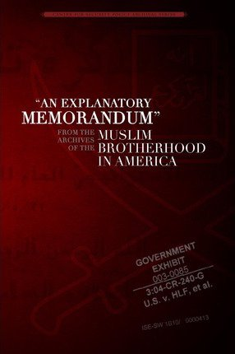
America’s Continuous War on Terror
From the www.tilproject.com
Former Muslim from Iran; now living in the USA. Shahram Hadian goes all over the country and speaks on the concerns of Islam being infiltrated in to the USA is an issue of National Security.

Slide 102
America’s Continuous War on Terror
I am not saying all Muslims are terrorists.
There are reports in the Middle East where Muslims are saving Christians from persecution of other Muslims.
There is a difference in doctrine in the Muslim faith (I.E. Look at the Kurds in Syria).
We have to be careful (A Seek vs. a Muslim).

Slide 103
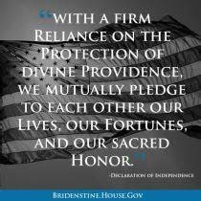
What we do from here?
Defend the Constitution. First, read it. Second, share the information with others. Recommend Constitution Alive by Rick Green and David Barton. Recommend Hillsdale College’s free course on the Constitution.
Vote in people who defend the Constitution. Expose those who do not defend the Constitution. Look at score cards. Ivoterguide.com
Give of your lives, fortunes and sacred honor.
Lives (could be service); fortunes (finances);
sacred honor (your word).
Help get great people elected.
Do not waste your vote. Don’t just get involved in Presidential Elections. Get involved in ALL elections.

Slide 104
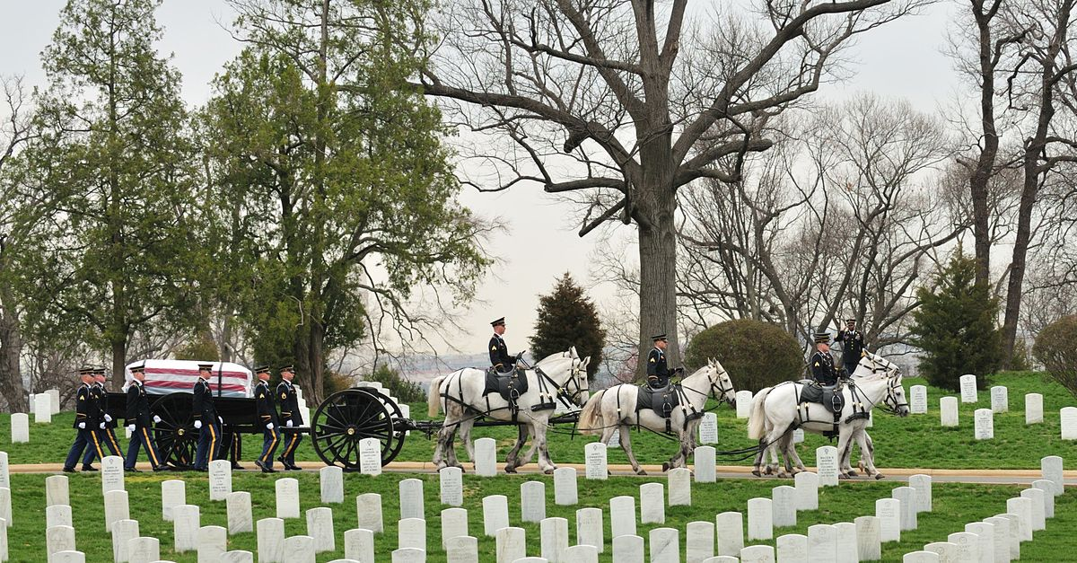
What we do from here?
Do not let their deaths be in vain.
Live out your freedoms, and protect your liberties.
Too much blood has been shed to give up and to not FIGHT.

Slide 105
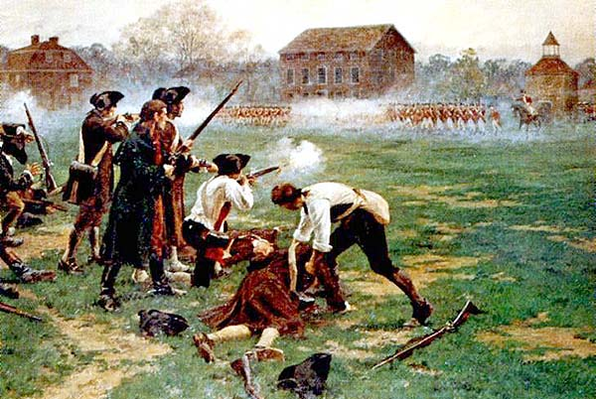
What we do from here?
"Stand your ground. Don't fire unless fired upon, but if they mean to have a war let it begin here." Captain John Paarker, to his Minute Men on Lexington Green, April 19, 1775.

Slide 106
What we do from here?
Remember that HISTORY will ALWAYS be HIS –Story.
Remember the greatest day of HISTORY will ALWAYS be the Cross
Daniel Webster : “History is God’s providence in human affairs.”

Slide 107
Exhibits
Exhibit A: Franklin’s Appeal at the Constitutional Convention
Exhibit B – A Model of Christian Charity – City on a Hill -1630
Exhibit C – Affidavit in Support of the Ten Commandments
Exhibit D - The History of the Bible in Print
Exhibit E – Platform of the National-Socialist Workers’ Party
Exhibit F: Bill of Responsibilities
Exhibit G – File Folder of various Thanksgiving Proclamations
Exhibits H1 and H2 – One Nation Under God, One Nation Under God Part 2
Exhibit H3 -The Sermon that influenced One Nation Under God
Exhibit I – Church in the US Capitol
Exhibit J – Morse Code
See Exhibit M – Letter from John Adams to his wife about the first prayer in the Continental Congress

Slide 108
Exhibits
Exhibit N – Webster Bible
Exhibit O – Websters History of the US
Exhibit P – A Vindication of the Government of the New England Churches
Exhibit Q – Reverend Jonas Clark on the Battle of Lexington
Exhibit R – History of the Black Robe Regiment
Exhibit S– No the Founding Fathers Did Not Want Pastors to Stay out of Politics
Exhibit T – The FF on the Bible and Jesus
Exhibit U – Separation of Church and State
Exhibits V and W – Americas War on Terror, Parts 1 and 2

Slide 109
Organizations I Support
Please see hand out

Slide 110
Credits
Created by: Marcia A. Lennick
Exhibits are courtesy of Wallbuilders.com. Used with permission.

