Slide 3
What makes America beautiful?
What other country are these three scenarios possible?
Anna – born and raised in the USA, now a missionary in Africa.
Monica – born and raised in socialist Romania and won the American lottery and came to America. Former dental assistant, now realtor, and her family has appeared on the television show: “The Righteous Gemstones.”
Gloire – a legal immigrant from Africa, whose book Grow Up Church was # 1 on Amazon in Church growth.

Slide 4
What makes America Beautiful?
We get the beauty of choice. In Israel they have to join the military when the government says so.
In WWII we actually let the folks of Hiroshima know we were going to bomb them before we bombed them. What other superpower would do that?
What ever your idea of the American dream is if America ceases to exist so will your American dream.
I never want America to turn socialist or communist. In fact, the Pilgrims tried socialism and did not work. When they used the Biblical mandate of “you don’t work, you don’t eat” that is when the Pilgrims started to succeed.

Slide 5
What makes America Beautiful?

Slide 6
If you want a copy of Alexis de Tocqueville's “Democracy in America” it is under my “Influence of the Bible in America” Exhibit GG under www.starsandstripes316.com/the-influence-of-the-bible-in-america

Slide 7
Did you know the secret ingredient to America’s Exceptionalism comes from The Declaration of Independence?

Slide 8
Ingredient # 1 to American Exceptionalism -We understand there is a creator
-We hold these truths to be self-evident, that all men are created equal, that they are endowed by their Creator with certain unalienable Rights, that among these are Life, Liberty and the pursuit of Happiness.

Slide 9
Tenants to American Exceptionalism
1. That There is a Creator
Where do rights come from? God!
If rights come from government, then they can take those rights away, but what happens when rights come from God?

Slide 10
Did you know the Declaration of Independence lists the Deity of God four times?

Slide 11
Ingredient # 2 to American Exceptionalism -We understand there are unalienable rights
-We hold these truths to be self-evident, that all men are created equal, that they are endowed by their Creator with certain unalienable Rights, that among these are Life, Liberty and the pursuit of Happiness.

Slide 12
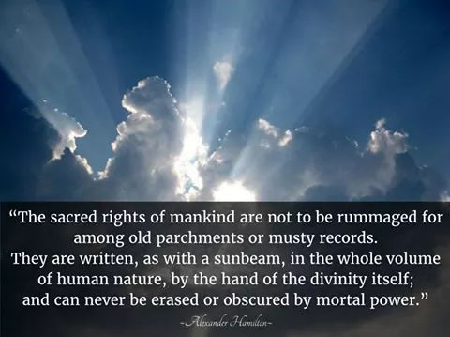
Ingredient # 2 to American Exceptionalism -We understand there are unalienable rights
-We hold these truths to be self-evident, that all men are created equal, that they are endowed by their Creator with certain unalienable Rights, that among these are Life, Liberty and the pursuit of Happiness.

Slide 13
Ingredient # 3 to American Exceptionalism -Government is to protect Unalienable Rights
-That to secure these rights, governments are instituted among men….

Slide 14
Ingredient # 3 to American Exceptionalism -Government is to protect Unalienable Rights
-That to secure these rights, governments are instituted among men….

Slide 15
Ingredient # 4 to American Exceptionalism -There is a Fixed Moral Law
-When in the Course of human events, it becomes necessary for one people to dissolve the political bands which have connected them with another, and to assume among the powers of the earth, the separate and equal station to which the Laws of Nature and of Nature’s God entitle them, a decent respect to the opinions of mankind requires that they should declare the causes which impel them to the separation.

Slide 16
Ingredient # 3 to American Exceptionalism -Government is to protect Unalienable Rights
-That to secure these rights, governments are instituted among men….

Slide 17
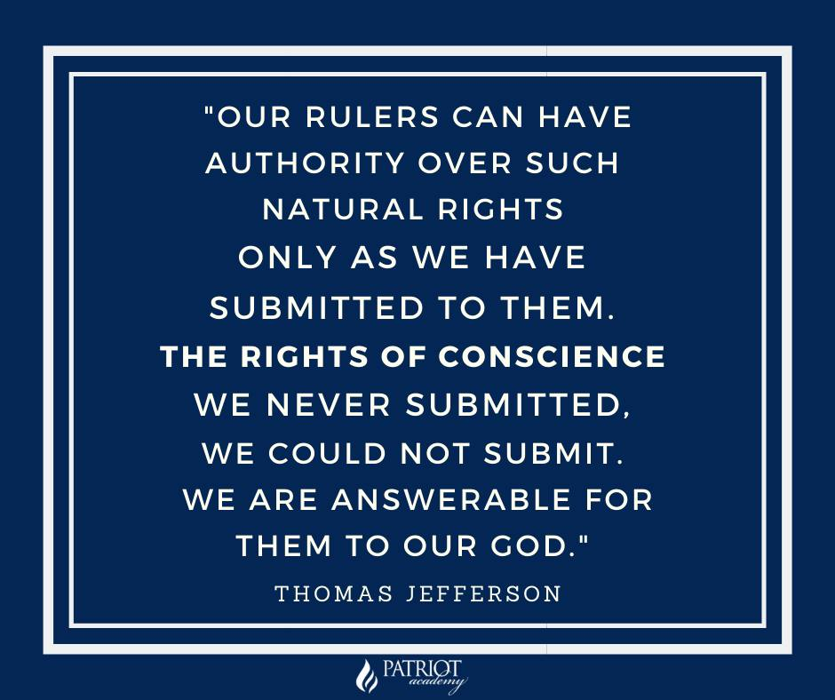
Ingredient # 3 to American Exceptionalism -Government is to protect Unalienable Rights
-That to secure these rights, governments are instituted among men….

Slide 18
Ingredient # 3 to American Exceptionalism -Government is to protect Unalienable Rights
-That to secure these rights, governments are instituted among men….

Slide 19
Ingredient # 5 to American Exceptionalism -The Consent of The Governed
-…governments are instituted among men, deriving their powers from the consent of the governed

Slide 20
We hear this famous Bible Scripture quoted all the time: “Render unto Caesar what is Caesar’s”. My question, should we be rendering unto Caesar what belongs to God? This is how our nation keeps getting messed up. We are of alignment with the boundaries God has ordained.

Slide 21
Ingredient # 5 to American Exceptionalism -The Consent of The Governed
-America is Republican form of Government:
Article 4, Section 4, of the US Constitution: The United States shall guarantee to every State in this Union a Republican Form of Government, and shall protect each of them against Invasion; and on Application of the Legislature, or of the Executive (when the Legislature cannot be convened) against domestic Violence.
-We got this idea from Exodus 18:21

Slide 22
Ingredient # 6 to American Exceptionalism -Alter, Abolish, or create a New Government
-That whenever any form of government becomes destructive of these ends, it is the right of the people to alter or to abolish and to institute a new government.

Slide 23
How can we preserve American Exceptionalism?
Read and understand your Bible. The Bible has been proven as a Founding Document by Political Scientists. By reading your Bible you will become better citizens, and you will understand our Founding Documents.

Slide 24
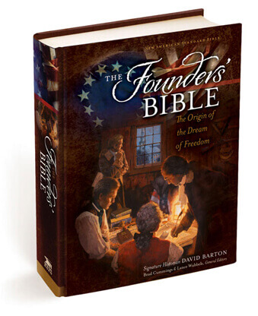
How can we preserve American Exceptionalism?

Slide 25
How can we preserve American Exceptionalism?

Slide 26
How can we preserve American Exceptionalism?
Read the Documents of Freedom. “Every member of the State ought diligently to read and to study the constitution of his country, and teach the rising generation to be free. By knowing their rights, they will sooner perceive when they are violated, and be the better prepared to defend and assert them.” John Jay, First Chief of the Supreme Court of the United State of America

Slide 27
How can we preserve American Exceptionalism?
3. Live out Your Freedoms

Slide 28
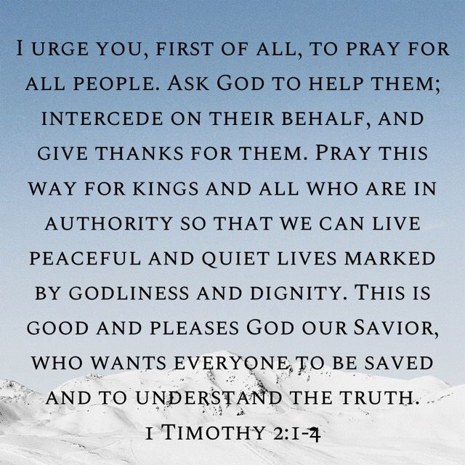
How can we preserve American Exceptionalism?
4. Pray for your representatives

Slide 29
How can we preserve American Exceptionalism?
5. Confront Evil
God raises up His people in every generation to confront evil.
-Confession of Madgeburg
-Pastors of the American Revolution and Protestant Resistant Theory
-Spurgeon and Karl Marx were alive at the same time and in fact lived in the same city. -Whitefield, Harry Hoosier
-Bonhoeffer and Hitler
-Eric Metaxes, Rob McCoy and others confronting evil today

Slide 30
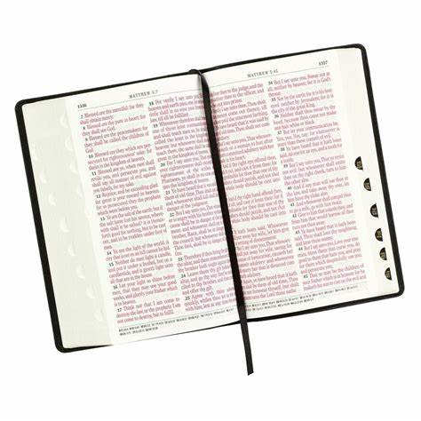
What does the Bible have to say about Biblical Confrontation?

Slide 31
Biblical Confrontation
From Wallbuilders Article
And just as history does not demand the exclusion of ministers, neither does the Bible. Consider how often God sent His ministers to publicly confront civil leaders or expose their wicked policies:
➢ Elijah confronted civil leaders Ahab and Queen Jezebel over issues such as their unjust use of eminent domain, religious persecution, and subornation of perjury (1 Kings 21:1-24, 1 Kings 18:18).
➢ Isaiah confronted civil ruler Hezekiah over national security failures and issues related to the treasury (1 Chronicles 32:27-31, 2 Kings 20:12-19)

Slide 32
Biblical Confrontation
From Wallbuilders Article
➢ Nathan confronted civil leader David over his wicked moral policies and practices (2 Samuel 12),
➢ Eliezer and Jehu confronted King Jehoshaphat over his blunders in foreign relations and ill-advised foreign alliances (2 Chronicles 19:1-2, 2 Chronicles 20:35-37)

Slide 33
Biblical Confrontation
From Wallbuilders Article
➢ John the Baptist confronted civil leaders for their hypocrisy (Matthew 3:7)
➢ Jeremiah confronted King Zedekiah over numerous of his wicked public policies (Jeremiah 34)
➢ John the Baptist confronted King Herod over his divorce and marriage practices (Luke 13:32. Matthew 12:23, 23:33, 23:27)

Slide 34
Biblical Confrontation
From Wallbuilders Article
➢ Samuel confronted King Saul over not fulfilling his assigned responsibilities (1 Samuel 13:1-14, I Samuel 15)
➢ Micaiah regularly confronted King Ahab over his wicked public policies (1 Kings 22:7-18)

Slide 35
Biblical Confrontation
From Wallbuilders Article
➢ Gad confronted King David over wrong-headed public policies stemming from his own pride and arrogance (2 Samuel 24)
➢ Jesus refused to be intimidated by Herod (Luke 13:31-32) and confronted the teachers of the law (Matthew 23)
➢ Daniel confronted Nebuchadnezzar over his pride and arrogance (Daniel 4:1-27), and Belshazzar over his moral debauchery (Daniel 5:17-28)

Slide 36
Biblical Confrontation
From Wallbuilders Article
➢ Azariah (along with eighty other priests) confronted King Uzziah for usurping religious practices through an improper expansion of government powers (2 Chronicles 26:16-21)
And God’s ministers not only called out bad civil leaders and pointed out unbiblical public policies, they also frequently partnered with civil leaders in constructing good public policies and offering sound guidance. For example:
➢ Elisha provided the King of Israel counsel and advice regarding military intelligence and policy (2 Kings 6)

Slide 37
Biblical Confrontation
From Wallbuilders Article
➢ Nathan provided guidance to David on architectural issues (2 Samuel 7:1-13)
➢ Ezra gave strong counsel on marriage policy (Ezra 9-10), and Governor Nehemiah implemented that counsel into public policy (Nehemiah 8:1-6, 13:23-27)
➢ Paul provided civil leaders with guidance during times of impending disaster and natural calamity (Acts 27:9-12)

Slide 38
Biblical Confrontation
From Wallbuilders Article
➢ Jeremiah provided military guidance to King Zedekiah (Jeremiah 21:1-10)
➢ King Joash pursued good policies as long as the priest Jehoiada provided him counsel, but when Joash lost that Godly input, his policies became wicked (2 Chronicles 24:1-2, 15-19)
➢ Isaiah provided guidance on national security issues and foreign policy to King Hezekiah (Isaiah 37)

Slide 39
If you want a copy of Alexis de Tocqueville's “Democracy in America” it is under my “Influence of the Bible in America” Exhibit GG under www.starsandstripes316.com/the-influence-of-the-bible-in-america

