Slide 1
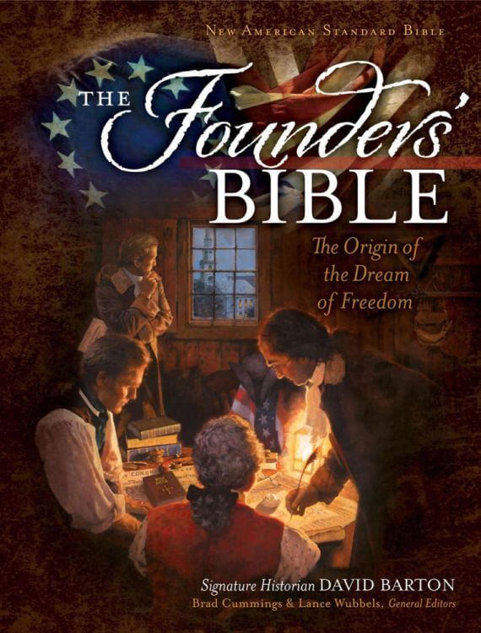
Reading The Founder’s Bible 2023
With Marcia A. Lennick,
Great Falls’ Godly Heritage Coach
March 29th, 2023
Looking at The Ten Commandments

Slide 2
MISSION: THE ARTICLE ON PSALM 11 – BRINGING MORALITY IN TO ALL AREAS OF SOCIETY
VISION: THAT ALL WE BECOME MISSIONARIES TO AMERICA BRINGING BIBLICAL VALUES, TRUTH AND MORALITY BACK IN TO ALL AREAS OF SOCIETY
ASK YOURSELF: HOW ARE YOU BRINGING BIBLICAL TRUTH AND MORALITY IN YOUR SPHERE OF INFLUENCE?

Slide 3
Deut. 5, page 287 in your Founder’s Bible

Slide 4
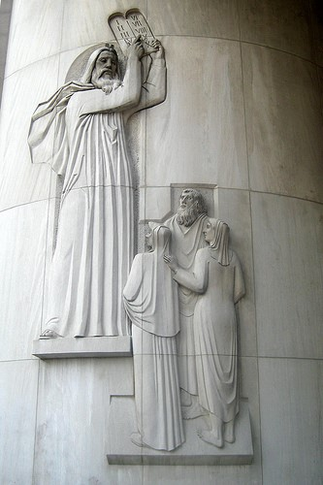
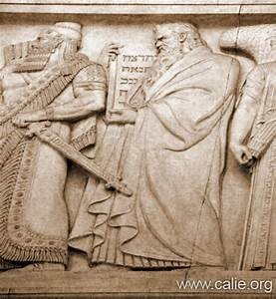
The Ten Commandments
ON THE LEFT;
The Ten Commandments pictured at the US Supreme Court.
ON THE RIGHT:
Moses giving the Israelites the Ten Commandments New York Supreme Court.

Slide 5
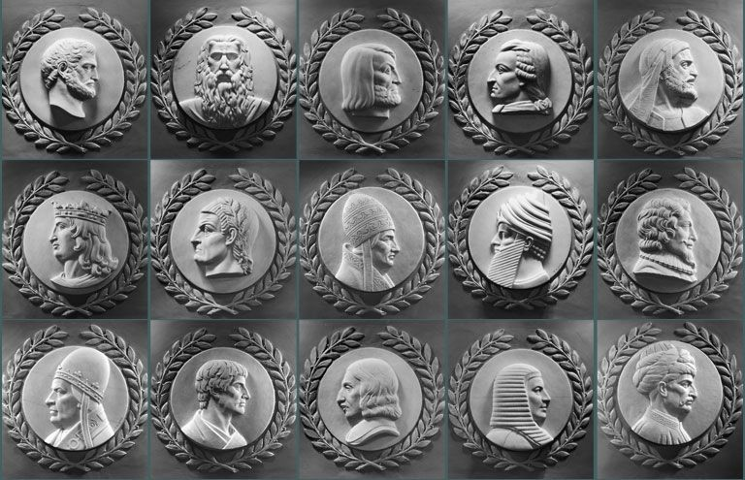
Many great lawgivers throughout time are shown here; however, Moses is the only one facing the Speaker of the House in the rotunda in our nation’s capitol.

Slide 6
Ceremonial Law, Moral Law, Social Compact Law and Judicial Law
Why so much law?
First we must understand law is made for the lawbreaker. 1 Timothy 1:8-10
We cannot separate God from anything. God is part of all our lives, including Government and Law.
Law is for all of time and for all nations.
Law brings liberty when followed because we have proper guardrails in our homes,
lives, community and nation.

Slide 7
Ceremonial Law, Moral Law, Social Compact Law and Judicial Law
Ceremonial Law
The ceremonial law is a law of types and shadows of things to come which all pointed to Christ and were finished at the Cross.
DON’T CONFUSE CEREMONIAL LAW AND THE TEN COMMANDMENTS

Slide 8
Ceremonial Law, Moral Law, Social Compact Law and Judicial Law
Moral Law (essentially tells us what is right and wrong and never changes)
The Ten Commandments are God’s Moral Law. Moral Law you don’t cross. Blackstone actually got our common law (laws of nature and nature’s God) from The Ten Commandments.
There are also moral laws found in the Bible we don’t cross (marriage being one example).
One cannot vote on Moral Law.
The 7th Amendment goes in great deal of common law.

Slide 9
Ceremonial Law, Moral Law, Social Compact Law and Judicial Law
Judicial Law
This law can change from nation to nation. Judges in Australia will act differently than in America. Judicial law can change!
-Judges used to give salvation messages from the bench
-Judges used to be removed for public drunkenness
-In order for a nation to be right again, a seed must be planted with our judges: --Isaiah 1:26:
“Then I will restore your judges as at the first, And your counselors as at the beginning; After that you will be called the city of righteousness, A faithful city.”
I encourage all folks to Read Federalist # 78

Slide 10
Ceremonial Law, Moral Law, Social Compact Law and Judicial Law
Social Compact Law
This type of law falls under moral law and where the will of the majority wins.
The Bible instructs on other laws. For example, bestiality or rape, or marrying first cousins or a sister (these aren’t necessarily found in the Ten Commandments, but are still are moral laws).
Social Compact Law creates an orderly society. For example, lets say I don’t like how your lawn is mowed. Do I have the right go over on your property and mow y
your lawn to my standard? No!

Slide 11
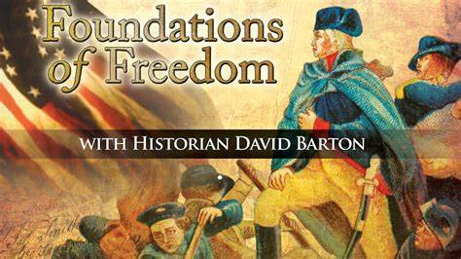
Ceremonial Law, Moral Law, Social Compact Law and Judicial Law
How can we fix some of our law?
Christians need to get back to having a Biblical Worldview and believing in ONE MORAL TRUTH.
For more information on these laws and how the Bible influenced America, I recommend my lecture “The Influence of the Bible in America” and Foundations of Freedom by David Barton.

Slide 12
Ceremonial Law, Moral Law, Social Compact Law and Judicial Law
FOR MORE READING ON THESE LAWS, READ THE ARTICLE IN YOUR FOUNDER’S BIBLE ON PAGE 161: “THE TEN COMMANDMENTS, THE MORAL LAW FOR NATIONS”

Slide 13
Did you know all 10 Commandments found in the Book of Genesis?
Have no other Gods
-God desired a relationship with Adam and Eve – Genesis 2
-When God calls Abraham to give up his son – Genesis 17
No Graven Images
-Rachel’s theft – Genesis 31
Don’t take God’s name in vain
-Satan challenged the authority of God’s Word – Geneses 3:1
Keep the Sabbath
-Genesis 2:2-3
-Scripture proves the creation itself right now. Why would God institute the Sabbath if it wasn’t actual six day period?.

Slide 14
Did you know all 10 Commandments found in the Book of Genesis?
Honor your parents
-God created the family and God gave Adam and Eve children – Genesis 2 and 4
Do not kill
-Condemnation of Cain’s crime- Genesis 4
Don’t commit adultery
-Marital union is found – Genesis 2:18; Genesis 2:23-24
-Joseph and Potiphar's Wife – Genesis 39:6-31
Do not Steal
-Private property and property rights were assumed. God gave Adam and Eve dominion over the earth with the exception of The Tree of Knowledge of Good and Evil – Genesis 1:28-30, Genesis 2:15-17
-Abraham’s Cattle-Genesis 13:2

Slide 15
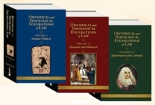
Did you know all 10 Commandments found in the Book of Genesis?
No False Witnessing
-Look when Satan contradicted God – Genesis 3:4-5
-When Cain lied about Abel- Genesis 4:9
No Coveting
-Adam and Eve coveted after something they shouldn’t have
For further study, you can purchase
Foundations of Law from
Wallbuilders

Slide 16
Premise of Hebrew Law
God exists, and He is one God – omnipotent, omniscient, and omnipresent, righteous, just, truthful, immutable and loving.
-The principle of Unity of God – His laws are consistent and harmonious with one another
God is the source of all Law – Isaiah 33:22
-any law contrary to the law of God is invalid
Law reflects the will and character of God
-Psalm 19:7
-pagan laws – laws that are arbitrary capricious, whimsical and unreasonable
-God’s laws – reflect His character of Truth, Righteousness and Justice
God’s justice required punishment of sin
-Ezekiel 18:4, 20
-God’s attributes are perfect justice and perfect righteousness
-In Judaism and Christianity the purpose of sacrifice was to satisfy God’s justice

Slide 17
Premise of Hebrew Law
Man is created in God’s image
-Genesis 9:6
-Psalm 5
-Man’s creation in the image of God is the basis for the doctrine for human rights because that which is created in God’s image possesses human dignity and certain rights go naturally with that dignity
Ever since the Fall, man has continued to be sinful
-Psalm 51:5
-Isaiah 53:6
God has established human government to punish crime to preserve order
-Romans 13:1-7
-Government is not to engage in social engineering or income redistribution
-Government is to protect ordered liberty against foreign invasion and domestic crime

Slide 18
Premise of Hebrew Law
Before government can punish crime, evidence must be presented that the person is guilty, and that no one is wrongfully convicted
-Since all men are created in the image of God, we get the human dignity clause and this clicks the wheel forward because innocent people should not be wrongfully convicted
If a defendant is proven guilty, punishment is appropriate
Hebrews were a unified people
-even though divided in 12 tribes, each person was an equal citizen of the Hebrew Republic
-no class systems
-no one was above the law- Leviticus 24:22
The family was the basis for the society
Government was the consent of the governed
-Exodus 19:8
-All who held office from the lowest to the highest was responsible to the people

Slide 19
Premise of Hebrew Law
The Hebrews respected the dignity of Labor
-Proverbs 6:6, 6:9, 10:26, 13:4, 20:4, 26:16
The Hebrews placed high value on education
-Adults –their education included the public reading of the Law every 7 years – Deut 31:12- 13
-Covenant renewal enactments occurred: Deut. 29-30; Joshua 23-24
-Periodic national festivals in which Israel’s history and tradition were taught
Hebrews values liberty, and their legal instructions were designed to promote and protect liberty
-Leviticus 25:10
-In the Old Testament, Liberty had various contexts: National freedom led out by bondage by Egypt, freedom as an Independent State, freedom from servanthood in the year of Jubilee and freedom from oppressive burdens, thou shalt/thou shalt not – gave Hebrews boundaries by God of what to do or not to do

Slide 20
Premise of Hebrew Law
For further study, you can purchase
Foundations of Law from
Wallbuilders

Slide 21
Some Great Lawgivers to study that influenced American Law
William Blackstone – Natural Law
Montesquieu – his writings would influence Jefferson and remember what Jefferson drafted?
The DOI.b yy

Slide 22
What did Founding Father Fisher Ames have to say about the Word? Deut. 6, page 289 in your FB

Slide 23
Benjamin Rush’s Defense of the Bible in Schools, Deut. 11, Page 301 in your FB.
His defense can be found on my website

Slide 24
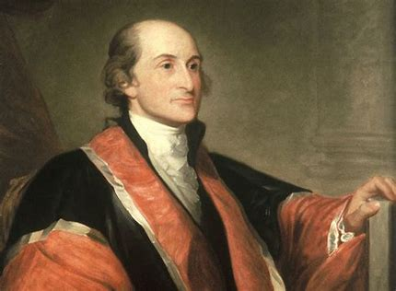
Who was John Jay and what did he remind us to do?
"Every member of the State ought diligently to read and to study the constitution of his country, and teach the rising generation to be free. By knowing their rights, they will sooner perceive when they are violated, and be the better prepared to defend and assert them."
​
John Jay, First Chief of the Supreme Court of the United State of America

Slide 25
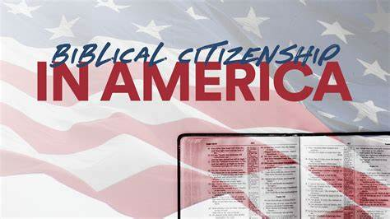
We will also move forward as Biblical Citizens as Paul did in Acts 22-26 as we have discussed previously
The Apostle Paul knew his rights, but he approached people with civil discourse and almost pursued Agrippa to Salvation

Slide 26
Let’s talk about some rights folks
don’t realize they have
-Your child’s or grandchild’s school can lose funding if they are denied the right to pray
-Your child’s school must teach the constitution. "Here is the information on the Federal Laws if a school receives federal funding they must teach the Constitution! "See: HR 4818; Division J. Sec. 111 (2)
-Under Title VII, employers have an affirmative duty to provide a reasonable accommodation to employees for religious observances, such as requesting a day off to observe a religious holiday, unless the employer can demonstrate that providing such a reasonable accommodation would result in an "undue hardship" on the employer.
-Jury nullification: refers to a jury's knowing and deliberate rejection of the evidence or refusal to apply the law either because the jury wants to send a message about some social issue that is larger than the case itself, or because the result dictated by law is contrary to the jury's sense of justice, morality, or fairness.

Slide 27
Download this today for your students –
Drafted by Kristen Juras and Steve Sem and published by the Pacific Justice Institute

