Slide 1
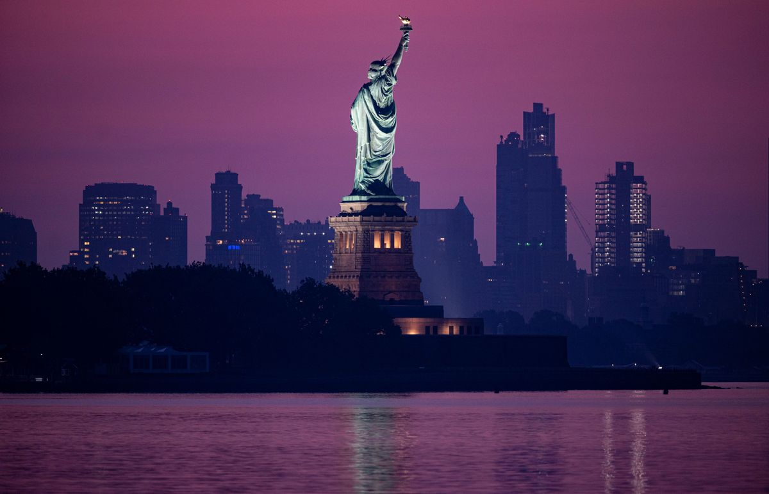
Are America’s Founding Documents Godless?
Presented by: Marcia A. Lennick

Slide 2
This message is dedicated to those who served in Enduring Iraqi Freedom. New York City was America’s original capitol. The very church where George Washington prayed after taking the oath survived 9/11.

Slide 3
The Greatest Day of History will ALWAYS be the Cross. After all history is His-Story!

Slide 4
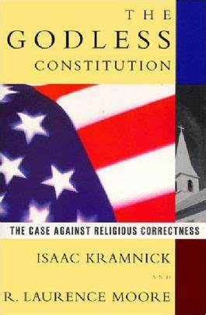
Debunking the idea that America’s Documents are Godless
This book is about ½ inch thick and does not contain footnotes. Can you imagine turning in an essay to your teacher without footnotes?

Slide 5
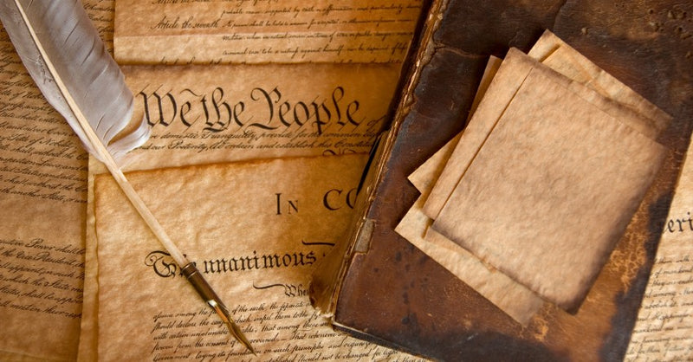
A few major documents in America’s founding
-Mayflower Compact -1620
-Declaration of Independence -1776
-Constitution Ratified -1787
-Bill of Rights - 1791

Slide 6
The history of the Church in America –quick overview The Black Robed Regiment On the left, this is the famous church in Philadelphia, Christ’s Church, where many of our Founding Fathers are buried

Slide 7
If you want a copy of Alexis de Tocqueville's “Democracy in America” it is under my “Influence of the Bible in America” Exhibit GG

Slide 9
Did you know the Declaration of Independence lists God four times?

Slide 10
The Declaration of Independence
-When in the Course of human events, it becomes necessary for one people to dissolve the political bands which have connected them with another, and to assume among the powers of the earth, the separate and equal station to which the Laws of Nature and of Nature’s God entitle them, a decent respect to the opinions of mankind requires that they should declare the causes which impel them to the separation.

Slide 11
The Declaration of Independence
-We hold these truths to be self-evident, that all men are created equal, that they are endowed by their Creator with certain unalienable Rights, that among these are Life, Liberty and the pursuit of Happiness.

Slide 12
The Declaration of Independence
-We, therefore, the Representatives of the United States of America, in General Congress Assembled, appealing to the Supreme Judge of the world for the rectitude of our intentions, do, in the Name, and by the Authority of the good People of these Colonies, solemnly publish and declare, That these United Colonies are, and of Right ought to be Free and Independent States;

Slide 13
The Declaration of Independence
-And for the support of this Declaration, with a firm reliance on the protection of divine Providence, we mutually pledge to each other our Lives, our Fortunes, and our sacred Honor”

Slide 15
The Declaration of Independence and The Constitution are linked
Genesis is how we got life, liberty, pursuit of happiness in our founding documents through the Noadic Covenant (which extended the Adamic Covenant).
Genesis 1:28 – Be fruitful and multiply, and fill the earth, and subdue it, and rule. (Adamic Covenant)

Slide 16
The Declaration of Independence and The Constitution are linked
Genesis 9:1 – Be fruitful and multiply, and fill the earth (Noadic Covenant)
-Be fruitful and multiply – the right to life
-Fill, or replenish the earth – when breaking down the Hebrew word fill through the scientific method, we break down essential ingredients and it forms into another – a concept of right to liberty
-Subdue the earth and rule, or have dominion, over it (dominion means a parcel of land) – the right to own property
From a Biblical standpoint, Genesis is where we get our foundation which is absolutely crucial
-God made the earth – there is a Creator

Slide 17
The Declaration of Independence and The Constitution are linked
-God made Adam then Eve (we are equal, but made different – have different roles)
-The marriage covenant can be seen throughout the Bible as the man represents God and the woman represents God’s Church and what a beautiful picture when in harmony with one another. One day soon Jesus Christ will have His true Church in heaven with Him.

Slide 18
The Declaration of Independence and The Constitution are linked
-The 2nd Adam (Jesus) saved us from our sins while the first Adam (Adam in the garden) brought sin
-Through the fall of Adam and Eve, sin entered the world
-Jesus was God’s plan since the beginning (Genesis 3)
-Noah is how we got the rainbow today
I love how science and history are always trying to catch up with the Bible – already confirming what we know.
-I.E. finding the Dead Sea scrolls or findings of the historical Sodom and Gomorrah
-We have a creator – how can we all have separate DNA or finger prints – only by intelligent design.

Slide 19
The Declaration of Independence and The Constitution are linked
I called Wallbuilders to make a photocopy of their article in the Founder’s Bible called: “Inseparably Linked The Declaration of Independence and the Constitution”, pages 1243-1252. I do not have permission to photocopy to this info because it is more than 3 pages.
Also see “Exhibit T: The DOI and Constitution Linked Plymouth Rock”.
Also see: www.plymrock.org/the-declaration-and-the-constitution-inseperable/

Slide 20
The Preamble to the Constitution is Biblical

Slide 21
Preamble to the Constitution
We the People of the United States, in Order to form a more perfect Union, establish Justice, insure domestic Tranquility, provide for the common defense, promote the general Welfare, and secure the Blessings of Liberty to ourselves and our Posterity, do ordain and establish this Constitution for the United States of America.

Slide 22
Preamble to the Constitution
Significantly, the Preamble (that is, the introduction) to the Constitution sets the tone for the limited nature of that document. It identifies five basic functions of civil government, and each reflects Biblical precepts. Those five enumerated purposes of America’s federal government are to:
“Establish justice.” Dozens of Bible verses specifically address this as being a proper and primary object of government. For example:
Thus says the Lord of hosts: “Execute true justice.” (Zechariah 7:9)
All His ways are justice—a God of truth and without injustice.
(Deuteronomy 32:4)
Righteousness and justice are the foundation of Your throne. (Psalm 89:14)

Slide 23
Preamble to the Constitution
1. Government must administer God’s justice.
“Insure domestic tranquility.” In 1 Timothy 2:1-2, the Bible urges Christians to pray for civil rulers “in order that we may lead a tranquil and quiet life in all Godliness and dignity.” God wants His people to seek and enjoy, and the government to produce domestic tranquility.
“Provide for the common defense.” In Romans 13:4, the Bible affirms that civil government “does not bear the sword in vain.” The “sword” is a military weapon, and even Jesus Christ taught His disciples the legitimacy of being armed, telling them in Luke 22:36, “Now…let him who has no sword sell his robe and buy one.” Protecting innocent human life is a primary purpose of government (cf. Romans 13:1-5 and 1 Peter 2:13-14), and to fulfill this purpose, governments organize armies to protect citizens from international threats, and establish police forces to protect citizens from domestic threats.

Slide 24
Preamble to the Constitution
4.“Promote the general welfare.” Romans 13:4 says that civil leaders are to be servants “to you for good”—they are to serve and seek the common good of all classes of citizens. God wants government to reflect equality in the same way He does; after all, God uses the same standards for all (see Matthew 5:45), and all were created equal by and before God. As the Bible affirms:
Have we not all one Father? Has not one God created us? (Malachi 2:10)
God does not show favoritism. (Acts 10:34, Romans 2:11)
For the Lord your God…shows no partiality. (Deuteronomy 10:17)

Slide 25
Preamble to the Constitution
By the way, notice that the Preamble says that government is to “promote the general welfare,” not “provide for the general welfare.” Numerous Scriptures make clear that needy individuals are to be cared for by private acts of charity from individuals, churches, and families, but not from government. The Framers of our government frequently reiterated the same point about promoting welfare.[82]
The fifth purpose of American government set forth in the preamble is to “Secure the blessings of liberty.” “Blessings” means “God’s favor and protection” and liberty is one of God’s blessings for all the people.
Proclaim liberty throughout the land unto all the inhabitants thereof. (Leviticus 25:10)
Where the Spirit of the Lord is, there is liberty. (2 Corinthians 3:17)
You have been called unto liberty. (Galatians 5:13)

Slide 26
Preamble to the Constitution
Significantly, the most basic of our Creator-endowed blessings are identified in the Declaration of Independence as well as in the Fifth Amendment of the Constitution as “life, liberty, [and] private property.” Just as God is the source of liberty, the Scriptures also identify Him as the source of life (Genesis 1:27, “And God created man…” and Acts 17:28 “In Him we live, move, and have our being”). God is also the source of private property (Ecclesiastes 5:19 states, “For every man to whom God has given riches and wealth, He has also empowered him to eat from them…and rejoice in his labor; this is the gift of God”; and 1 Chronicles 29:12, likewise affirms: “Both riches and honor come from Thee.”)
The purpose for which American government exists and the Constitution was written is set forth in the five clauses of the Preamble, and all five are firmly rooted in Bible teachings.

Slide 27
Preamble to the Constitution
See “Exhibit D: The American Founding and the Federal Era (1785-early-1800s)” from The Influence of The Bible in America

Slide 29
Sundays Excepted Clause – The US Constitution Obeys the Sabbath!
Sundays Excepted Clause
The US Constitution, 1787, Article 1, Section 7, the President has ten days to sign a law, “Sundays excepted”
Article 1 - The Legislative Branch Section 7 - Revenue Bills, Legislative Process, Presidential Veto
…..But in all such Cases the Votes of both Houses shall be determined by Yeas and Nays, and the Names of the Persons voting for and against the Bill shall be entered on the Journal of each House respectively. If any Bill shall not be returned by the President within ten Days (Sundays excepted) after it shall have been presented to him, the Same shall be a Law, in like Manner as if he had signed it, unless the Congress by their Adjournment prevent its Return, in which Case it shall not be a Law.

Slide 31
Our Republican Form of Government
US Constitution Article IV, Section 4
The United States shall guarantee to every State in this Union a Republican Form of Government, and shall protect each of them against Invasion; and on Application of the Legislature, or of the Executive (when the Legislature cannot be convened) against domestic Violence.
See “Exhibit D: The American Founding and the
Federal Era (1785-early-1800s)” from The Influence of the Bible in America

Slide 32
Our Republican Form of Government
Our Republican form of government:
Exodus 18:21-22 (NASB):
²¹ Furthermore, you shall ^{[a]}select out of all the people able men who fear God, men of truth, those who hate dishonest gain; and you shall place these over them as leaders of thousands, ^{[b]}of hundreds, ^{[c]}of fifties and ^{[d]}of tens.
Thousands, hundreds, fifties and of tens are our different levels of government (federal, state, county, city).

Slide 34
We do not have three coequal branches of government
Federalist 51: In republican government, the legislative authority necessarily predominates.
Federalist 78: This simple view of the matter suggests several important consequences. It proves incontestably, that the judiciary is beyond comparison the weakest of the three departments of power

Slide 35
Separation of Powers
Separation of Powers:
Jeremiah 17:9 (NASB):
“The heart is more deceitful than all else And is desperately sick; Who can understand it?”
The founders wanted each branch to keep each other accountable because too much power wielded to the wrong person/branch can lead to disaster. The heart is deceitful.
See “Exhibit E: How Does Jeremiah 17:9 Relate to the Constitutional Separation of Powers?” from The Influence of the Bible in America

Slide 36
Separation of Powers
Our three branches of government:
Isaiah 33:22 (NASB):
²² For the Lord is our judge, The Lord is our lawgiver, The Lord is our king; He will save us—
Judge (judicial); lawgiver (legislative); king (executive).
See “Exhibit D: The American Founding and the Federal Era (1785-early-1800s)” from The Influence of the Bible in America

Slide 37
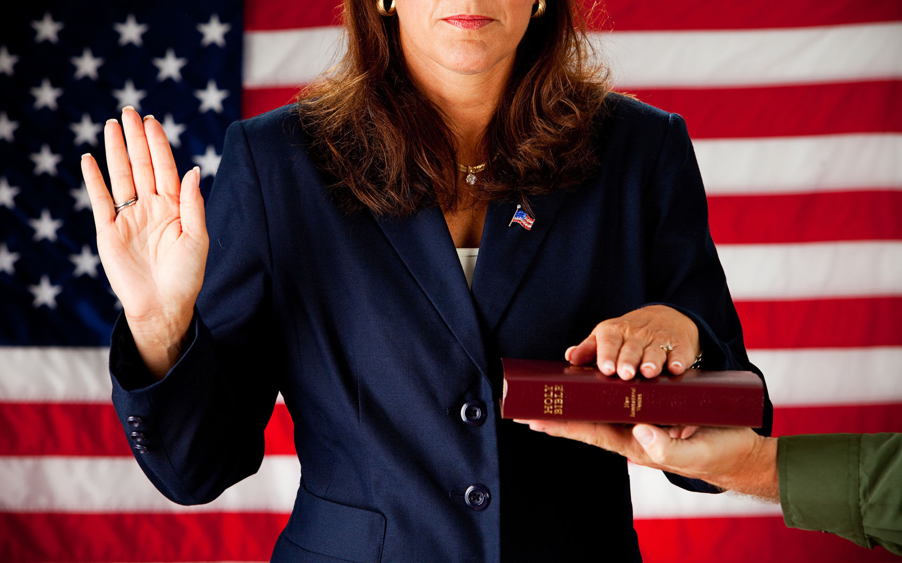
The Influence the Bible had on the Oath of Office

Slide 38
Taking the Oath of Office
Traditionally, in taking an oath an individual raises their right hand, places the other on the Bible, takes the oath, and concludes with “So help me God.”
Notice how the elements in this sequence directly parallels specific verses in the Bible.
For example, in Genesis 26:2-3, God told Isaac “I will perform the OATH which I SWORE to Abraham your father”—so God Himself swore an oath.
Concerning the oath, God declared: “I RAISED MY HAND IN AN OATH . . .” (Ezekiel 20:15, 23; 36:7; Psalm 106:26). The Scripture further tells us that “The Lord has sworn by His RIGHT hand” (Isaiah 62:8).

Slide 39
Taking the Oath of Office
And when God’s people were instructed about how to take an oath, they were told: “You shall . . . take oaths IN HIS NAME” (Deuteronomy 10:20), which is what we do today when we use the phrase “So help me God.” Clearly, the oath-taking clauses of the Constitution reflect specific Biblical practices.
See “Exhibit D: The American Founding and the Federal Era (1785-early-1800s)”
See “Exhibit Y - Did George Washington Actually Say So Help Me God During His Inauguration”
Exhibits are from The Influence of the Bible in America

Slide 40
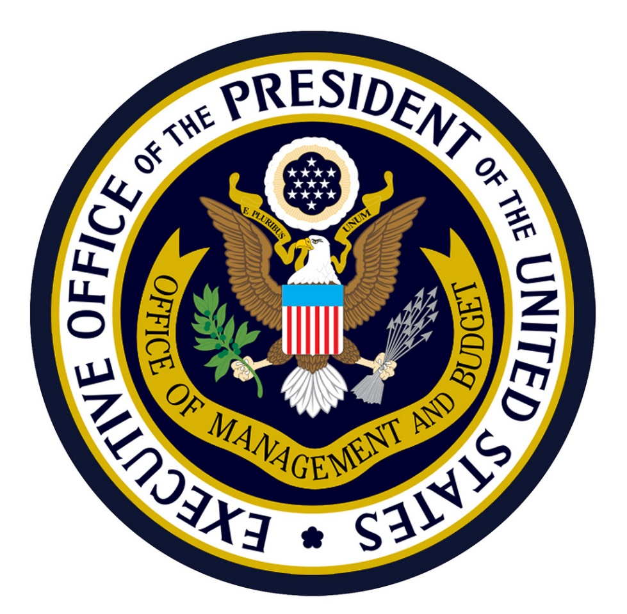
How did we get the idea the POTUS must be a natural born citizen?

Slide 41
The President Must be a Natural Born Citizen
Concerning the selection of a national executive leader, the Bible says “One from among your brethren you shall set as king over you; you may not set a foreigner over you, who is not your brother” (Deuteronomy 17:15, ESV). The national leader cannot be an immigrant but must be native-born.
Reflecting this same requirement, the Constitution stipulates: “No person except a natural born citizen...shall be eligible to the office of President” (Article II, Section 1, Paragraph 5). The Constitution allows a US Senator or Representative to be an immigrant, but it requires that the national leader—the President—must be native-born (or as the Bible specified, “one from among your brethren” who is “not a foreigner”).
See “Exhibit D: The American Founding and the Federal Era (1785-early-1800s)” from The Influence of the Bible in America

Slide 43
The Death Penalty
Concerning the death penalty, the Bible says: “Whoever is deserving of death shall be put to death on the testimony of two or three witnesses; he shall not be put to death on the testimony of one witness.” (Deuteronomy 17:6, NKJV)
Concerning treason (a death penalty offense specifically named in the Constitution), the Constitution likewise requires: “No person shall be convicted of treason [and put to death], unless on the testimony of two witnesses to the same overt act” (Article 3, Section 3)
See “Exhibit D: The American Founding and the Federal Era (1785-early-1800s)” from The Influence of The Bible in America

Slide 44
Attainder Clause
The Bible says: “The son shall not bear the guilt of the father, nor the father bear the guilt of the son. The righteousness of the righteous shall be upon himself, and the wickedness of the wicked shall be upon himself” (Ezekiel 18:20, NKJV). The family is not to be punished for the wrongdoing of a single member of the family.

Slide 45
Attainder Clause
Attainder (common in European governments at the time) punishes an entire family for the wrongdoing of one member of the family. For example, if one person in the family commits treason, then the bloodline of the entire family becomes “corrupt” and for generations thereafter no member of the family can own property or enjoy other rights. But the Constitution, echoing the Bible’s teaching, says: “No attainder of treason shall work corruption of blood or forfeiture, except during the life of the person attainted” (Art. III, Sec. 3, Clause 2).
See “Exhibit D: The American Founding and the Federal Era (1785-early-1800s)” from The Influence of The Bible in America

Slide 46
Conclusion
The evidence is overwhelming that God is in the Constitution and America was founded upon Christian principles
Sign up for a class www.constitutioncoach.com to find out more!
Visit www.marciaalennick.wixsite.com/mysite

