Slide 1
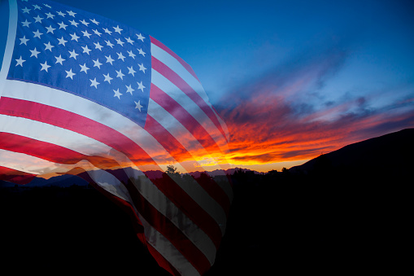
Is America worth saving?

Slide 2
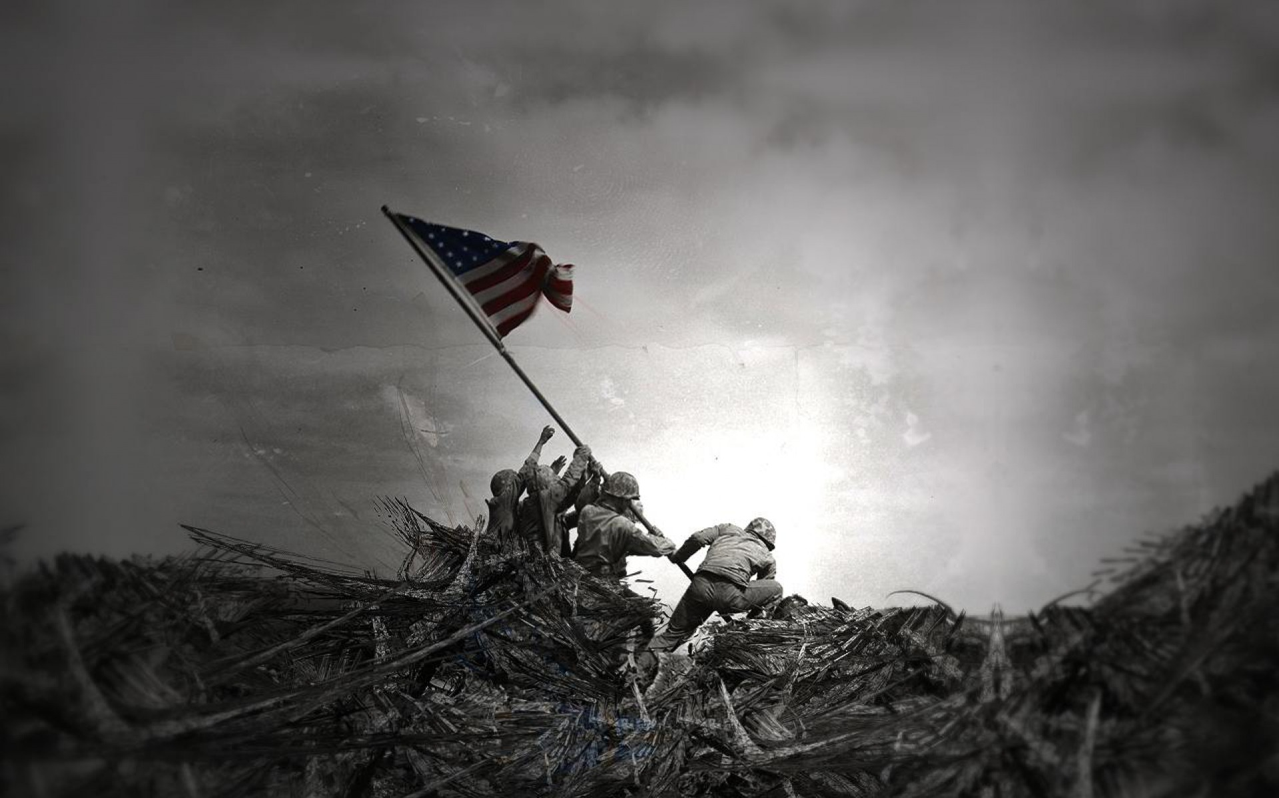
A resounding YES!
A resounding yes!

Slide 3
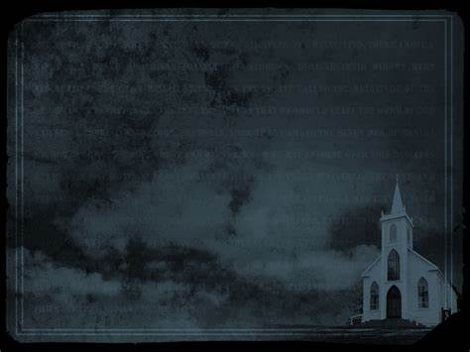
A few questions to ask yourself:
can we continue down this moral decay and continue as a nation?
can we continue on down this path of financial debt?
is our hope in American politics or the God that America was founded upon?
can we stop Bible prophecy?
is America listed in Bible prophecy?
A few questions to ask yourself: 1) can we continue down this moral decay and continue as a nation? 2) can we continue on down this path of financial debt? 3) is our hope in American politics or the God that America was founded upon? 4) can we stop Bible prophecy? 5) is America listed in Bible prophecy?

Slide 4
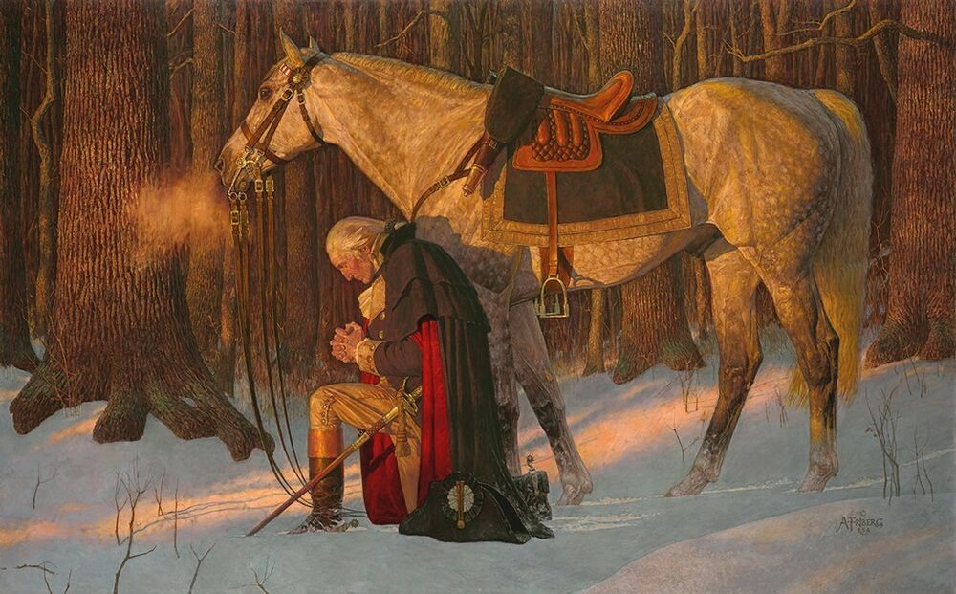
Washington’s Farewell Address warned of a moral decay and what would happen to America
Washington’s Farewell Address warned us of moral decay
September 19, 1796, Washington said: The propitious smiles of Heaven can never be expected on a nation that disregards the eternal rules of right and order which Heaven itself has ordained. … Of all the dispositions and habits which lead to political prosperity, religion and morality are indispensable supports.
“The propitious smiles of Heaven can never be expected on a nation that disregards the eternal rules of right and order which Heaven itself has ordained. … Of all the dispositions and habits which lead to political prosperity, religion and morality are indispensable supports.”

Slide 5
To God and to Posterity I want to be found faithful. As a citizen of Heaven and a citizen of America, I want to be a good steward of The Gospel, America, and the liberties obtained by serving Christ and living in one of the greatest countries on earth!
I must recognize that America is not listed in Bible prophecy, and she could fall in our lifetime as Bible prophecy is happening before our eyes. Whether it is the moral decay, the looming financial calamity, the one world religion center opening in 2022, and the globalist movement to have a one world government by 2030, there is still hope.
My hope is not in the donkey or the elephant, but in the lamb.
A few questions to ask yourself: 1) can we continue down this moral decay and continue as a nation? 2) can we continue on down this path of financial debt? 3) is our hope in American politics or the God that America was founded upon? 4) can we stop Bible prophecy? 5) is America listed in Bible prophecy?

Slide 6
The Good News of Jesus Christ is not just about the Cross at Calvary. The Good News is that Jesus Christ was the atoning sacrifice for all sins for all of humankind, and on the Cross, he paid my debt and your debt. Jesus Christ was born of the Virgin Mary, lived a sinless life, went to Calvary, rose on the Third Day, and is pleading our innocence to God The Father. The Good News is that Jesus Christ will be coming back one day. His return could be soon. It is imminent.
I would encourage all folks to study prophecy. 1/3 of the Bible is prophecy, and if one is not studying prophecy, this will change one’s worldview. If one is not studying prophecy, one is not under the full counsel of God.
Some may be concerned for the times in which we live, but prophecy is meant to bless us. Revelation 1:3: “³ Blessed is the one who reads, and those who hear the words of the prophecy and ^{[a]}keep the things which are written in it; for the time is near.”

Slide 7
Get in to the Bible today!
Questions? Please ask.

Slide 8
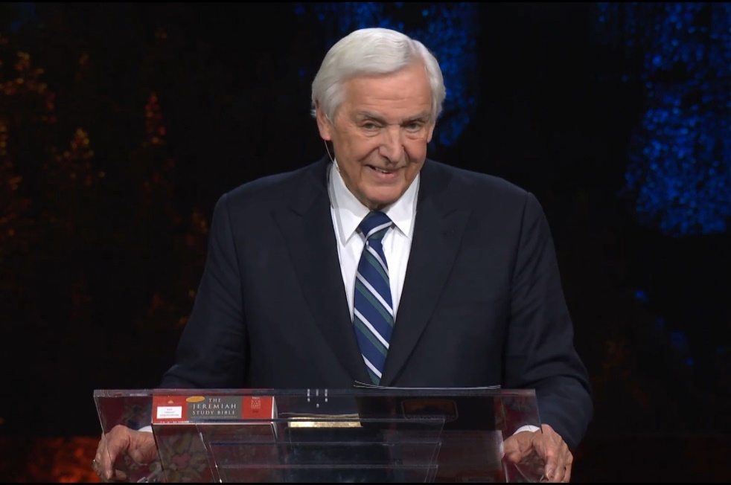
Prophecy Online Academy by Dr. David Jeremiah of Turning Point Ministries
https://www.davidjeremiah.org/this-could-be-the-day

Slide 10
Questions about God, your faith or the Bible? Reach out today!

Slide 11
Marcia A. Lennick, Constitutional Teacher and Enthusiast!
marciaalennick@hotmail.com
https://marciaalennick.wixsite.com/mysite
https://starsandstripes316.substack.com
www.facebook.com/groups/biblicalcitizenshipgreatfalls
Asking the Church to be salt and light by proclaiming our Biblical,
Historical and Constitutional Heritage.
We must be unequivocal, and unapologetic in our society.
Truth has not changed.

