Slide 1
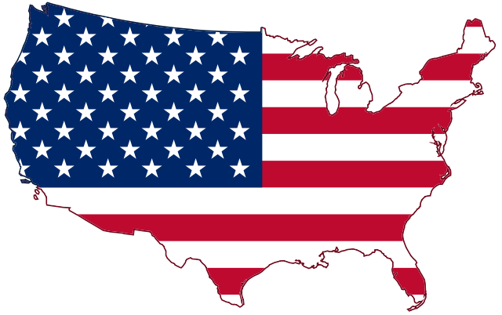
Voter Registration Drive Training for Churches
By: Caleb Oriet
And
Marcia A. Lennick

Slide 2
Format for today:
-Welcome
-First class is from 9 a.m. to 10:30 a.m./half hour break/How to be a Constitution Coach at 11 a.m. to 12 p.m.
-Prayer
-Pledge
-Caleb Oriet
-Alexis de Tocqueville
-How do we keep the churches righteous?
-Discuss the Black Robed Regiment, Separation of Church and State, proper view of Romans 13, what our Founding Father’s thought of Romans 13, Doctrine of Lesser Magistrates
-RESOURCES, RESOURCES, RESOURCES on my website for you
-Hosting a Voter Registration Drive (how to get one going, legal does and don’ts).
-How do I register someone? SO MANY platforms to do this.
-Other classes I offer

Slide 3
If you want a copy of Alexis de Tocqueville's “Democracy in America” it is under my “Influence of the Bible in America” Exhibit GG

Slide 4
How do we keep our pulpits righteous?
Pray for our Pastors.
Focus. Focus on the attributes of God. I encourage you to look some up and reflect on these. Or reflect on The Promises of God.
No idols. Make sure politics and what you are doing isn’t a god or an idol
Remember. Remember our fight isn’t by blood, but spiritual (Ephesians 6:12). Politics won’t save our country. Only Jesus can. We can’t get in to heaven because of our Republican status or military status or Law Enforcement status.
Check your heart. Please stop saying, “Let’s Go Brandon” and “FJB”
Be a Biblical Citizen. Remember Trump enacted “Operation Warp Speed”, had stimulus bills, and had “The Abraham Accords”. The Abraham Accords have paved the way for the one world religion center to open.
Pray. 1 Timothy 2:1-4. May we have the hearts of Daniel, Esther and Nehemiah (the wisdom) and to know when to say something to find favor with the King (our leaders). May we be bold with Truth (remember God would put one righteous person in the King’s or Judge’s cabinet in Ancient Israel and the nation would be saved from destruction). May we have the heart of The Apostle Paul before Agrippa to persuade our leaders to salvation.
Don’t hold on to America, but hold on to God. America is worth fighting for. We must also realize the times. Are we in the end days? We must lock shields for the Gospel, which is the utmost important task.

Slide 6
Pastors in the American Revolution
Should Pastors be involved in politics?
Why or why not?
Black Robe Regiment
These were Pastors who would speak up from the pulpit during The American Revolutionary War.
Still exists today. Wallbuilders is trying to rebuild the Black Robe Regiment and inform Pastors on current topics and what to address from the pulpit.

Slide 7
Pastors in the American Revolution
Reverend Jonas Clark
His words would be known as the primer in the guns on the Lexington-Green.
Minutemen actually attended his Church.
-Exhibit Q – Reverend Jonas Clark on the Battle of Lexington.
This is a sermon given one year AFTER the “shot heard around the world.”
-Exhibit R – History of the Black Robe Regiment.
These exhibits can be found under America’s Unknown Known History Lecture

Slide 8
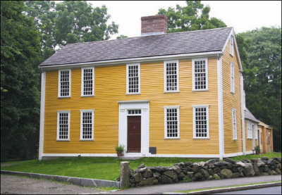
Pastors in the American Revolution
Information on The Hancock-Clark house are courtesy of: https://www.bostoncentral.com/activities/landmarks/p1496.php

Slide 9
Pastors in the American Revolution
Muhlenberg Brothers. Frederick Muhlenberg was a our First Speaker of the House and helped draft the First Amendment.
Samuel Davies – Patrick Henry’s Pastor.
Did you know that Patrick Henry’s famous speech “Give Me Liberty or Give Me Death” was preached in a Church?
John Wise – his words influenced The Declaration of Independence. The Sons of Liberty would redistribute Reverend John Wise’s words and would preserve the seeds of liberty.
Exhibit P – A Vindication of the Government of the New England Churches
See Patrick Henry’s Speech.
These exhibits can be found under America’s Unknown Known History Lecture

Slide 11
Separation of Church and State
Different types of government:
totalitarianism: communistic/socialistic and led by a dictator or a czar (Emperors – Lk: 2:1; Caesars – Mk 12:17; Pharaohs: Ex:1-14).
monarchy: king or queen get to dictate.
republic and constitutional republic (Ex. 18:21; Deut. 1:15-16; 16:18)
Oligarchy: power is in elite few (Sanhedrin Lk. 22:66).
anarchy or revolutionary: government without laws and power is in each individual and we all do what is right in our own eyes (Deut. 12:8; Judges 17:6; 21:25).
democracy: majority rules (Matt. 27:21).
theocracy: where representatives say they here from God and these are His direct steps – without a proper view of Separation of Church and State. This is the reason why we left Great Britain.

Slide 12
Separation of Church and State
America is Republic form of Government:
Article 4, Section 4, of the US Constitution: The United States shall guarantee to every State in this Union a Republican Form of Government, and shall protect each of them against Invasion; and on Application of the Legislature, or of the Executive (when the Legislature cannot be convened) against domestic Violence.

Slide 13
Separation of Church and State
Lets talk about Separation of Church and State. It is not what modern folks think it is – that the Church can DOMINATE the government, but it also is not the idea that folks cannot express their religious views in the public square.
We are not a theocracy. We are not an oligarchy or a monarchy or an anarchy. We believe in the people’s right to choose their leaders, and there should not be a special group of people in charge either. Anarchy would be purely scary – so government has a job to establish rule and order.
Deuteronomy 15:11 tells us that the poor will always be among us. God gave certain instructions for the Israelites and how to care of the poor. For example, if the owner of the land gleaned a field, and they forgot certain produce, they were to leave it for the poor to come and get it.

Slide 14
Separation of Church and State
The individual and the Church are responsible to assist the poor with food, clothing, physical effects of this nature. The priest could grant proportional relief to an individual after determining the need of an individual.
Individually: Deuteronomy 15:7-8, 10-11; Matthew 25:34-40.
Church: Leviticus 27:8; Acts 4:34-35.
The government's job is to provide justice to the poor and to maintain the rights of the poor.
Exodus 23:3,6; Leviticus 19:15; Proverbs 29:14.

Slide 15
Separation of Church and State
Truth behind Separation of Church and State
When drafting the First Amendment – and Separation of Church and State:
there is nothing in legislative intent with the journals.
Jefferson paid the Marine Marching band to play hymns.
Jefferson funded Bible Studies.
Jefferson had his own Bibles printed (1804 and 1820 versions).
Jefferson actually attended Church on Capitol Hill two days AFTER drafting Separation of Church of and State letter.

Slide 16
Separation of Church and State
Since this was Jefferson’s view concerning religious expression, in his short and polite reply to the Danbury Baptists on January 1, 1802, he assured them that they need not fear; that the free exercise of religion would never be interfered with by the federal government. As he explained:
“Gentlemen, – The affectionate sentiments of esteem and approbation which you are so good as to express towards me on behalf of the Danbury Baptist Association give me the highest satisfaction. . . . Believing with you that religion is a matter which lies solely between man and his God; that he owes account to none other for his faith or his worship; that the legislative powers of government reach actions only and not opinions, I contemplate with sovereign reverence that act of the whole American people which declared that their legislature should “make no law respecting an establishment of religion or prohibiting the free exercise thereof,” thus building a wall of separation between Church and State. Adhering to this expression of the supreme will of the nation in behalf of the rights of conscience, I shall see with sincere satisfaction the progress of those sentiments which tend to restore to man all his natural rights, convinced he has no natural right in opposition to his social duties. I reciprocate your kind prayers for the protection and blessing of the common Father and Creator of man, and tender you for yourselves and your religious association assurances of my high respect and esteem.”

Slide 17
Separation of Church and State
In 1947, in the case Everson v. Board of Education, the Supreme Court declared, “The First Amendment has erected a wall between church and state. That wall must be kept high and impregnable. We could not approve the slightest breach.” The “separation of church and state” phrase which they invoked, and which has today become so familiar, was taken from an exchange of letters between President Thomas Jefferson and the Baptist Association of Danbury, Connecticut, shortly after Jefferson became President.
-We need to understand Jefferson helped draft the Dec. of Independence (1776), not the Constitution (1787), not the Bill of Rights (1791), Separation of Church and State Letter (1802)
Three separate documents. Not many folks realize these are three separate documents.
When the Constitution was drafted Jefferson was not in the USA.

Slide 18
Separation of Church and State
First Amendment from The Bill of Rights:
Congress shall make no law respecting an establishment of religion, or prohibiting the free exercise thereof; or abridging the freedom of speech, or of the press, or the right of the people peaceably to assemble, and to petition the Government for a redress of grievances.
Our founding fathers never wanted a theocracy (establishment clause). Our founding fathers wanted us to be able to live out our religious faith (free exercise clause).
-Exhibit S– No the Founding Fathers Did Not Want Pastors to Stay out of Politics
-Exhibit T – The FF on the Bible and Jesus
-Exhibit U – Separation of Church and State
All Exhibits can be found under America’s Unknown Known History Lecture

Slide 19
We hear this famous Bible Scripture quoted all the time: “Render unto Caesar what is Caesar’s”. My question, should we be rendering unto Caesar what belongs to God? This is how our nation keeps getting messed up. We are of alignment with the boundaries God has ordained.

Slide 20
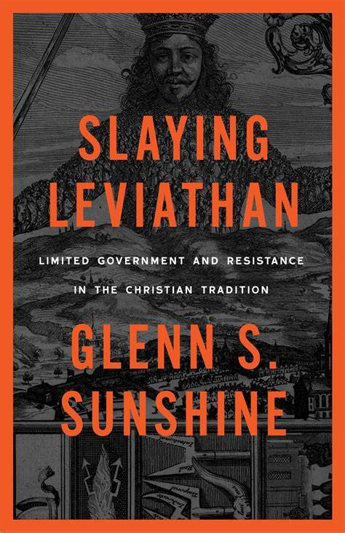
I recommend this book: “Slaying
Leviathan” by Glenn S. Sunshine
From Canon Press
Glenn will be in Billings in April of 2022 with The Big Sky Worldview Forum, if you want to hear him speak.

Slide 21
"How are we to respond to the threats to liberty we are facing? Starting to answer that question begins with this book. We are remarkably unaware of our own Christian history." ~From Slaying Leviathan
Leviathan is rising again, and the first weapon we must recover is the Christian tradition of resisting governmental overreach. The bloated bureaucratic state we have now would have been unrecognizable to the Founders, and our acceptance of its encroachments on liberty would have infuriated them. But here is the point: our Leviathan would not have surprised them. They were well acquainted with the tendency of governments to turn tyrannical. A popular quote in the nineteenth century was "Eternal vigilance is the price we pay for liberty.“
In Slaying Leviathan, Glenn S. Sunshine surveys some of the stories and key elements of Christian political thought from Augustine to the Declaration of Independence. Specifically, the book introduces theories of unalienable rights, resistance, and limited government that were synthesized into a coherent political philosophy by John Locke. It was Locke who influenced the American founders and was, like us, fighting against the spirit of Leviathan in his day. Christians first expressed these political truths under Caesars, kings, popes, and emperors. We need them in the age of presidents.
This book is published by Canon Press. At Canon Press, we’re gospel outfitters: no matter who you are or what you do, you’re called to be increasing in Biblical faithfulness. That’s because Jesus’s death and resurrection changed everything: All of Christ, for all of life, for all the world.
As the wisest man said, “Go, eat your bread with joy, and drink your wine with a merry heart; for God has already accepted your works” (Eccl. 9:7).
We believe reformation and revival start from faith in the Lord with joyful obedience to the Bible, and that is what makes everyday tasks significant and transforms culture. Because of these beliefs, we offer books on Christian living, encouragement, contentment, raising kids, healthy marriages, educational choices, classical education, homeschooling, politics, government, feminism, identity, manhood, womanhood, singleness, virtue, and so much more.

Slide 22
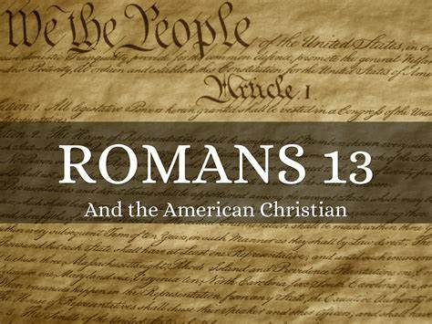
Did the Founding Fathers commit Biblical Rebellion to start the American Revolution? And should we just obey our government when we are a republic?
-Colonel Parker: “Stand your ground. Don’t fire unless fired upon, but if they mean to have a war, let it begin here.” 4/15/1775 – Battle of Lexington and Concord
-Castle Doctrine. –Exodus 22
-Who is in charge of the government in America?
For more information go to: https://marciaalennick.wixsite.com/mysite/interpreting-romans-13

Slide 24
BY: PASTOR TREWHELLA
Many Americans seem to know that America's founders gave us three boxes through which we can resist tyranny, namely - the ballot box, the jury box, and the cartridge box. But a lesser-known tool which the founders themselves employed is the lesser-magistrate doctrine.
Simply put, the lesser-magistrate doctrine declares that - when a magistrate, who is lower in authority than another higher authority, opposes and/or resists the unjust orders or laws of the higher authority, he is justified in doing so and his actions are morally right, proper, and legitimate (emphasis supplied).

Slide 25
BY: PASTOR TREWHELLA
For example, if Congress or the President makes an unjust or immoral edict, a state legislature or the governor could stand in defiance of their unjust edict and refuse to obey or implement it. They could in fact actively oppose it. Or for that matter, a city council or mayor could act in defiance or opposition of an unjust edict by a higher authority.
The lesser-magistrate doctrine became important to Christian men during the Reformation, though it had been spoken of and practiced prior to that by Christians. For example, the Magna Carta was written by a group of barons (lesser-magistrates) who had the tyrant King John of England sign it in the year 1215 at Runneymede, which is located southwest of London

Slide 26
BY: PASTOR TREWHELLA
This great document which stands in defiance of tyranny and oppression by making clear that the State has limitations and that all are subject to the law – people and state officials alike - was penned by Christian men.
Calvin spoke of the lesser-magistrate doctrine in his Institutes of the Christian Religion. Amazingly, he did not appeal to Scripture in his support of it, rather he appealed to pagan historical examples. But other Reformers did give a Scriptural foundation to the doctrine.

Slide 27
BY: PASTOR TREWHELLA
John Knox for example, in his Appellation written to the nobles of Scotland in 1558, cites many passages to support the doctrine. Knox wrote his appellation (appeal) to the nobles because the Roman church had condemned him and burned him in effigy. He wrote to declare to the nobles, as lesser-magistrates, their responsibility in protecting the innocent and opposing those who had made unjust decrees.
Knox makes it clear that it is the duty of lesser-magistrates to resist the tyranny of chief magistrates when the chief magistrate exceeds his God-given authority or actually makes declarations which are in rebellion to the law of God. (emphasis supplied).

Slide 28
BY: PASTOR TREWHELLA
He exhorts the nobles (lesser-magistrates) in his Appellation, "You are bound to correct and repress whatsoever you know him (the higher magistrate) to attempt expressly repugning to God's word, honor, glory, or what you shall espy him to do against his subjects great or small." Some of the Scripture texts Knox cites to expound on the lesser-magistrate doctrine are Daniel 3; I Kings 12; II Kings 11; and Jeremiah 26:10-16; 36:9-31; 37:11- 21 & 39:7-10.
The lesser-magistrate doctrine had a huge impact upon the thinking of our founders, and upon our nation's people regarding government and law. We however live in the midst of a statist, slave-like people where such thinking has long been forgotten. The magistrates themselves know nothing of this doctrine today because the pulpits have long been silent regarding it. (Emphasis supplied.)

Slide 29
BY: PASTOR TREWHELLA
He exhorts the nobles (lesser-magistrates) in his Appellation, "You are bound to correct and repress whatsoever you know him (the higher magistrate) to attempt expressly repugning to God's word, honor, glory, or what you shall espy him to do against his subjects great or small." Some of the Scripture texts Knox cites to expound on the lesser-magistrate doctrine are Daniel 3; I Kings 12; II Kings 11; and Jeremiah 26:10-16; 36:9-31; 37:11- 21 & 39:7-10.
The lesser-magistrate doctrine had a huge impact upon the thinking of our founders, and upon our nation's people regarding government and law. We however live in the midst of a statist, slave-like people where such thinking has long been forgotten. The magistrates themselves know nothing of this doctrine today because the pulpits have long been silent regarding it. (Emphasis supplied.)

Slide 30
BY: PASTOR TREWHELLA
If ever this nation needs to understand the lesser-magistrate doctrine, it is now. Immoral and unjust edicts are commonplace. The preborn are being murdered, and sodomy is being proliferated.
The assault upon our freedom and liberties is a daily undertaking by those in high office. The attacks upon the law of God are ferocious and relentless. In our nation today, the State has declared good to be evil and evil to be good. The lesser-magistrate has a duty before God to uphold the good regardless of the new definitions created by the State. (Emphasis supplied.)

Slide 31
BY: PASTOR TREWHELLA
We must remember that all authority is delegated. No man who holds State office rules autonomously. The authority he has is delegated to him by God. Hence, all those in positions of authority stand accountable to God. This is why the practice of the church historically has been – when the State commands that which God forbids or forbids that which God commands, we have a duty to obey God rather than man. The Bible clearly teaches this principle.
The lesser-magistrate is to apply this principle to his office as magistrate. When an unjust edict is made by a higher authority, the lesser-magistrate must choose to either join the higher magistrate in his rebellion against God, or stand with God in opposition to the unjust edict.
As our nation sinks more and more into rebellion and depravity, the lesser-magistrate doctrine needs to be taught more than ever. May the Lord grant us the strength and favor to do so.

Slide 32
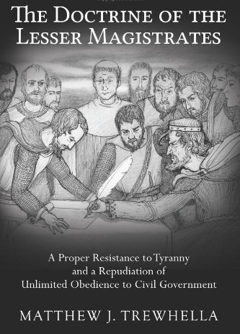

Slide 34
LEGAL DO’S FOR CHURCHES
Do teach on moral issues and civic involvement
Do educate on political process and political/social/ legislative issues
Do distribute candidate surveys and incumbent voting records (avoid editorial opinions and make sure they cover a wide range of issues)
Do encourage members to voice their opinions in favor or in opposition to certain legislation*
Do discuss Biblical instruction pertaining to moral and cultural issues such as abortion, same-sex marriage, etc.

Slide 35
LEGAL DO’S FOR CHURCHES
• Do support or oppose judicial, department, or cabinet appointments
• Do support or oppose other political appointments of non-elected officials
• Do use church facilities by political candidates (as long as all other candidates are allowed or invited)
• Do hold petition drives supporting or opposing legislation
• Do support or oppose legislation unrelated to the church organization*
• Do support or oppose legislation that directly relates to the organization**
• Do engage in voter registration activities that avoid
promoting any one candidate or particular political party

Slide 36
LEGAL DONT’S FOR CHURCHES
• Don’t endorse or oppose political candidates
• Don’t contribute to Political Action Committees
• Don’t have a church bulletin editorial where the pastor or staff member endorses or opposes a candidate
• Don’t campaign for candidates
• Don’t grant use of a name to support a political candidate
• Don’t contribute to political candidates
• Don’t have in-kind and independent expenditures for
or against political candidate

Slide 37
LEGAL DO’S FOR
PASTORS
• Do preach on moral and social issues and encourage civic involvement
• Do engage in voter registration activities that avoid promoting any one candidate or particular political party
• Do distribute educational materials to voters (such as voter guides), but only those that do not favor a particular candidate or party and that cover a wide range of issues
• Do conduct candidate or issues forums where each duly qualified candidate is invited and provided an equal opportunity to address the congregation
• Do Invite candidates or elected officials to speak at
church services

Slide 38
LEGAL DONT’S FOR PASTORS
•Don’t endorse candidates on behalf of the church
•Don’t Use church funds or services (such as mailing lists or office equipment) to contribute directly to candidates or political committees
• Don’t permit the distribution of material on church premises that favors any one candidate or political party
•Don’t Use church funds to pay fees for political events
•Don’t Set up a political committee that would
contribute funds directly to political candidates
• Don’t Allow candidates to solicit funds while
speaking in a church

Slide 39
FYI
“Churches that allow only one candidate or a single party’s candidate to speak can be seen as favoring that candidate or party. No candidate should be prohibited from addressing a church if others running for the same office have been allowed to speak. Exempt from this are candidates or public figures who may speak at a church, but they must refrain from speaking about their candidacy.” Developed by: For Faith & Family Copyright 2007
All this info on legal do’s and don’ts are taken from
The Family Research Council

Slide 40
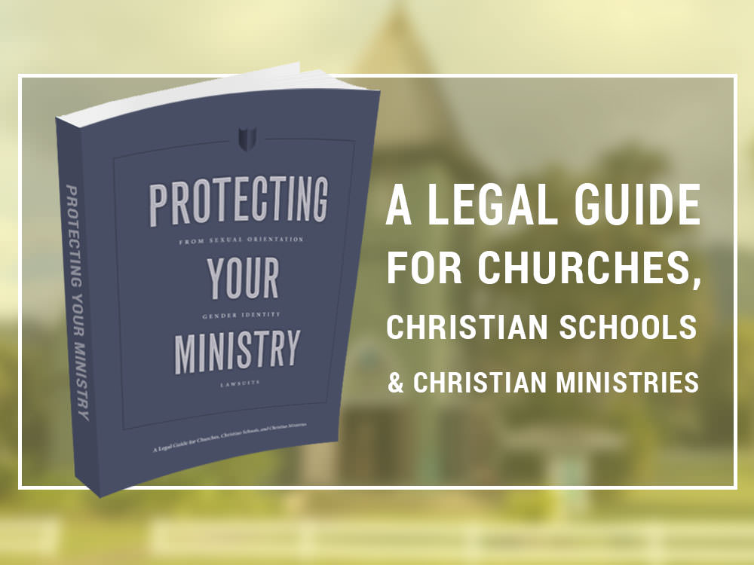
A few years ago, Alliance Defending Freedom came out with a book called: “Protecting Your Ministry”. Churches or Christian organizations should be amending their bylaws and Church Constitutions.
Can be found on my website today: https:// marciaalennick.wixiste.com/mysite/voterregistrationdriveforchurches

Slide 41
Steps to follow to host a Voter Registration Drive
Christians can have a positive impact on elections and ultimately our nation’s future. Elections determine our leaders, who in turn influence whether our nation honors family values, protects life in the womb, and allows the freedom to express our faith in the public arena. Yet every election, millions of Christians fail to exercise their rights and responsibilities as citizens. We can help our people obey Christ’s call to participate in government (Matt. 22:21) by encouraging voter registration and voting Christian values.

Slide 42
Steps to follow to host a Voter Registration Drive
STEP 1: ASK
Get permission from your pastor and church leadership so that you’re under biblical authority.
It’s Biblical. When asking, emphasize that voter registration is: Biblical. Selecting Godly leaders is rooted in biblical principle (see Exod. 18:21; Prov. 29:2) and that process begins with registering to vote.
It’s Simple. Recent federal laws have made voter registration easier than ever, with a national registration form that’s acceptable in most states.
Legal. The IRS says church voter-registration drives are legal, and even encouraged, unless they endorse or oppose candidates. (Legal Tips Below

Slide 43
Steps to follow to host a Voter Registration Drive
STEP 2: Prepare, Part 1
Plan. Here is a suggested game plan:
Contact your county clerk’s or secretary of state’s office to obtain registration forms and learn collection procedures. Voters can mail their own forms, but it’s more effective to collect them from members and then volunteer to mail or return them in bulk. Some states, like Texas, require you to be deputized before doing that. Other states may require a valid ID. For state voter registration policies and contact info, https://www.usa. gov/election-office.
Train your volunteers if they are helping you. Be sure they know the rules for conducting voter registration drives in your area. Registration drives should be kept nonpartisan and not promote any one candidate or platform.

Slide 44
Steps to follow to host a Voter Registration Drive
STEP 2: Prepare, Part 2
Schedule registration drives to coincide with July 4th worship services and 30-60 days preceding an election. The Sunday nearest July 4th is a perfect time to focus on our biblical duty as Christian citizens. Also, conduct voter registration at least three consecutive Sundays leading up to the month before the election. Many states have a voter registration deadline 30 days before elections, so plan ahead.
Advertise your registration drive on the church website, social media, newsletters, announcement slides, and other church communications. Ultimately, the pastor is the key to promotion because when the pastor leads, the people will follow.

Slide 45
Steps to follow to host a Voter Registration Drive
STEP 3: Register, Part 1, Pews
Pew Registration. On the Sunday your pastor preaches on Christian Citizenship, here are two ways to conduct the nonpartisan voter registration drive: Pews. The most effective method is to have ushers distribute voter registration forms in the pews, allowing church member time to fill out the forms before they are collected
Biblical Citizenship in Modern America. I have sermons on my website about Christian Citizenship. I would encourage folks to take the 8 week course “Biblical Citizenship in Modern America by David Barton and Rick Green. I would encourage folks, if you are a small group leader as well, host these classes, and distribute these materials. (This section was not taken from the Family Research Council, but added in by me.)

Slide 46
Steps to follow to host a Voter Registration Drive
STEP 3: Register, Part 2, Booths/Tables. Part 1
Table/Booths. If your pastor prefers, set up a table in a high traffic area of the church. Recruit a team of volunteers and train them. Have plenty of registration forms and pens.
Take the initiative. Be friendly and assertive. Speak to folks, saying, “Good morning, can I help you fill out this form?” If already registered, ask if they have moved since the last election; if so, re-register them.
Provide assistance. Lead people step-by-step through the process so they don’t feel like any question is stupid. Look over the form and ensure it is complete.
Keep records. It can be helpful to have a record of the results for reference later. But be sure to follow the law on record keeping. Keep records. It can be helpful to have a record of the results for reference later. But be sure to follow the law on record keeping.

Slide 47
Steps to follow to host a Voter Registration Drive
STEP 3: Register, Part 2, Booths/Tables. Part 2
If the pastor doesn’t feel comfortable with either approach, ask for permission to call members who aren’t registered. Start by comparing your church mailing list with voter registration records, which are public information. Offer to mail them a voter registration form or point them to PrayVoteStand.org where they can register to vote. They can help register a friend as well. However, don’t put them on the defensive by confronting them about not being registered. Instead, offer to help them become a voter.

Slide 48
Steps to follow to host a Voter Registration Drive
STEP 4: Stay Legal, Part 3
Tips from First Liberty Institute:
For more information, visit firstliberty.org, email info@firstliberty.org or call (972) 941-4444. You can also review IRS guidelines at: irs.gov/charitiesnon-profits/private-foundations/influencing-electionsand-carrying-on-voter-registration-drives

Slide 49
Steps to follow to host a Voter Registration Drive
STEP 5: Follow-up
Have a plan to translate voter registration into values voting:
-Collect the forms and deliver in person or by mail to your county election office. Many states have a deadline when the forms must be returned.
-Ask the pastor to encourage voter participation as the election approaches.
-Encourage voters who will be out of town to request an absentee ballot.
-Contact those on your follow-up list a week before early voting begins and again before Election Day and remind them to vote.
-Provide a sign-up sheet and transportation to the polls and childcare for parents.
-Direct people to PrayVoteStand.org for information on Biblical Values and voter registration guides

Slide 50
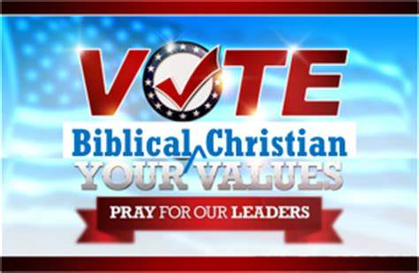
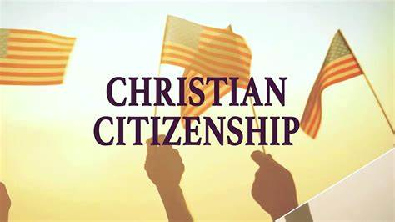
Should Christians vote? Voter guides. More resources for Pastors and Churches.
For sermons on Biblical Christian Citizenship, go to:
https:// marciaalennick.wixiste.com/mysite/voterregistrationdriveforchurches

Slide 51
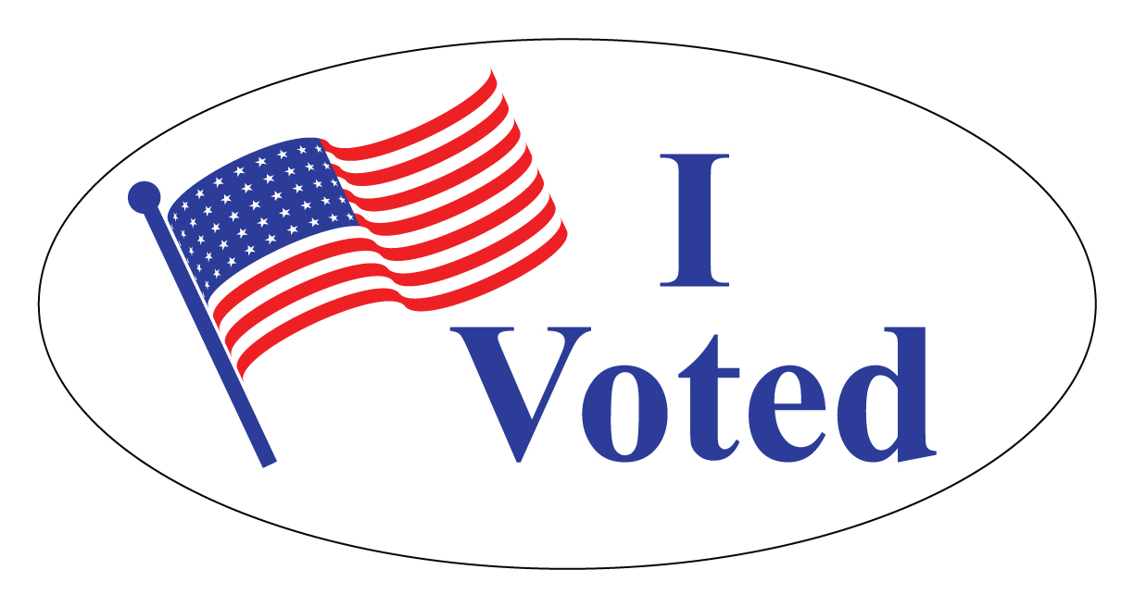
For information on how to contact or local elections office or the Montana Secretary of State, you can visit my website: https:// marciaalennick.wixiste.com/mysite/voterregistrationdriveforchurches
SO MANY DIFFERENT PLATFORMS, HOW DO I SHOW SOMEONE HOW TO REGISTER TO VOTE?

Slide 52
www.biblicalcitizens.com

Slide 53
Remember, so goes the Church, so goes the culture.
Biblical Citizenship Track for Pastors
-www.patriotacademy.com/pastor

Slide 54
Other Classes I offer: -America’s Unknown Known History -Black History -Revisiting the Shot Heard Around the World -Is America a Christian Nation? -The Influence of the Bible in America -Constitution Classes -Biblical Citizenship in Modern America -Constitution Class for high schoolers -And more! Just ask

Slide 56
Go see Caleb’s table ½ hour break Training for Coaches at 11

