Slide 1
Pursuing Biblical Womanhood in 2024
By: Marcia A. Lennick

Slide 2
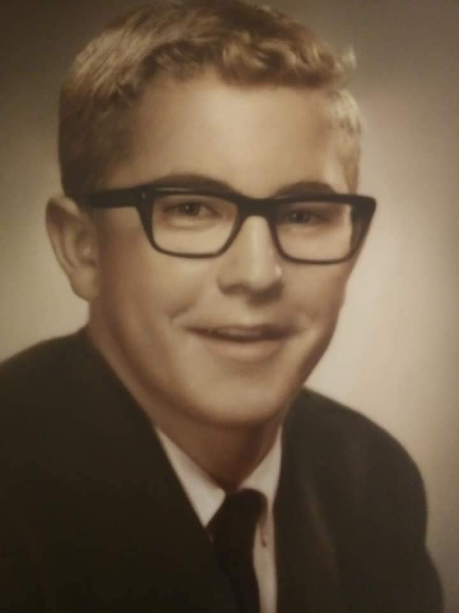
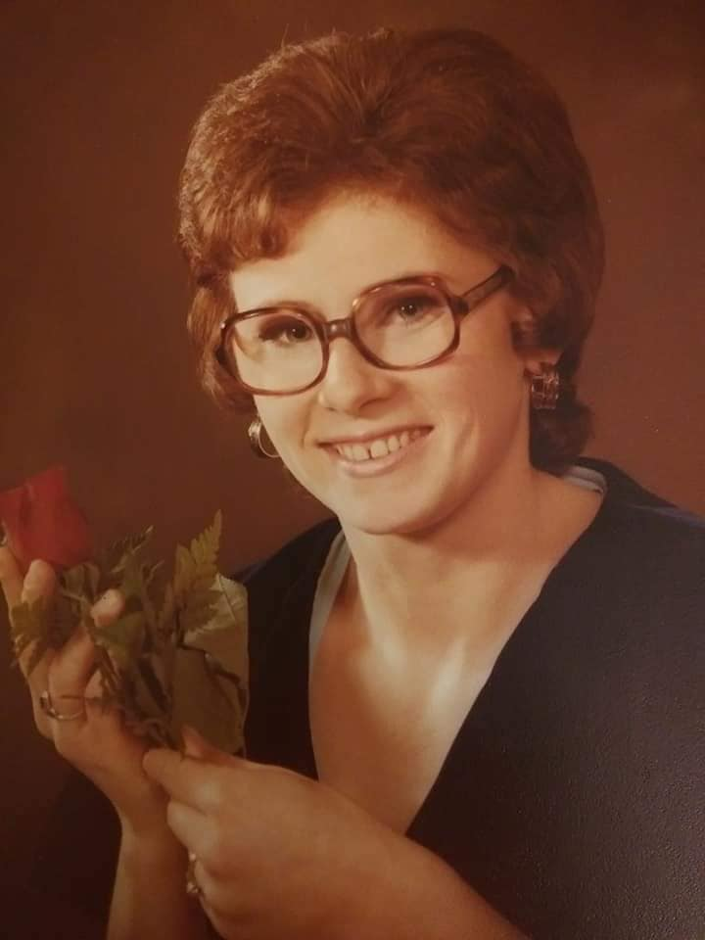
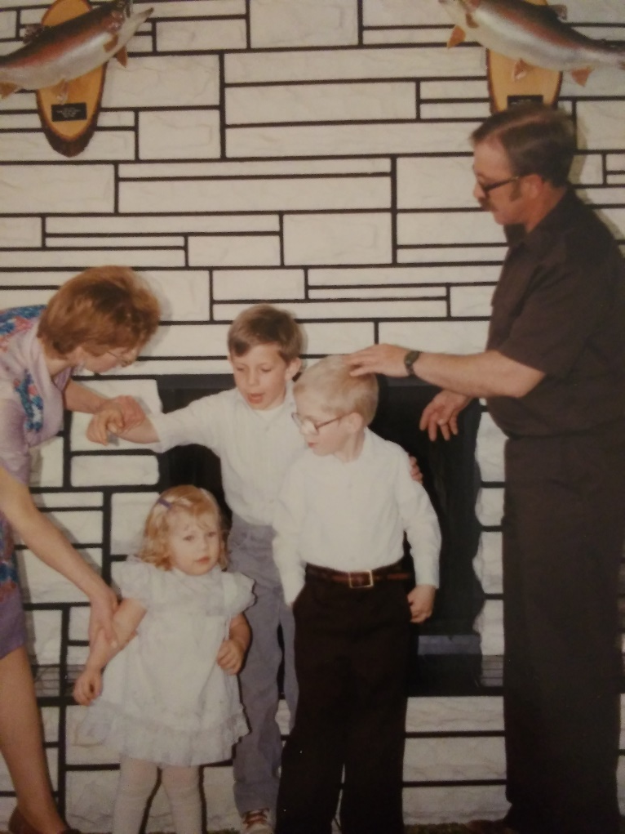
Dedicated to and In Loving Memory

Slide 3
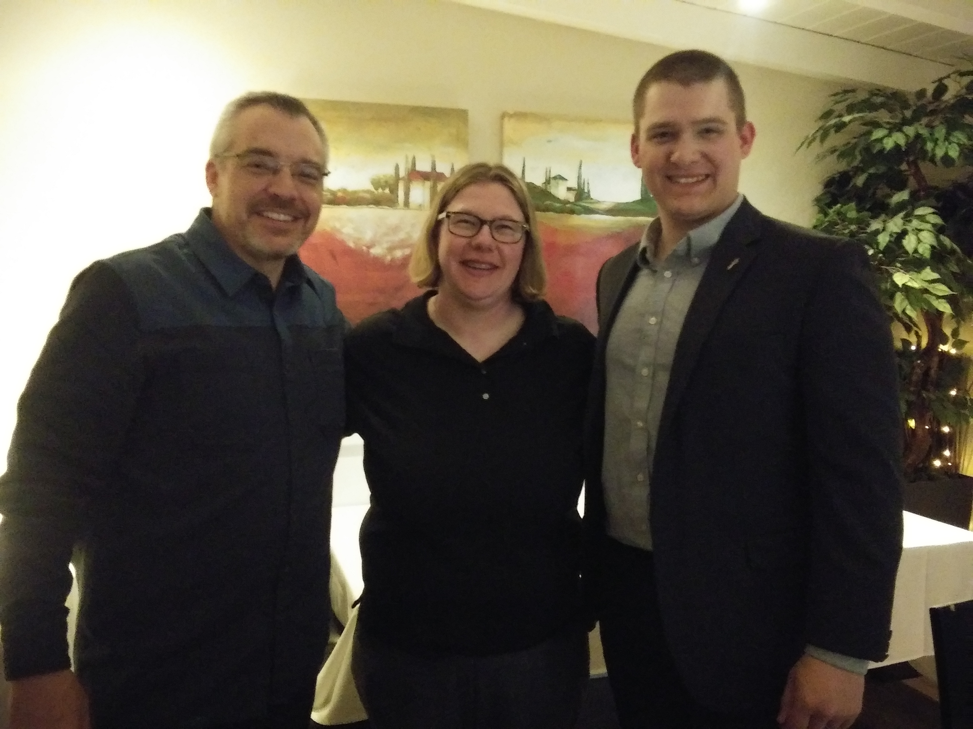
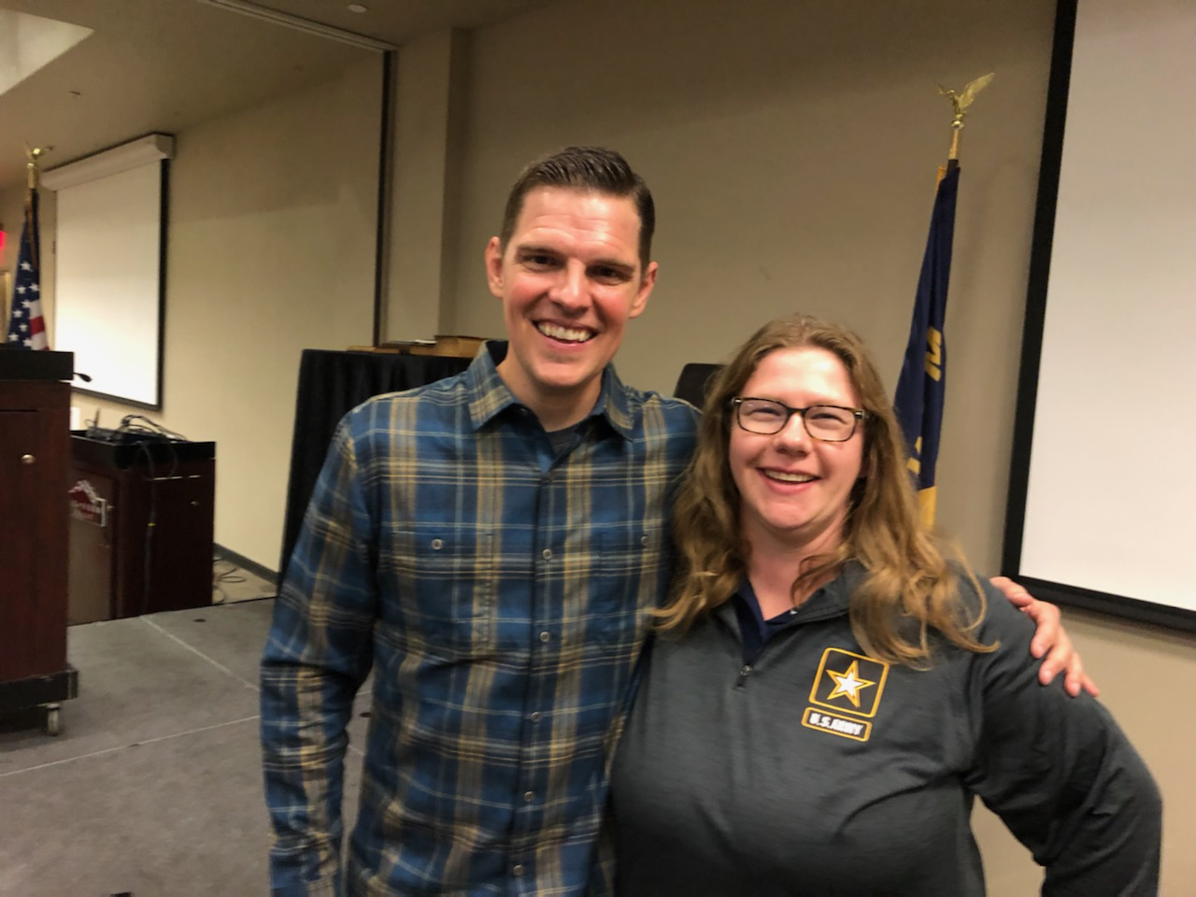
About The StarsandStripes316
On the left, Marcia with America’s Constitution Coach, Rick Green
On the right, Marcia with The President of Wallbuilders, Tim Barton

Slide 4
About The StarsandStripes316
Mission: Calling upon the Church of God to be salt and light by promoting and preserving our Biblical, Historical, Constitutional and Providential Heritage while reflecting on the attributes of God and growing in a Biblical Worldview. Our history is nothing to be ashamed of. Truth has not changed. We must be unequivocal and unapologetic in our society.
www.starsandstripes316.com

Slide 5
What is Biblical Womanhood?
4 goals with today’s message:
Root causes of problems in our culture.
Root solutions of the problems in our culture.
Defining Biblical Womanhood.
Tools to help us live out Biblical Womanhood.

Slide 6
Root Cause of the Problems Today
Plainly Put – we have forgotten our Bibles.
Influence. The Church is to influence society. Saul Alinsky understood this.
Jurisdiction/Roles. God is a God of order for individuals, families and nations.
Understanding the Sinner’s Prayer and Revival.
Keynesian economics vs. Biblical Morality.

Slide 7
Root Solutions of the Problems of Today
The Great Commission. The Church is to TEACH ALL things; not IGNORE all things.
Keep the Bible at the Forefront of Your Mind. Biblical Worldview is a must.
The Bible used to be so penetrated in our society we would actually know that these verses came from Scripture
By The Skin of My Teeth – Job 19:20
The Writing is on the Wall – The Book of Daniel
I’m at my wits end – Psalm 107:27
A little birdie told me so – Ecclesiastes 10:20
The apple of my eye – Deuteronomy 32:10
Have a Caleb Heart. Numbers 14:24

Slide 8
Root Solutions of the Problems of Today
3. Confront Evil God raises up His people in every generation to confront evil.
1. Confession of Madgeburg
2. Pastors of the American Revolution and Protestant Resistant Theory
3. Spurgeon and Karl Marx were alive at the same time & in fact lived in the same city. 4. Whitefield, Harry Hoosier
5. Bonhoeffer and Hitler
6. Eric Metaxes, Rob McCoy and others confronting evil today
7. Majority of people listed in the Hebrews Hall of Faith committed civil disobedience
Understanding all issues are BIBLICAL before political – even though our culture has been all issues political.

Slide 9
What is Biblical Womanhood? We seem very PUZZLED by it.
Lets get rid of the junk the world has defined as womanhood.
If we as the church don’t get this right, we can’t expect the world to get this right.
Understanding gender roles is a primary Gospel issue as it is an attack on The Gospel itself – marriage is a representation of Christ and His bride.
Biblical Womanhood is simply a woman who is made in the image of God pursuing Christ, in all walks of life and it is for all stages of life. God’s Word speaks to the single, married, widow, young and old. Depending on the stage the woman is in, lifestyles will look different, but that woman can still live a counter cultural, Gospel enhancing life!

Slide 10
Defining Biblical Womanhood Let’s get UNPUZZLED
One of my favorite quotes on Biblical Womanhood comes from Abigail Dodds on a Revive Our Hearts Podcast “She shall be called woman”
“God gave women uteruses to give life and breasts to nourish life.”
It is in my sincerest hope as we dive in to this, regardless of what stage of life you are in, you will be encourage to walk out your faith in your distinct role that God has designed you to be.

Slide 11
Defining Biblical Womanhood Let’s get UNPUZZLED
Genesis 1:26-28: ²⁶ Then God said, “^{[a]}Let Us make mankind in Our image, according to Our likeness; and ^{[b]}let them rule over the fish of the sea and over the birds of the sky and over the livestock and over all the earth, and over every crawling thing that crawls on the earth.” ²⁷ So God created man in His own image, in the image of God He created him; male and female He created them. ²⁸ God blessed them; and God said to them, “Be fruitful and multiply, and fill the earth, and subdue it; and rule over the fish of the sea and over the birds of the sky and over every living thing that ^{[c]}moves on the earth.”
Genesis 2:18: ¹⁸ Then the Lord God said, “It is not good for the man to be alone; I will make him a helper ^{[a]}suitable for him.”

Slide 12
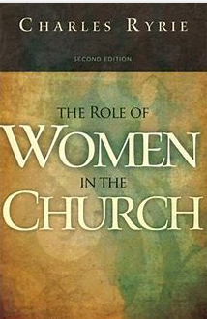
Defining Biblical Womanhood Let’s get UNPUZZLED
Truth to combat culture: Men and women are created equal in the eyes of God, even though we have distinct and different roles then men.
Understanding Jurisdiction and Roles as defined by God:
What is jurisdiction?
God is a God of order and jurisdiction.
Who did He say to take care of the poor?
In a republic who is Ceaser?
God has given women distinct roles in society and in the church.
In society
In the Church today
In the early church
In history

Slide 13
Defining Biblical Womanhood Let’s get UNPUZZLED
Titus 2:3-5 (NASB): ³ Older women likewise are to be reverent in their behavior, not malicious gossips nor enslaved to much wine, teaching what is good, ⁴ so that they may ^{[a]}encourage the young women to love their husbands, to love their children, ⁵ to be sensible, pure, workers at home, kind, being subject to their own husbands, so that the word of God will not be dishonored.
Hermeneutics: -false teaching was posing a threat -Paul was a mentor to Titus -Instructions for the Church -Cretans are mentioned in 1:12, who are relatives to the Philistines, modern day Palestine -Titus is considered to be the a Gentile Christian that would have been present at the Jerusalem Council in Acts 15 -we can actually compare much of the New Testaments writings to today as our world has become a modern day Rome

Slide 14
Defining Biblical Womanhood Let’s get UNPUZZLED
Titus 2:3-5 (NASB): ³ Older women likewise are to be reverent in their behavior, not malicious gossips nor enslaved to much wine, teaching what is good, ⁴ so that they may ^{[a]}encourage the young women to love their husbands, to love their children, ⁵ to be sensible, pure, workers at home, kind, being subject to their own husbands, so that the word of God will not be dishonored.
What is an older woman? We can be older in age, but what about older spiritually?
Are you an older woman to someone?
Do you have an older woman in your life?
This is a concept I believe in our society that we are losing.
Godly Legacy 2) Our Posterity
We see the beauty of the command of God’s people to fill the earth from Genesis 1:26-28 to fulfill The Great Commission by the means of mentorship – this is a powerful way to reach the next generation who are hungry for this.

Slide 15
Defining Biblical Womanhood Let’s get UNPUZZLED
Titus 2:3-5 (NASB): ³ Older women likewise are to be reverent in their behavior, not malicious gossips nor enslaved to much wine, teaching what is good, ⁴ so that they may ^{[a]}encourage the young women to love their husbands, to love their children, ⁵ to be sensible, pure, workers at home, kind, being subject to their own husbands, so that the word of God will not be dishonored.
I believe the word likewise is here b/c these are specific instructions to women. Paul just gave instructions to older men and later on in the chapter will exhort younger men.

Slide 16
Defining Biblical Womanhood Let’s get UNPUZZLED
Titus 2:3-5 (NASB): ³ Older women likewise are to be reverent in their behavior, not malicious gossips nor enslaved to much wine, teaching what is good, ⁴ so that they may ^{[a]}encourage the young women to love their husbands, to love their children, ⁵ to be sensible, pure, workers at home, kind, being subject to their own husbands, so that the word of God will not be dishonored.
“Reverent in their behavior”
-something that is missing in our society towards God and towards our fellow man
-Reverent – NASB online concordance defines reverent as “holy”
-How can we be holy in our behavior?
-What about aging gracefully? Is this a holy act?

Slide 17
Defining Biblical Womanhood Let’s get UNPUZZLED
Titus 2:3-5 (NASB): ³ Older women likewise are to be reverent in their behavior, not malicious gossips nor enslaved to much wine, teaching what is good, ⁴ so that they may ^{[a]}encourage the young women to love their husbands, to love their children, ⁵ to be sensible, pure, workers at home, kind, being subject to their own husbands, so that the word of God will not be dishonored.
“not malicious gossips”
-before we speak, are we asking ourselves is this true, kind, necessary? Is this information going to the right person?
-I encourage you to encourage you to not be a fox in the vineyard – Song of Solomon 2:15
-in your marriage, in your relationships, in your church
-Proverbs 18:17 is also great counsel

Slide 18
Defining Biblical Womanhood Let’s get UNPUZZLED
Titus 2:3-5 (NASB): ³ Older women likewise are to be reverent in their behavior, not malicious gossips nor enslaved to much wine, teaching what is good, ⁴ so that they may ^{[a]}encourage the young women to love their husbands, to love their children, ⁵ to be sensible, pure, workers at home, kind, being subject to their own husbands, so that the word of God will not be dishonored.
“nor enslaved to much wine”
-if we give in to more than what we should that means we are lacking self-control
-being a glutton
-I think this may be in here b/c Titus was a messenger at the Church of Corinth (2 Cor 8:16-18). The Corinthian Church was known for the taking the Lord’s Supper inappropriately.

Slide 19
Defining Biblical Womanhood Let’s get UNPUZZLED
Titus 2:3-5 (NASB): ³ Older women likewise are to be reverent in their behavior, not malicious gossips nor enslaved to much wine, teaching what is good, ⁴ so that they may ^{[a]}encourage the young women to love their husbands, to love their children, ⁵ to be sensible, pure, workers at home, kind, being subject to their own husbands, so that the word of God will not be dishonored.
“teaching what is good”
-in the days in which we live, it is imperative to teach God’s Word.
-2nd Timothy 3:16-17
-people will be given over to the doctrine of demons.
-1st Timothy 4:1
-6% of Christians actually have a Biblical Worldview
See Exhibit Entitled: “American Worldview Inventory 2020 – At a Glance”

Slide 20
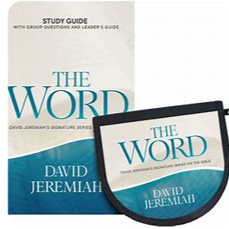
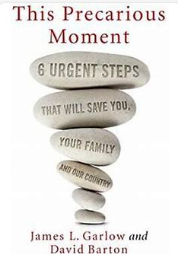
Defining Biblical Womanhood Let’s get UNPUZZLED
In order to grow in teaching what is good, we need to understand what is good!
-I am all reading books, but make sure reading books isn’t replacing your Bible reading time.
-In American history, Pastors used to read 4 books a week to disciple their congregations on the issues of the day.

Slide 21
Defining Biblical Womanhood Let’s get UNPUZZLED
In order to grow in teaching what is good, we need to understand what is good!

Slide 22
Defining Biblical Womanhood Let’s get UNPUZZLED
Titus 2:3-5 (NASB): ³ Older women likewise are to be reverent in their behavior, not malicious gossips nor enslaved to much wine, teaching what is good, ⁴ so that they may ^{[a]}encourage the young women to love their husbands, to love their children, ⁵ to be sensible, pure, workers at home, kind, being subject to their own husbands, so that the word of God will not be dishonored.
“encourage the young women to love their husbands”
-I would like perspective from a married woman on this
-what do if I am single?
-Song of Solomon 2:7b “That you will not disturb or awaken my love until she pleases.” -Godly courtship
-boundaries with men – whether married or single
-Read Proverbs 5 and 7 – which woman will you be?
-Using your sexuality for one man – your husband!

Slide 23
Defining Biblical Womanhood Let’s get UNPUZZLED
Titus 2:3-5 (NASB): ³ Older women likewise are to be reverent in their behavior, not malicious gossips nor enslaved to much wine, teaching what is good, ⁴ so that they may ^{[a]}encourage the young women to love their husbands, to love their children, ⁵ to be sensible, pure, workers at home, kind, being subject to their own husbands, so that the word of God will not be dishonored.
“to love their children ”
-I would like perspective from a married woman on this
-what if I don’t have children? What if I desire children?
God has told us to multiply and fill the earth – do you have spiritual children?
Nieces or nephews?
-What if I am scared to have children?
-What if my child is LGBTQ? Should I go to my child’s wedding if they are gay?

Slide 24
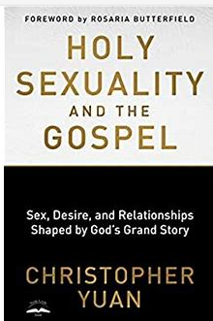
Defining Biblical Womanhood Let’s get UNPUZZLED
How can we grow in loving our husbands and our children (regardless of their age)?

Slide 25
Defining Biblical Womanhood Let’s get UNPUZZLED
Sexual discipleship should be key focal point for all!

Slide 26
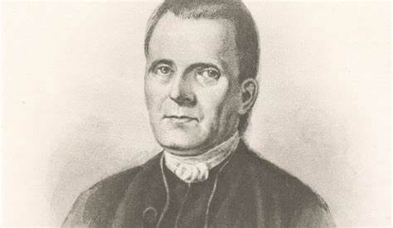
Defining Biblical Womanhood Let’s get UNPUZZLED
Titus 2:3-5 (NASB): ³ Older women likewise are to be reverent in their behavior, not malicious gossips nor enslaved to much wine, teaching what is good, ⁴ so that they may ^{[a]}encourage the young women to love their husbands, to love their children, ⁵ to be sensible, pure, workers at home, kind, being subject to their own husbands, so that the word of God will not be dishonored.
Passing on the legacy of faith like our Founding Fathers used to do-
lets look at Roger Sherman -the only founder to sign all four documents: -The Continental Association -The Articles of Confederation -Declaration of Independence, and -The Constitution.

Slide 27
Defining Biblical Womanhood Let’s get UNPUZZLED
Titus 2:3-5 (NASB): ³ Older women likewise are to be reverent in their behavior, not malicious gossips nor enslaved to much wine, teaching what is good, ⁴ so that they may ^{[a]}encourage the young women to love their husbands, to love their children, ⁵ to be sensible, pure, workers at home, kind, being subject to their own husbands, so that the word of God will not be dishonored.
“to be sensible” (some translations say discretion)
-I find it interesting in Luke 15:17 that the Prodigal Son was known for coming to his senses
-sensible – sober minded, prudent, showing discretion

Slide 28
Defining Biblical Womanhood Let’s get UNPUZZLED
Titus 2:3-5 (NASB): ³ Older women likewise are to be reverent in their behavior, not malicious gossips nor enslaved to much wine, teaching what is good, ⁴ so that they may ^{[a]}encourage the young women to love their husbands, to love their children, ⁵ to be sensible, pure, workers at home, kind, being subject to their own husbands, so that the word of God will not be dishonored.
“to be pure”/chastity
-chastity means abstaining from some sexual act that is considered immoral
-for the married woman, what would this be?
-for the single woman, what would this be?

Slide 29
Defining Biblical Womanhood Let’s get UNPUZZLED
Titus 2:3-5 (NASB): ³ Older women likewise are to be reverent in their behavior, not malicious gossips nor enslaved to much wine, teaching what is good, ⁴ so that they may ^{[a]}encourage the young women to love their husbands, to love their children, ⁵ to be sensible, pure, workers at home, kind, being subject to their own husbands, so that the word of God will not be dishonored.
“workers at home”
-this concept is as unique as the DNA of every woman -some are gifted in hospitality -some are introvert/extrovert

Slide 30
Defining Biblical Womanhood Let’s get UNPUZZLED
Titus 2:3-5 (NASB): ³ Older women likewise are to be reverent in their behavior, not malicious gossips nor enslaved to much wine, teaching what is good, ⁴ so that they may ^{[a]}encourage the young women to love their husbands, to love their children, ⁵ to be sensible, pure, workers at home, kind, being subject to their own husbands, so that the word of God will not be dishonored.
“kind”
-I found the word “benevolent”
-as defined by Webster’s 1828 dictionary. Noah Webster studied 26 languages when drafting this dictionary.

Slide 31
Defining Biblical Womanhood Let’s get UNPUZZLED
Titus 2:3-5 (NASB): ³ Older women likewise are to be reverent in their behavior, not malicious gossips nor enslaved to much wine, teaching what is good, ⁴ so that they may ^{[a]}encourage the young women to love their husbands, to love their children, ⁵ to be sensible, pure, workers at home, kind, being subject to their own husbands, so that the word of God will not be dishonored.
“being subject to their own husbands”
-I would like the married woman’s response to this
Commentator Matthew Henry wrote, “The woman was made out of Adam’s side. She was not made out of his head to rule over him, nor out of his feet to be trampled upon by him, but out of his side to be equal with him, under his arm to be protected, and near his heart to be loved.”
-how does a single woman submit?
-how does submission play out in our government?
-in a America (a republican form of government), who is Ceaser?
-if I want those that I have authority over to respect me, I must sew the idea of submission to my leadership too

Slide 32
Defining Biblical Womanhood Let’s get UNPUZZLED
Titus 2:3-5 (NASB): ³ Older women likewise are to be reverent in their behavior, not malicious gossips nor enslaved to much wine, teaching what is good, ⁴ so that they may ^{[a]}encourage the young women to love their husbands, to love their children, ⁵ to be sensible, pure, workers at home, kind, being subject to their own husbands, so that the word of God will not be dishonored.
“so that the word of God will not be dishonored.”
-I pray that as we have studied Biblical Womanhood – regardless of we are single, married, widowed; regardless of age, that we can pursue holiness in this area.

Slide 33
Bringing dignity back to womanhood
Sincerest hope:
That you grew in the understanding of Biblical Womanhood.
That you got some tools in your toolbelt to live out your God given design.
That you are encouraged to give life and nourish life wherever you are at.
That you are able to think long term for your legacy, posterity and eternity!
“Duty is ours, results are God’s” –
John Quincy Adams

Slide 34
Find this lecture on my website

