Slide 1
Revisiting the “Shot Heard Around the World”
By: Marcia A. Lennick

Slide 2
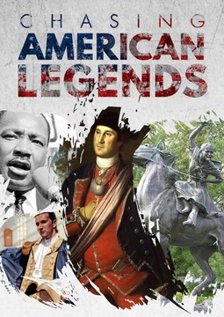
Disclaimer: I do not work for Wallbuilders or Patriot Academy. I am simply a supporter of Wallbuilders and Patriot Academy and have permission to use their information.
Who is Wallbuilders and David Barton? America’s top Christian Historian who was a former principal and found that history was not being taught and now he has the world’s largest, privately owned collection on America’s founding. www.wallbuilders.com
Who is Patriot Academy? Former Texas Legislature and America’s Constitution Coach, Rick Green feels the need to train Americans in their founding to preserve liberty and to pass the torch of freedom to the next generation!

Slide 3
More Resources for Historical Information

Slide 4
Why History Matters? Is this billboard historically accurate? Why or why not?

Slide 5
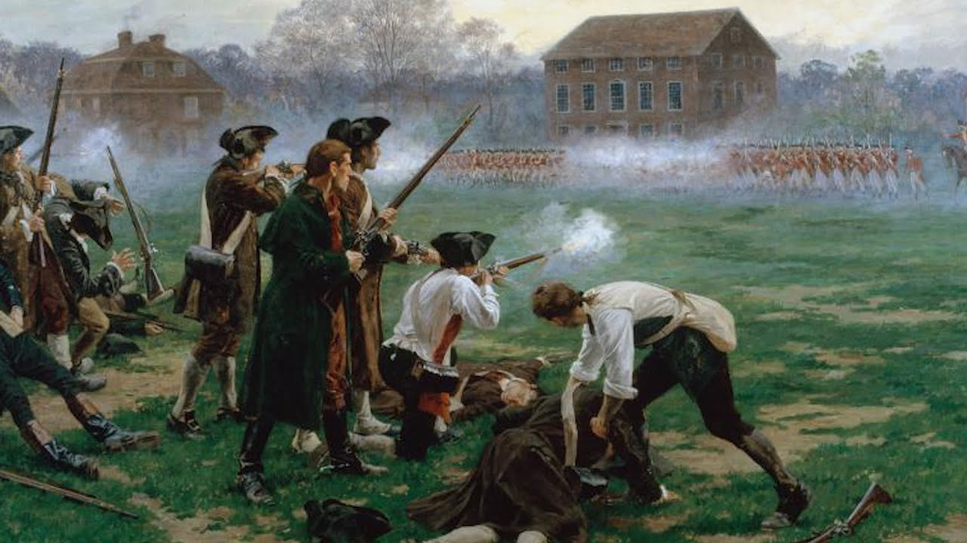
"Stand your ground. Don't fire unless fired upon, but if they mean to have a war let it begin here." Captain John Parker, to his Minute Men on Lexington Green, April 19, 1775.

Slide 6
The History of God in America
Did you know Capitol Hill used to be where the largest Church service occurred? You can read the journals of John Quincy Adams for supporting evidence.
A practice still today is that we have chaplains open daily with prayer. In our founding, chaplains had two jobs: open in prayer and prepare the Sunday sermon.

Slide 7
The History of God in America

Slide 8
Fun Facts on American History -Our Form of Government was inspired by Scripture
Our Republican form of government:
Exodus 18:21-22 (NASB):
²¹ Furthermore, you shall ^{[a]}select out of all the people able men who fear God, men of truth, those who hate dishonest gain; and you shall place these over them as leaders of thousands, ^{[b]}of hundreds, ^{[c]}of fifties and ^{[d]}of tens.
Thousands, hundreds, fifties and of tens are our different levels of government (city, county, state, federal).

Slide 9
Fun Facts on American History -Our Form of Government was inspired by Scripture
Our three branches of government:
Isaiah 33:22 (NASB):
²² For the Lord is our judge, The Lord is our lawgiver, The Lord is our king; He will save us—
Judge (judicial); lawgiver (legislative); king (executive).
Separation of Powers:
Jeremiah 17:9 (NASB):
“The heart is more deceitful than all else And is desperately sick; Who can understand it?
The founders wanted each branch to keep each other accountable because to much power wielded to the wrong person/branch can lead to disaster. The heart is deceitful.

Slide 10
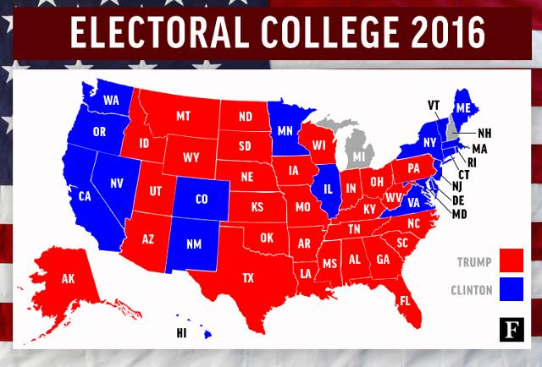
I love our Republican form of government!
How many representatives does each state have? Depends on population.
How many senators does each state have? 2

Slide 11
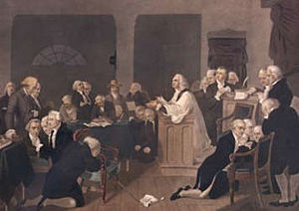
First Prayer in Congress
Read from Psalm 35.
Would last over two hours.
Occurred in Carpenter's Hall (behind Independence Hall).
Different denominations showed up to pray that day!
See Exhibit A – Letter from John Adams to his wife about the first prayer in the Continental Congress.

Slide 12
Pastors in the American Revolution
Should Pastors be involved in politics?
Why or why not?
Black Robe Regiment
These were Pastors who would speak up from the pulpit during The American Revolutionary War.
Still exists today. Wallbuilders is trying to rebuild the Black Robe Regiment and inform Pastors on current topics and what to address from the pulpit.
-Exhibit B – History of the Black Robe Regiment.

Slide 13
Pastors in the American Revolution
Reverend Jonas Clark
His words would be known as the primer in the guns on the Lexington-Green.
Minutemen actually attended his Church.
-Exhibit C – Reverend Jonas Clark on the Battle of Lexington
This is a sermon given one year AFTER the “shot heard around the world.”

Slide 14
Pastors in the American Revolution
The Hancock-Clark House:
The Hancock-Clark House is 1/4 mile from Buckman Tavern, on Hancock Street. On the evening of April 18, 1775, John Hancock and Samuel Adams, prominent leaders in the colonial cause, were guests of the Reverend Jonas Clark in the parsonage. Fearing that they might be captured by the British, Dr Joseph Warren of Boston sent William Dawes and Paul Revere to Lexington with news of the advancing British troops. Arriving separately, they stopped to warn Hancock and Adams, then set off for Concord. Today Dawes is all but forgotten, but Paul Revere's midnight ride has been immortalized by Longfellow.

Slide 15
Pastors in the American Revolution
The Hancock-Clark House was the home of the Reverend John Hancock and the Reverend Jonas Clark - two ministers who served the spiritual and secular needs of Lexington for 105 years. Soon after coming to Lexington in 1698 the Reverend Mr. Hancock built a small parsonage on this site and in 1738 his son Thomas, a wealthy Boston merchant, enlarged his parents' home. The Reverend Hancock's grandson John, a frequent visitor to this house, was the first signer of the Declaration of Independence and the first Governor of Massachusetts. Succeeding Hancock as minister in 1752, the Reverend Jonas Clark, who reared twelve children in this parsonage, was an eloquent supporter of the colonial cause. The Reverend Clark's fervent sermons were a source of inspiration to the citizens of Lexington during the crisis with Britain. This house is of particular interest because it contains furnishings and portraits owned by the Hancock and Clark families and an exhibit area that includes William Diamond's drum and Major Pitcairn's pistols - treasured relics of April 19, 1775.

Slide 16
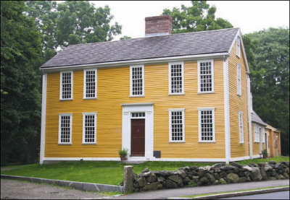
Pastors in the American Revolution
Information on The Hancock-Clark house are courtesy of: https://www.bostoncentral.com/activities/landmarks/p1496.php

Slide 17
Pastors in the American Revolution
Muhlenberg Brothers.
Samuel Davies – Patrick Henry’s Pastor.
Did you know that Patrick Henry’s famous speech “Give Me Liberty or Give Me Death” was preached in a Church?
John Wise – his words influenced The Declaration of Independence. The Sons of Liberty would redistribute Reverend John Wise’s words and would preserve the seeds of liberty.
Exhibit D – A Vindication of the Government of the New England Churches (Exhibit will be sent via email as it is 278 pages).
See Patrick Henry’s Speech.

Slide 18
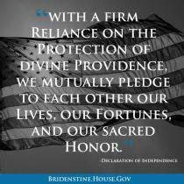
What we do from here?
Defend the Constitution. First, read it. Second, share the information with others. Recommend Constitution Alive by Rick Green and David Barton. I will be doing a Constitution Class starting around August or September 2020.
Vote in people who defend the Constitution. Expose those who do not defend the Constitution. Look at score cards. Ivoterguide.com
Give of your lives, fortunes and sacred honor.
Lives (could be service); fortunes (finances);
sacred honor (your word).
Help get great people elected.
Do not waste your vote. Don’t just get involved in Presidential Elections. Get involved in ALL elections.

Slide 19
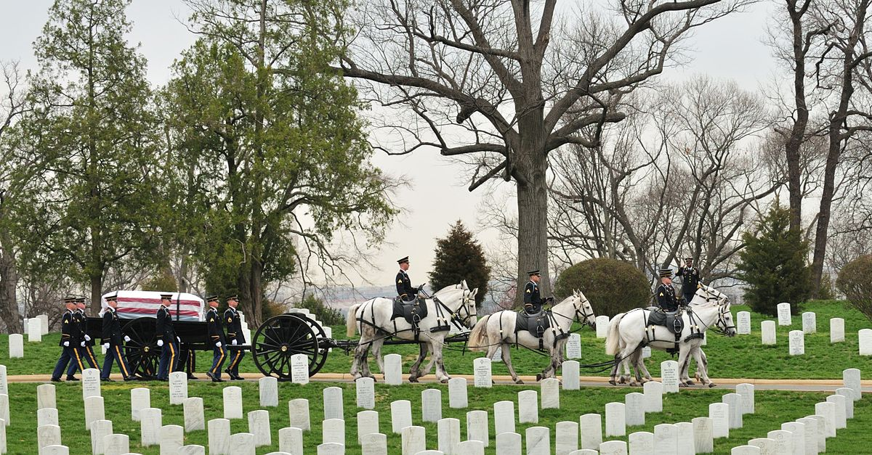
What we do from here?
Do not let their deaths be in vain.
Live out your freedoms, and protect your liberties.
Too much blood has been shed to give up and to not FIGHT.

Slide 20
Credits
Created by: Marcia A. Lennick
Exhibits are courtesy of Wallbuilders.com. Used with permission.
Chasing American Legends Bibliography.
Please give me your email so I can send you exhibits.

