Slide 1

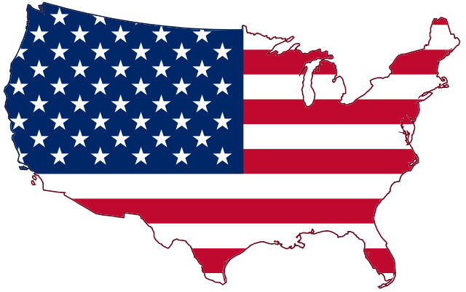
Presenting: The Influence of the Bible in America
By: Marcia A. Lennick

Slide 2

The Greatest Day of History will ALWAYS be the Cross. After all history is His-Story!

Slide 3
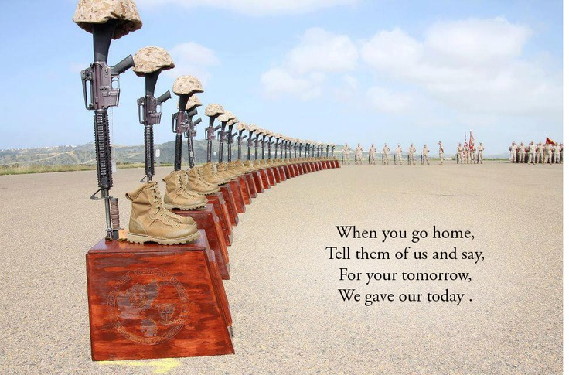

Slide 4
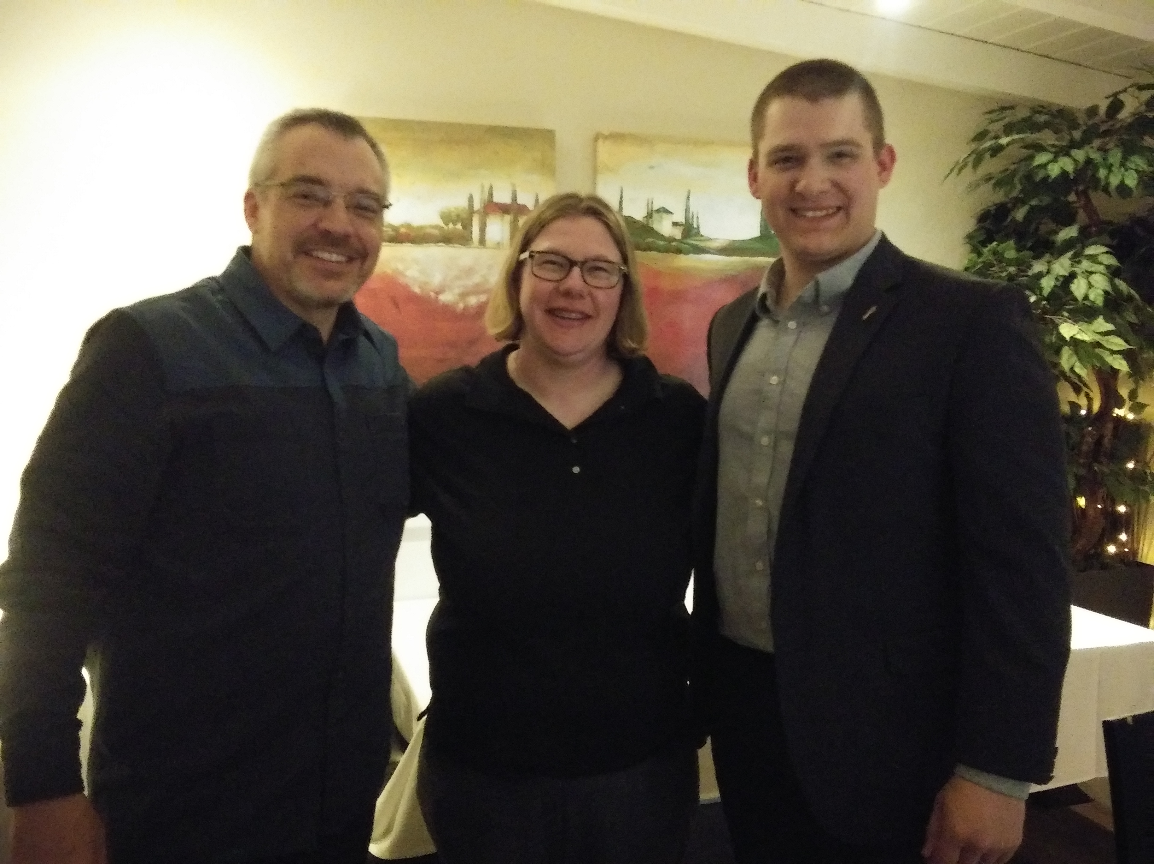

Slide 5
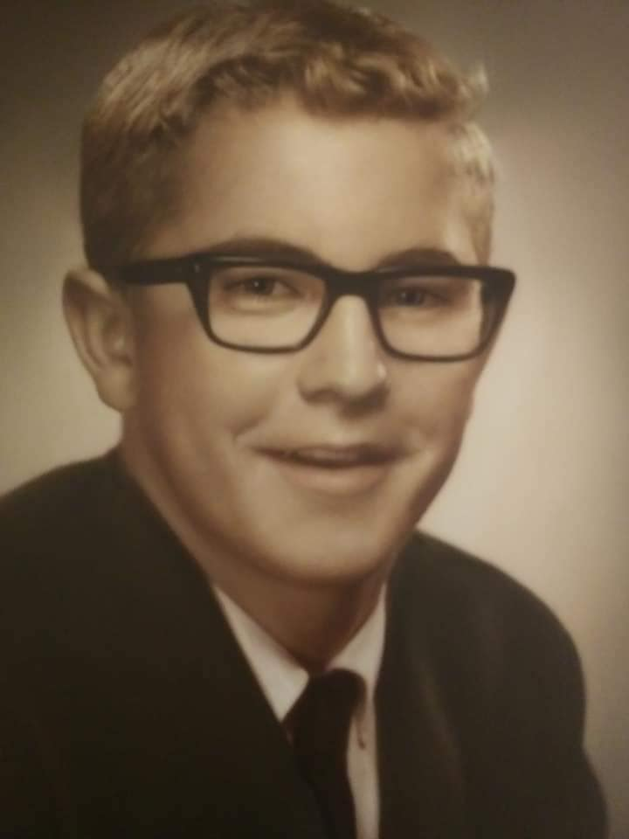

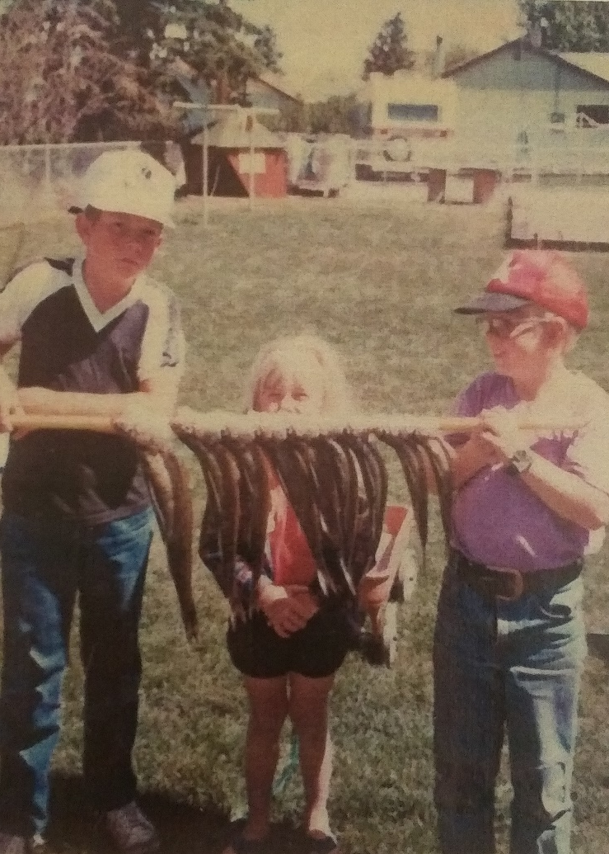
This message series is dedicated to my Mom, Dad, and both brothers. I miss you all more with each passing day!

Slide 6
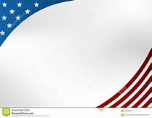
Thank you to all those who have helped proofread this series, and put up with me!

Slide 7
You can get a copy of this lecture series and exhibits at: marciaalennick.wixsite.com/mysite/the-influence-of-the-bible-in-America
You can get a copy of this lecture series and videos at: www.facebook.com/groups/theinfluenceofthebibleinamerica

Slide 8


Slide 9
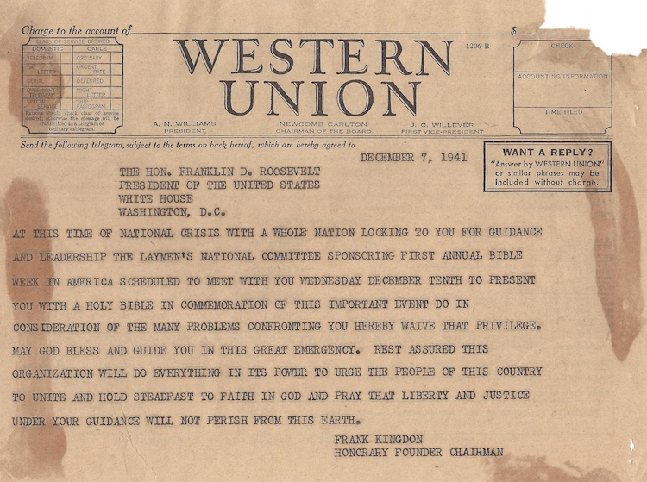

Slide 10
I decided to do this lecture series as close to Thanksgiving as possible.
Why?
Did you know since FDR, the week of Thanksgiving is declared: National Bible Week.
What better way to enjoy your Bible during Thanksgiving with this information contained in this lecture.
For more information, visit: www.nationalbible.org/nationalbibleweek

Slide 11
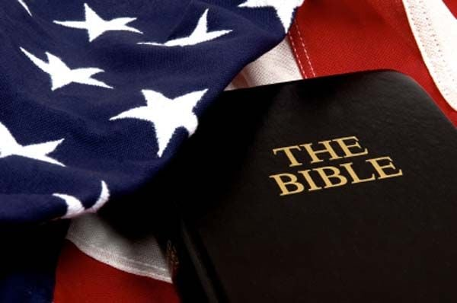
What did the Founding Fathers think of the Bible?
I encourage you to read the Exhibit A: A Few Declarations of Founding Fathers and Early Statesmen on Jesus, Christianity and the Bible.
Go and learn about some Founding Fathers you may never have heard of!

Slide 12
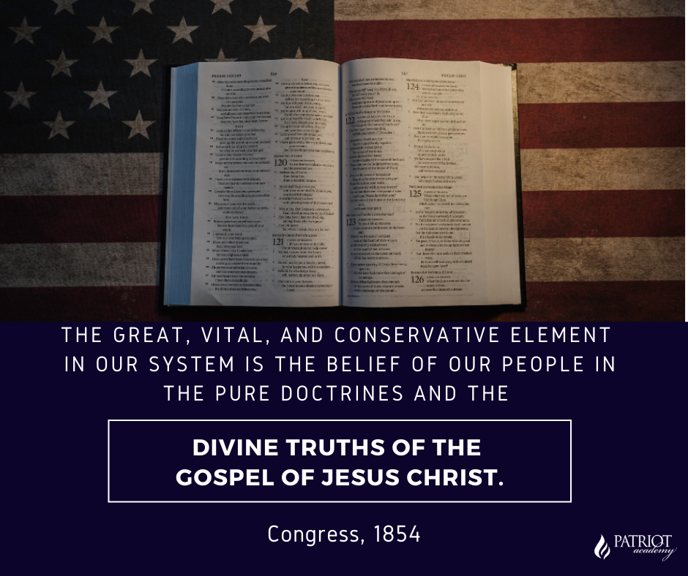

Slide 13
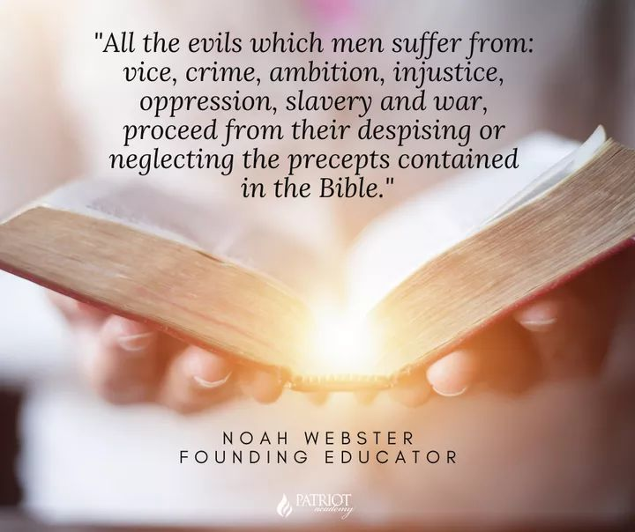

Slide 14
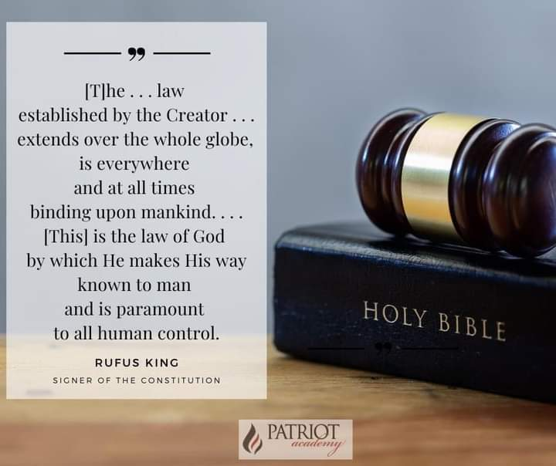

Slide 15
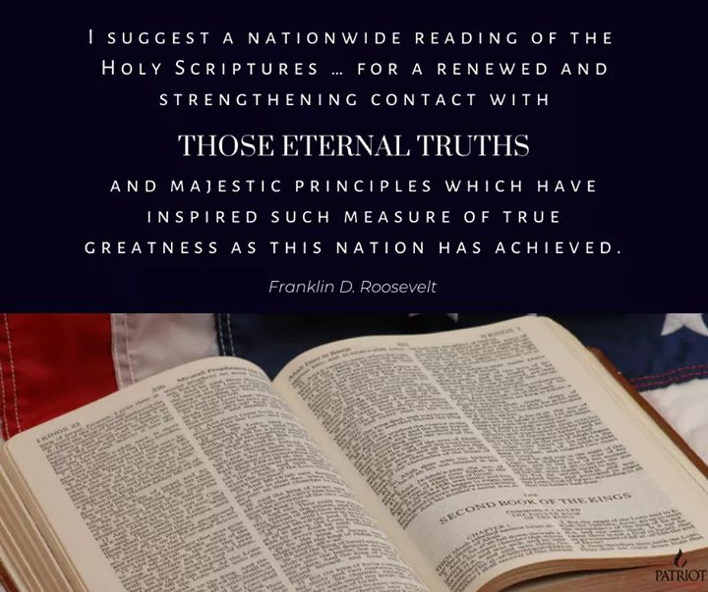

Slide 16

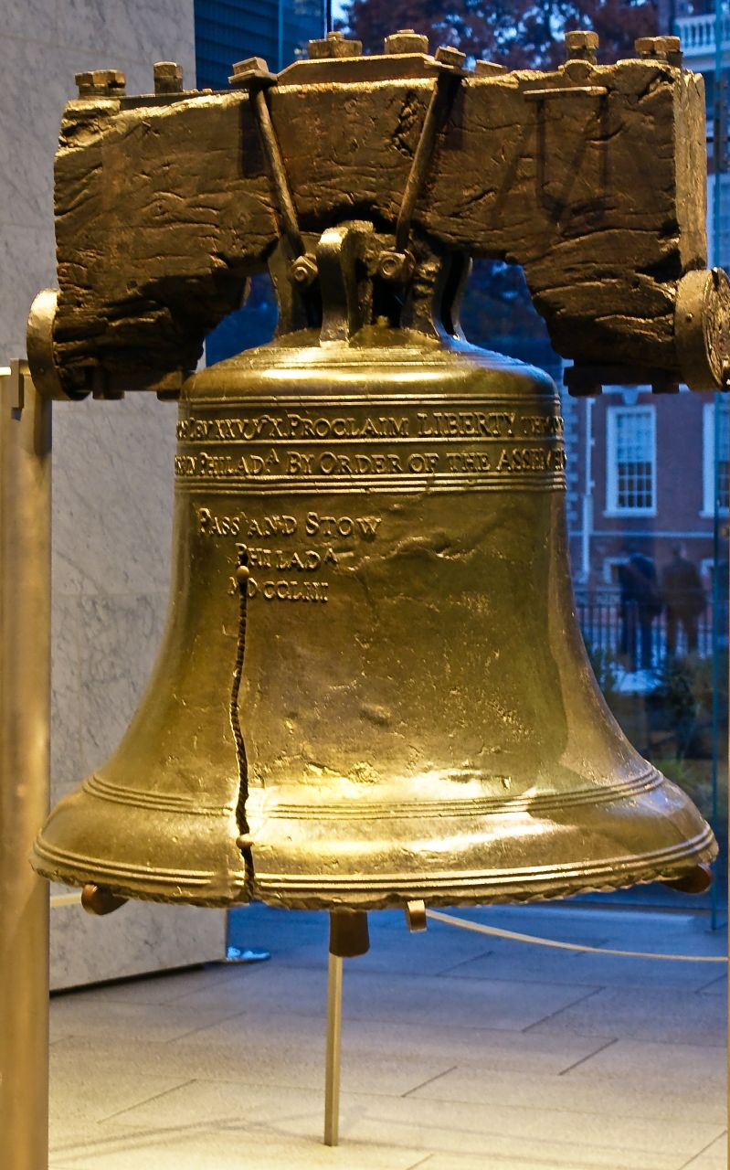
Some fun facts about the influence of the Bible in American History
How did the Liberty Bell get its name? The Scripture on it.
Leviticus 25:10 “Proclaim liberty throughout all the land unto all the inhabitants thereof”
See Exhibits B and C: “Ringing of
the Liberty Bell” and
“Liberty Bell”

Slide 17
Some fun facts about the influence of the Bible in American History
Our Republican form of government:
  Exodus 18:21-22 (NASB):
  ²¹ Furthermore, you shall ^{[a]}select out of all the people able men who fear God, men of truth, those who hate dishonest gain; and you shall place these over them as leaders of thousands, ^{[b]}of hundreds, ^{[c]}of fifties and ^{[d]}of tens.
    Thousands, hundreds, fifties and of tens are our different levels of government
    (federal, state, county, city).

Slide 18
Some fun facts about the influence of the Bible in American History
US Constitution Article IV, Section 4
The United States shall guarantee to every State in this Union a Republican Form of Government, and shall protect each of them against Invasion; and on Application of the Legislature, or of the Executive (when the Legislature cannot be convened) against domestic Violence.
See “Exhibit D: The American Founding and the
Federal Era (1785-early-1800s)”

Slide 19
Some fun facts about the influence of the Bible in American History
Separation of Powers:
  Jeremiah 17:9 (NASB):
  “The heart is more deceitful than all else And is desperately sick; Who can understand it?”
    The founders wanted each branch to keep each other accountable because too much power wielded to the wrong person/branch can lead to disaster. The heart is deceitful.
    See “Exhibit E: How Does Jeremiah 17:9
    Relate to the Constitutional Separation of
    Powers?”

Slide 20
Some fun facts about the influence of the Bible in American History
Our three branches of government:
  Isaiah 33:22 (NASB):
  ²² For the Lord is our judge, The Lord is our lawgiver, The Lord is our king;
  He will save us—
    Judge (judicial); lawgiver (legislative); king (executive).
    See “Exhibit D: The American Founding and the Federal Era (1785-early-1800s)”

Slide 21
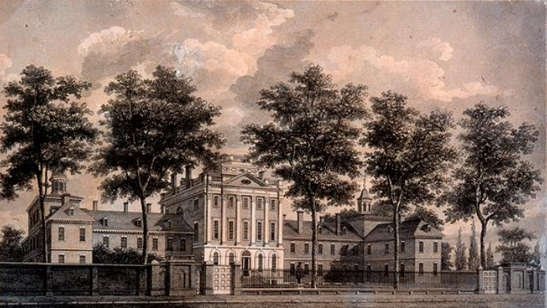
The First Hospital in America… based off the Bible: Luke 10:35
Benjamin Franklin built America’s first hospital based on the Parable of the Good Samaritan found in Luke 10:35 “Take care of him and I will repay thee.”
See Exhibit F: www.wallbuilders.com/fof13
See Website:
www.Benjamin-franklin-history.org/Pennsylvania-hospital

Slide 22
“In this situation of this assembly, groping, as it were, in the dark to find political truth, and scarce able to distinguish it when presented to us, how has it happened, sir, that we have not hitherto once thought of humbly applying to the Father of Lights to illuminate our understandings? In the beginning of the contest with Britain when we were sensible of danger, we had daily prayers in this room for the Divine Protection. Our prayers, sir, were heard, and they were graciously answered. All of us who were engaged in the struggle must have observed frequent instances of a superintending Providence in our favor….And have we now forgotten that powerful Friend?
or do we imagine we no longer need His assistance?
I have lived, sir, a long time;
One of the least religious Founding Fathers, Benjamin Franklin saves
The Constitutional Convention

Slide 23
and the longer I live, the more convincing proofs I see of this truth: that God governs in the affairs of men. And if a sparrow cannot fall to the ground without His notice, is it probable that an empire can rise without His aid? We have been assured, sir, in the Sacred Writings that except the Lord build the House, they labor in vain that build it. I firmly believe this; and I also believe that without His concurring aid, we shall succeed in this political building no better than the builders of Babel…and we ourselves shall become a reproach and a byword down to future ages. I therefore beg
leave to move, that henceforth prayers imploring the assistance of
Heaven, and its blessings on our deliberations, be held in this
assembly every morning before we proceed to business, and
that one or more of the clergy of the city be requested to
officiate in that service.”
One of the least religious Founding Fathers, Benjamin Franklin saves
The Constitutional Convention

Slide 24
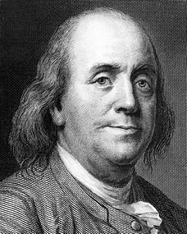
One of the least religious Founding Fathers, Benjamin Franklin saves
The Constitutional Convention
-Franklin was known to be one of the least religious Founding Fathers. Religious being relative.
-How many Scriptures did you pick from his speech?
-We used to know the Bible in our society where it was common place to speak like this!
-See “Exhibit D: The American Founding and the Federal Era
(1785-early-1800s)”
-See Exhibit G: Franklin’s Appeal for Prayer at the
Constitutional Convention

Slide 25
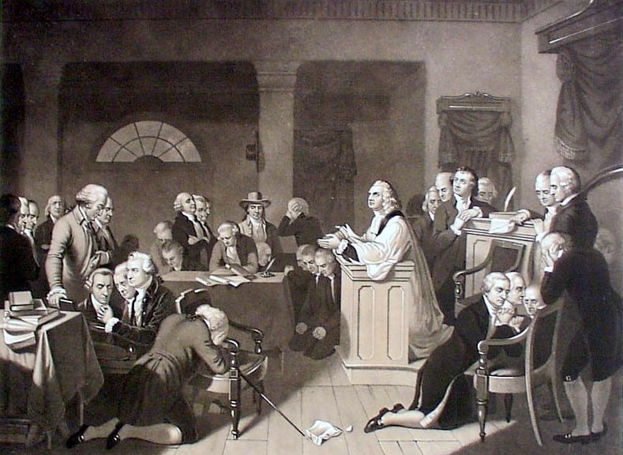
The First Prayer in The Continental Congress
See Exhibit H: American Revolution (1765-1785)
See Exhibit I: John Adams letter to his wife on the first prayer in the Continental Congress

Slide 26
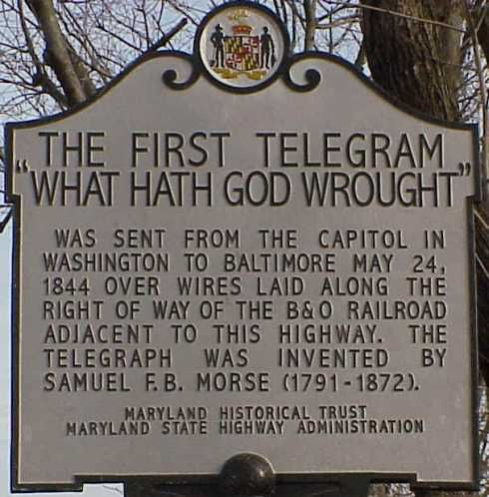
The First Message via Morse Code: Numbers 23:23
See Exhibit J: Morse Code

Slide 27
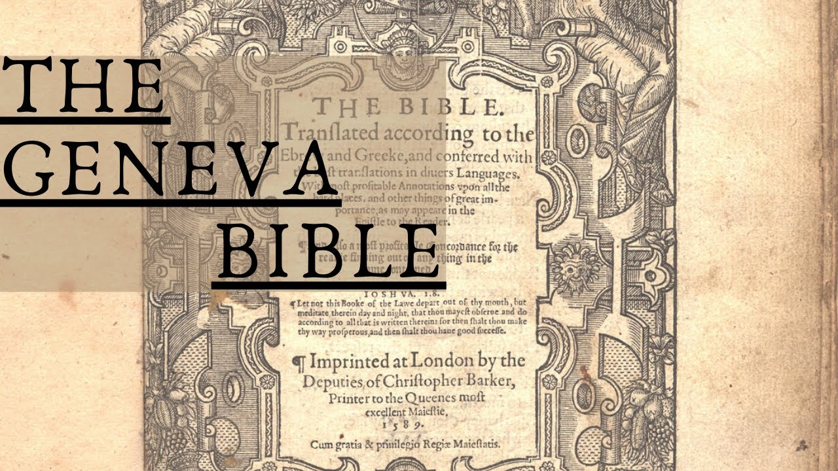

Slide 28
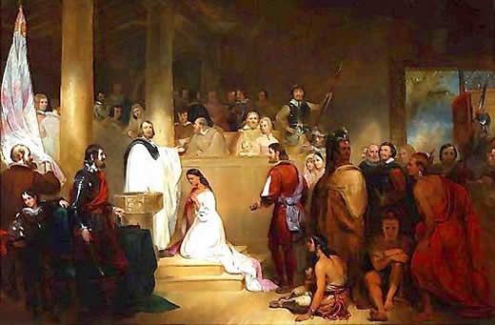

Slide 29
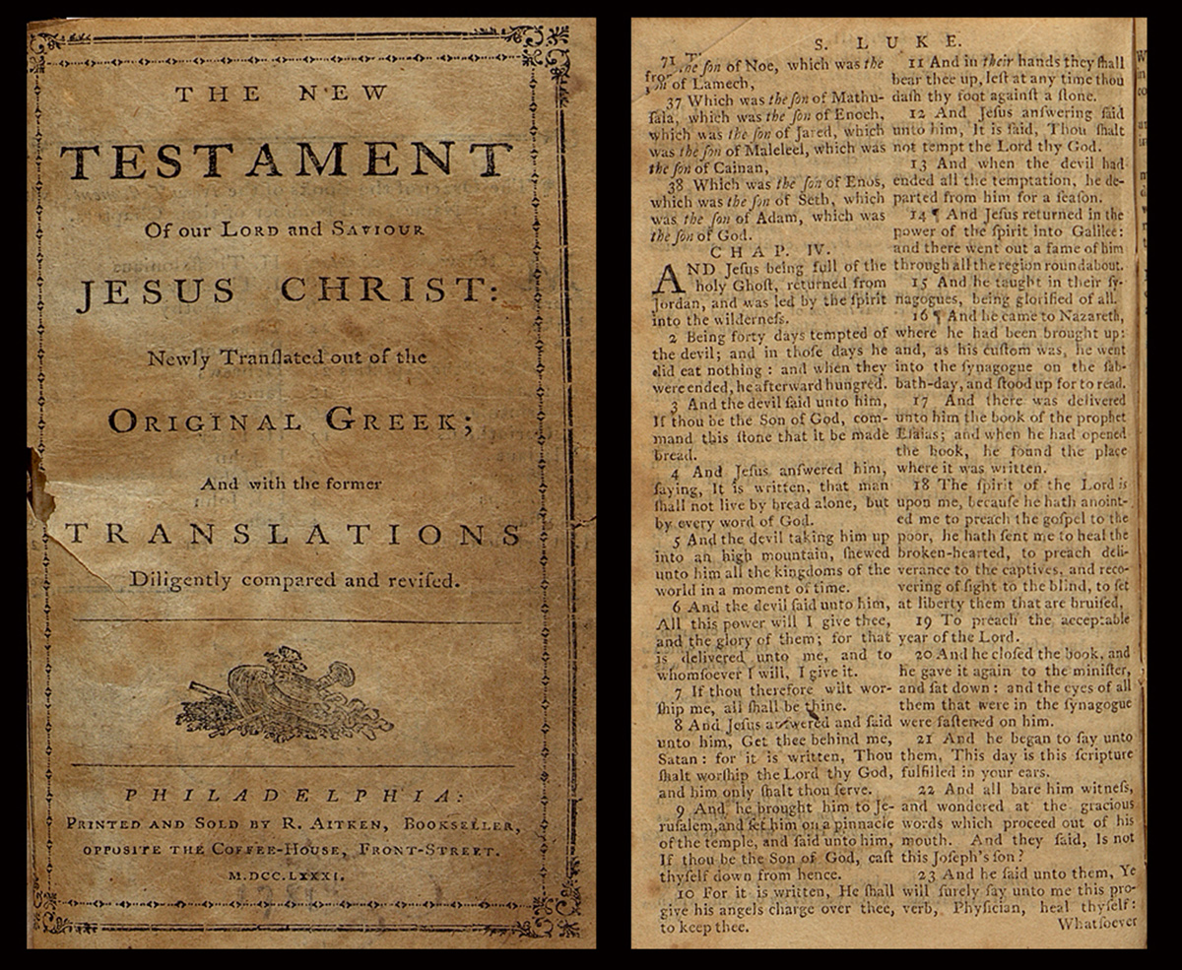
-The Aitkens Bible

Slide 30
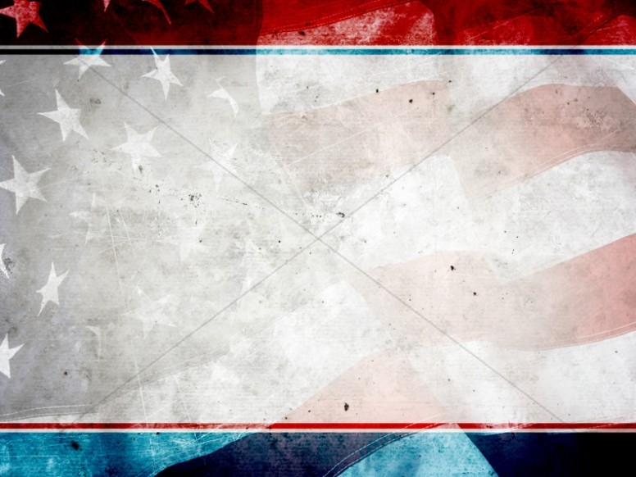
Supporting Exhibits on The Geneva Bible and other Bibles in America
www.Geneva-Bible.com
See Exhibits K, L, and M: “Discovery and Planting 1492-1600”, “Museum of the Bible”, and “First Bibles in America”
See Exhibits N and O: “Aitkens Bible” and “Aitken Bible for download”

Slide 31
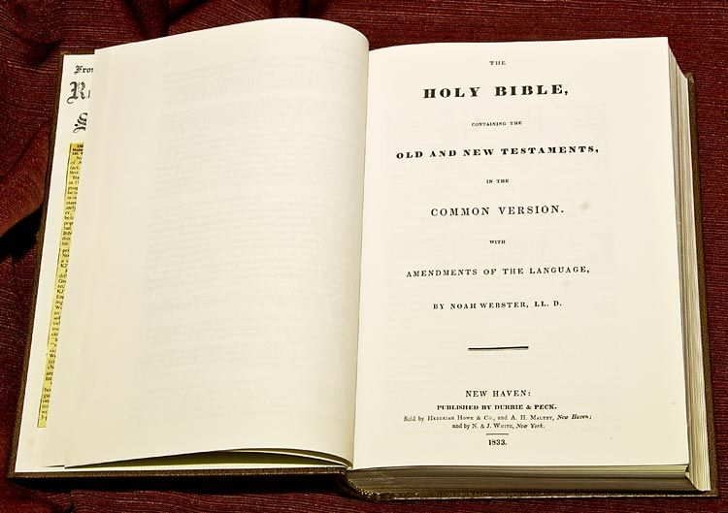
The Webster Bible of 1833
See Exhibit P: “Webster Bible for download”

Slide 32
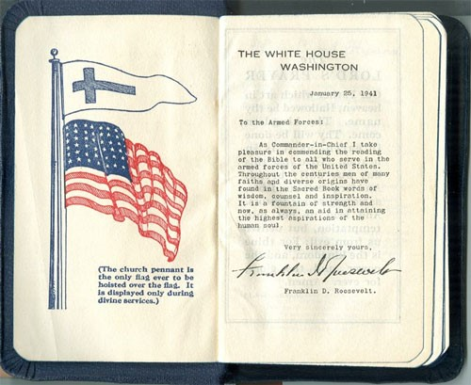
FDR Bible of WWII
Some will get upset that the Christian Flag is above the American Flag. Well, hold on. We have always been a nation of “God, Country, Family.” Our Founding Fathers understood that God is a God of order: In order for our families to be protected, we as a country need to be right with God. So the order God has set for nations is “God, Country, Family.”
See “Exhibit Q: FDR Bibles of WWII”

Slide 33
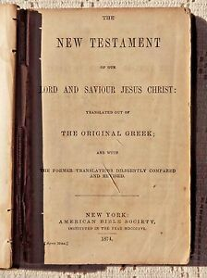
More info on the Bible in America
See some fun exhibits on the Bible in American History
Exhibit HH -1816 American Bible Society
Exhibit II -First American Bible Society
Exhibit JJ -Officers of the American Bible Society

Slide 34
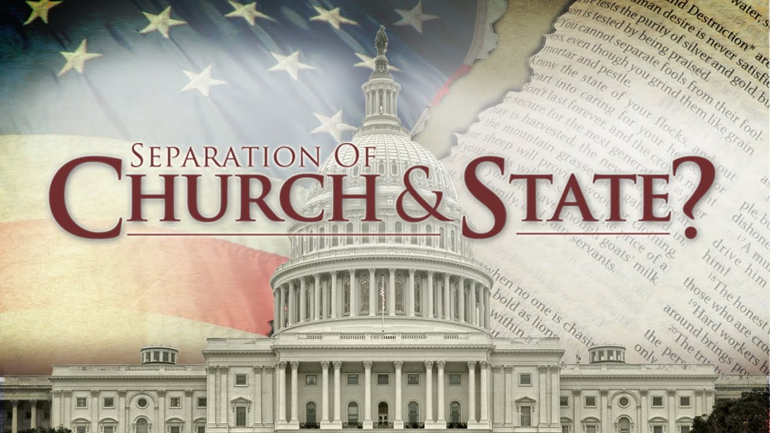

Slide 35
The Truth Behind Separation of Church and State
-this has grossly been taken out of context since 1947
-for starters, there is a healthy separation of church and state
-who did God say to take care of the poor?
-The Church and the individual; not the government-this has been taken so out of context that folks feel like they can’t pray in public if they are a representative?

Slide 36
-this was a private letter between Danbury Baptist Church and Thomas Jefferson. In 1801, Danbury Baptist wrote Jefferson a letter saying they were concerned the State would take over the Church, and Jefferson replied back on January 1st, 1802, that there would be a “separation of Church and State.”
-Jefferson’s intent was that the State would not establish a state religion (a theocracy) and part of the reason of the separation with Great Britain

Slide 37
-where did Jefferson go two days after authoring the letter? Church on Capitol Hill
-Capitol Hill used to have the largest Church services in American history
If Jefferson was such a proponent of Separation of Church and State, why did he draft two Bibles?
-A Pastor actually helped frame the First Amendment… a Pastor…
For more information on Separation of Church and State, see Exhibit KK: Separation of Church and State

Slide 38
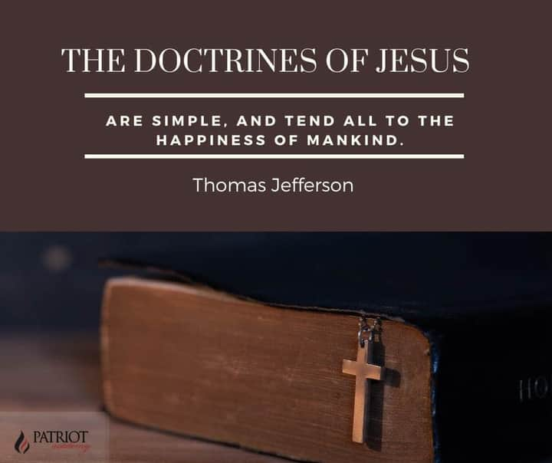

Slide 39
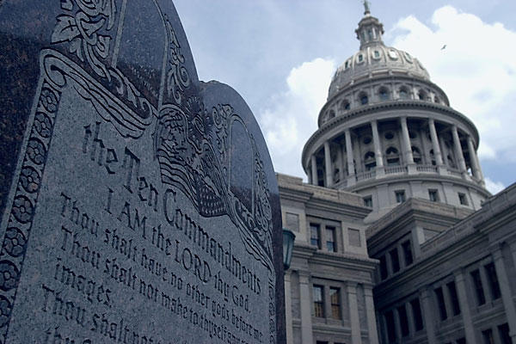
The Ten Commandments
Is it Constitutional or un-Constitutional to display the Ten Commandments outside of a Courthouse today?

Slide 40
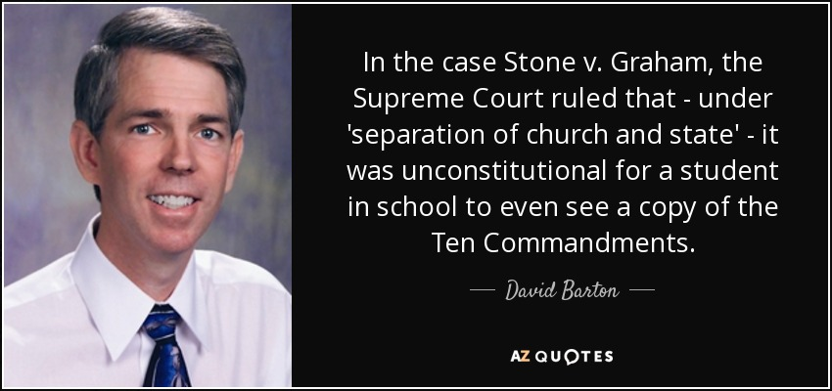
The Ten Commandments
One item I do like about David Barton of Wallbuilders is that he is considered an expert in this field of the Ten Commandments. David Barton was known for taking these kinds of cases to the US Supreme Court and show historical evidence of why the Ten Commandments SHOULD remain at our Courthouses.
David Barton does an excellent Affidavit in Support of the Ten Commandments. See -Exhibit R – Affidavit in Support of the Ten Commandments.

Slide 41
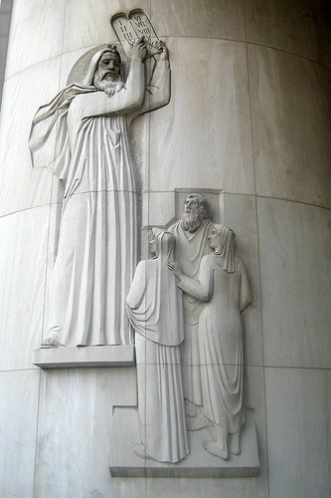
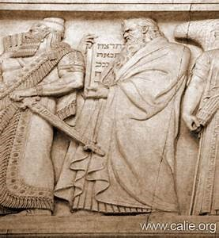
The Ten Commandments
Did you know it was more common to find The Ten Commandments outside of Courthouses than Churches at one point in American Government? Why? This is how we got our Civil Law of government
ON THE LEFT;
The Ten Commandments pictured at the US Supreme Court.
ON THE RIGHT:
Moses giving the Israelites the Ten Commandments
New York Supreme Court.

Slide 42
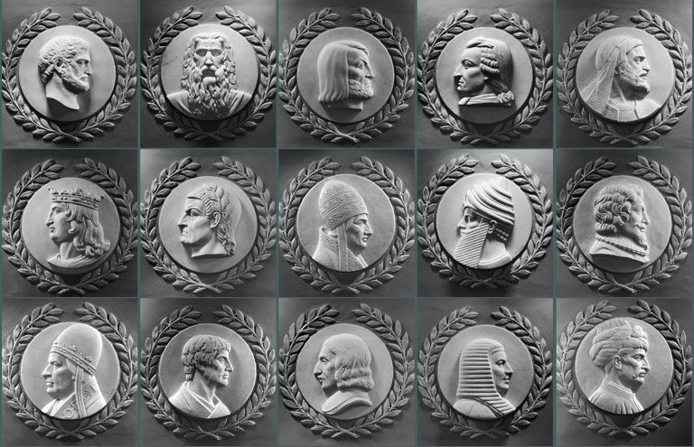
Many great lawgivers throughout time are shown here; however, Moses is the only one facing the Speaker of the House in the rotunda in our nation’s capitol.
This part of the rotunda was built in the 1920’s and here we are 100 years later. What has changed in our country?

Slide 43
The Ten Commandments in American History
Have No Other Gods
-First incorporated into the first written code of laws in America, Virginia Colony 1610, and Massachusetts of 1641, Connecticut 1642.
-If any man after legal conviction shall have or worship any other god but the Lord God, he shall be put to death. Deut. 13:6 & 10; 17:2 & 6; Ex. 22:20.
Have No Idols
-1680 law of New Hampshire.
-It is enacted by ye Assembly and ye authority thereof, yet if any person having had the knowledge of the true God openly and manifestly have or worship any other god but the Lord god, he shall be put to death. Ex: 22:20, Deut. 13:6, 10.

Slide 44
The Ten Commandments in American History
Honor the Sabbath
-During the American Revolution, the Commander in Chief, George Washington ordered the Sabbath be observed: “The Commander in Chief directs that Divine service be performed every Sunday at 11 o’clock … it is expected that officers of all ranks will by their attendance set an example to their men.”
Following the Revolution, the states continued to Honor the Sabbath:
-Vermont, 10 part Sabbath Law, 1787
-Massachusetts, 11 part Sabbath Law, 1794
-Virginia, 8 part Law, written by Thomas Jefferson, 1792
-New Jersey, 21 part Sabbath Law, 1798
-New Hampshire, 14 part Sabbath Law, 1799
-Maine, 13 part Sabbath Law, 1821

Slide 45
The Ten Commandments in American History
Honor Your Parents
Connecticut, 1642.
“If any child or children above sixteen years old and of sufficient understanding shall curse or smite their normal father or mother; he or they shall be put to death unless it can be sufficiently testified that the parents have been very unchristianly negligent in the education of children, or so provoke them by extreme and cruel correction that they have been forced thereunto to preserve themselves from death or maiming.” Ex. 21:17, Lev. 20, Ex. 20:12.

Slide 46
The Ten Commandments in American History
Do Not Murder
Massachusetts, 1641.
“Ex. 21:12, Numbers 35:13,14,30,31. If any person commit any willful murder, which is manslaughter committed upon premeditated malice, hatred, or cruelty not in a man’s necessary and just defense, not by mere casualty against his will, he shall be put to death. Ex. 21:14. If any person shall slay another through guile, either by poisoning or other such devilish practice, he shall be put to death.”

Slide 47
The Ten Commandments in American History
Do Not Commit Adultery
Massachusetts, 1641.
If any person committeth adultery with a married or espoused wife, the adultery and adulteress shall surely be put to death. Ex. 20:14.
Do Not Perjure Yourself
Connecticut,1642.
If any man rise up by false witness, wittingly and of
purpose to take away any man’s life, he shall be put
to death. Deut. 19:16, 18, 19.

Slide 48
The Ten Commandments in American History
Sundays Excepted Clause
The US Constitution, 1787, Article 1, Section 7, the President has ten days to sign a law, “Sundays excepted”
Article 1 - The Legislative Branch Section 7 - Revenue Bills, Legislative Process, Presidential Veto
…..But in all such Cases the Votes of both Houses shall be determined by Yeas and Nays, and the Names of the Persons voting for and against the Bill shall be entered on the Journal of each House respectively. If any Bill shall not be returned by the President within ten Days (Sundays excepted) after it shall have been presented to him, the Same shall be a Law, in like Manner as if he had signed it, unless the Congress by their Adjournment prevent its Return, in which Case it shall not be a Law.

Slide 49
The Ten Commandments in American History
Mississippi, 1950:
“The Sunday laws have a Divine origin… after six days of creation, the Creator Himself rested on the seventh. Genesis, Chapter 2, verses 2 and 3. Thus, the Sabbath was instituted as a day of rest. The original example was later confirmed as a commandment when the law was handed down from Mt. Sinai “Remember the Sabbath day, to keep it holy” [Exodus 20:8]
Florida Supreme Court, 1950:
“A people unschooled about the sovereignty of God, the Ten Commandments, and the ethics of Jesus could never have evolved the Bill of Rights, the Declaration of Independence, and the Constitution.
There is not one solitary fundamental principle of our democratic policy that did not stem directly from the basis moral concepts as embodies in the Decalogue and the ethics of Jesus.”

Slide 50
The Ten Commandments in American History
Pennsylvania, 1967:
“Remember the Sabbath day to keep it holy; six days shalt thou labor and do all thy work; but the seventh day is the Sabbath of the Lord thy God. In it thou shalt not do any work” [Deuteronomy 5:12-14]. This Divine pronouncement became part of the Common Law inherited by the thirteen American colonies and by the sovereign states of the American union.”

Slide 51
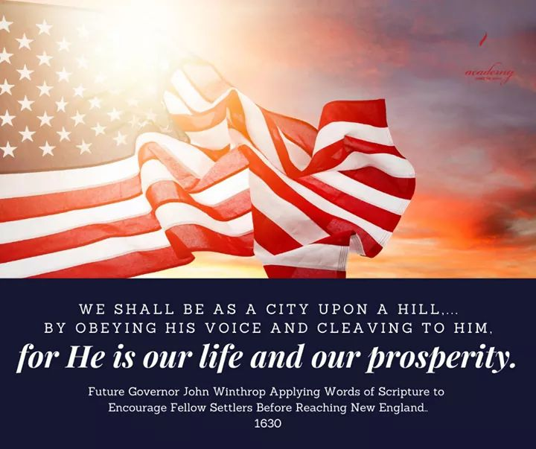
See “Exhibit K:Discovery and Planting 1492-1600”
See “Exhibit S: A Modell of Christian Charity”

Slide 52


Slide 53
I called Wallbuilders to make a photocopy of their article in the Founder’s Bible called: “Inseparably Linked The Declaration of Independence and the Constitution”, pages 1243-1252. I do not have permission to photocopy to this info because it is more than 3 pages.
Also see “Exhibit T: The DOI and Constitution Linked Plymouth Rock”.
Also see: www.plymrock.org/the-declaration-and-the-constitution-inseperable/

Slide 54
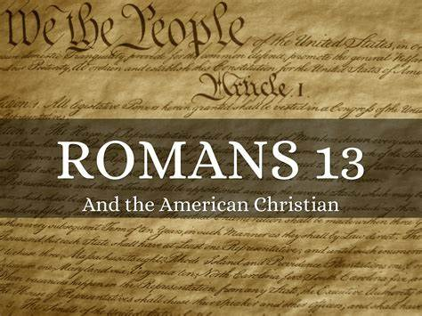
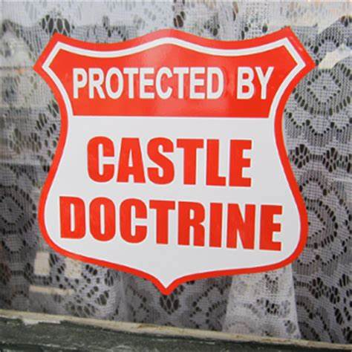
Did the Founding Fathers go against the Bible when they came to America from Great Britain based off of Romans 13?
What about the Castle Doctrine? Should we have the right to defend ourselves?
See Exhibits U, V, W: :Natural Law and Sir William Blackstone”, “The Bible and Self-Defense” and “The American Revolution Was it an Act of Biblical Rebellion”

Slide 55
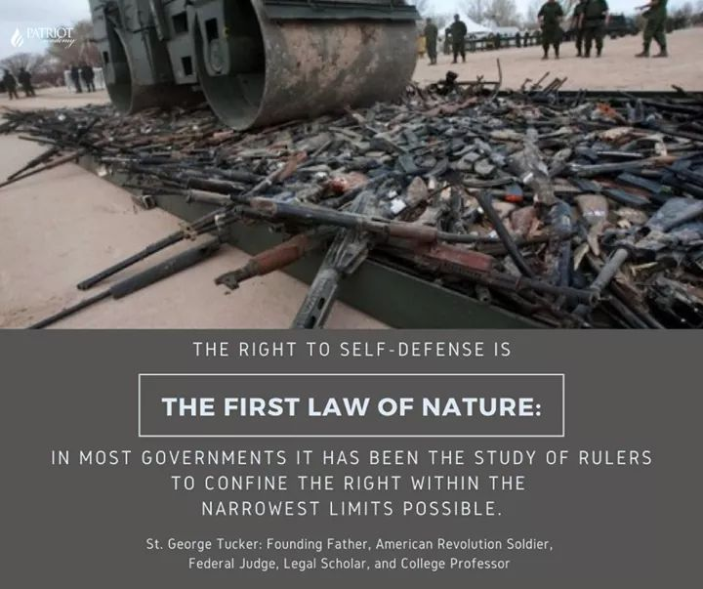

Slide 56
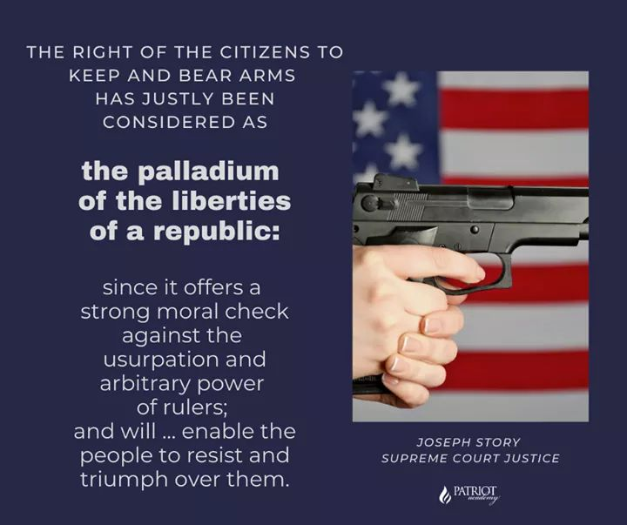

Slide 57
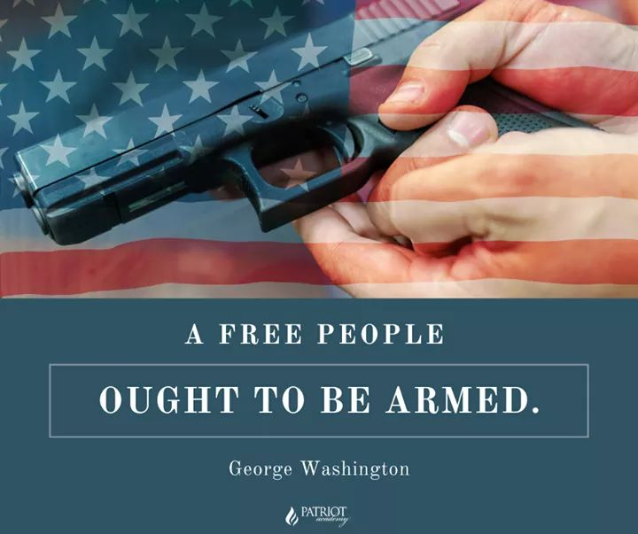

Slide 58
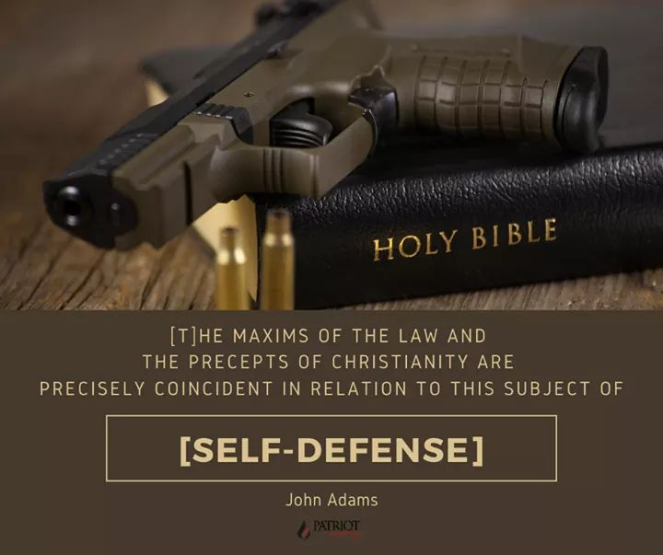

Slide 59
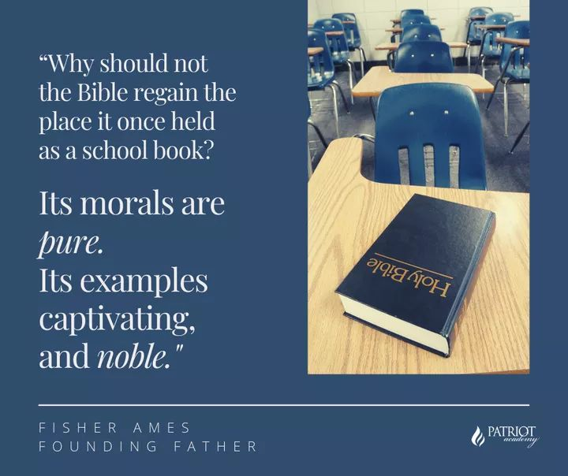

Slide 60

Should the Bible be allowed in public schools?

Slide 61


Slide 62
"It is now several months since I promised to give you my reasons for preferring the Bible as a schoolbook to all other compositions. Before I state my arguments, I shall assume the five following propositions:
1 . That Christianity is the only true and perfect religion; and that in proportion as mankind adopts its principles and obeys its precepts they will be wise and happy.
2. That a better knowledge of this religion is to be acquired by reading the Bible than in any other way.

Slide 63
3. That the Bible contains more knowledge necessary to man in his present state than any other book in the world.
4. That knowledge is most durable, and religious instruction most useful, when imparted in early life.
5. That the Bible, when not read in schools, is seldom read in any subsequent period of life.
See “Exhibit X - The Defense of the Bible in Schools”

Slide 64

Early American Textbooks
Noah Webster’s Book – History of the United States
(this was actually taught in American Education)
  Section 1. Of the first man. In the beginning God created the heaven and the earth, and the sun, moon, and stars. He created also grass, and other plants ; and various animals for the use of man. And last of all he created the first man, called Adam, endowed him with rational faculties, and gave him dominion over the earth, and over the beasts of the field, the fishes of the sea, and fowls of the air. 2. Of the first woman. The first woman, called Eve, was made by God as a helper to Adam. Being taken from Adam's body, she was presented to him, and received as his intimate companion, to share with him the toils and the felicities of life. These were the progenitors of all the human race.
  See “Exhibit BB- Websters History of the United States”

Slide 65
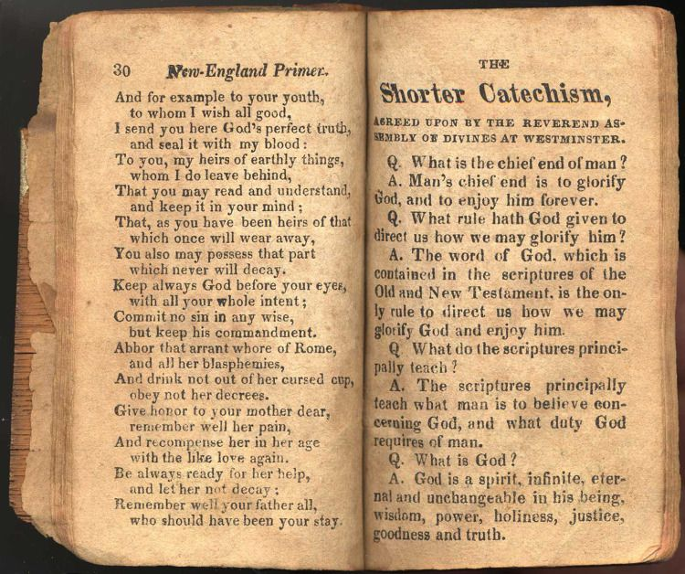
See Exhibit CC: New England Primer

Slide 66
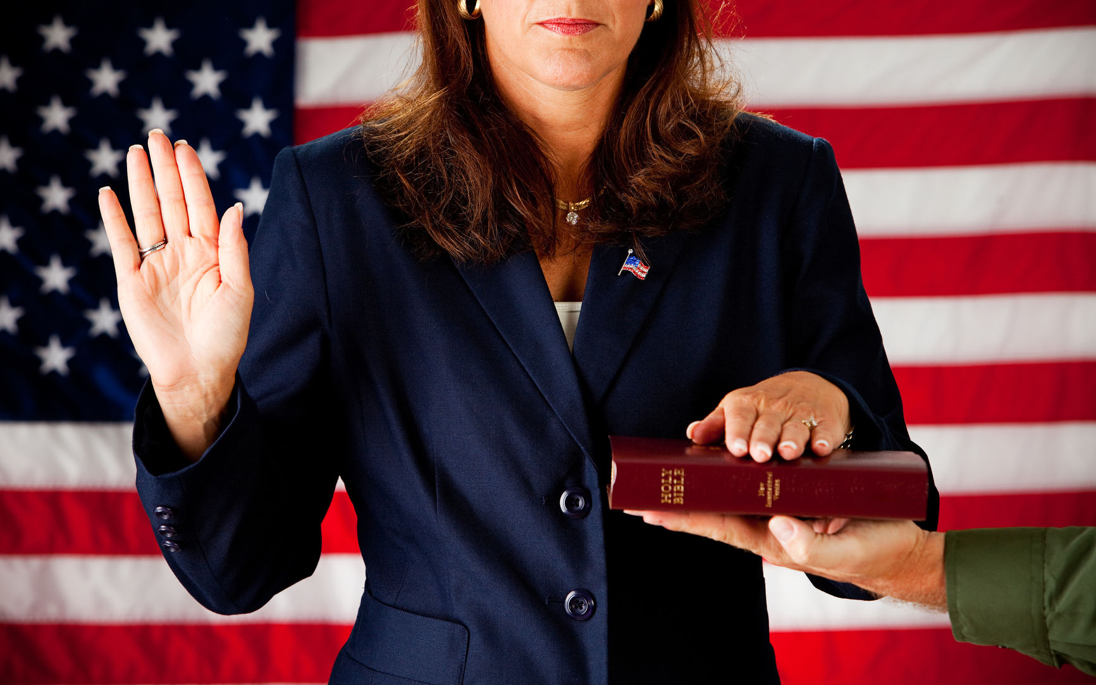
The Influence the Bible had on the Oath of Office

Slide 67
Traditionally, in taking an oath an individual raises their right hand, places the other on the Bible, takes the oath, and concludes with “So help me God.”
Notice how the elements in this sequence directly parallels specific verses in the Bible.
  For example, in Genesis 26:2-3, God told Isaac “I will perform the OATH which I SWORE to Abraham your father”—so God Himself swore an oath.
  Concerning the oath, God declared: “I RAISED MY HAND IN AN OATH . . .” (Ezekiel 20:15, 23; 36:7; Psalm 106:26). The Scripture further tells us that “The Lord has sworn by His RIGHT hand” (Isaiah 62:8).

Slide 68
  And when God’s people were instructed about how to take an oath, they were told: “You shall . . . take oaths IN HIS NAME” (Deuteronomy 10:20), which is what we do today when we use the
  phrase “So help me God.” Clearly, the oath-taking clauses of the Constitution reflect specific Biblical practices.
  See “Exhibit D: The American Founding and the Federal Era
  (1785-early-1800s)”
  See “Exhibit Y - Did George Washington Actually Say So
  Help Me God During His Inauguration”

Slide 69

How did we get the idea the POTUS must be a natural born citizen?

Slide 70
Concerning the selection of a national executive leader, the Bible says “One from among your brethren you shall set as king over you; you may not set a foreigner over you, who is not your brother” (Deuteronomy 17:15, ESV). The national leader cannot be an immigrant but must be native-born.
Reflecting this same requirement, the Constitution stipulates: “No person except a natural born citizen...shall be eligible to the office of President” (Article II, Section 1, Paragraph 5). The Constitution allows a US Senator or Representative to be an immigrant, but it requires that the national leader—the President—must be native-born (or as the Bible specified, “one from among your brethren” who is “not a foreigner”).
See “Exhibit D: The American Founding and the Federal Era
(1785-early-1800s)”

Slide 71
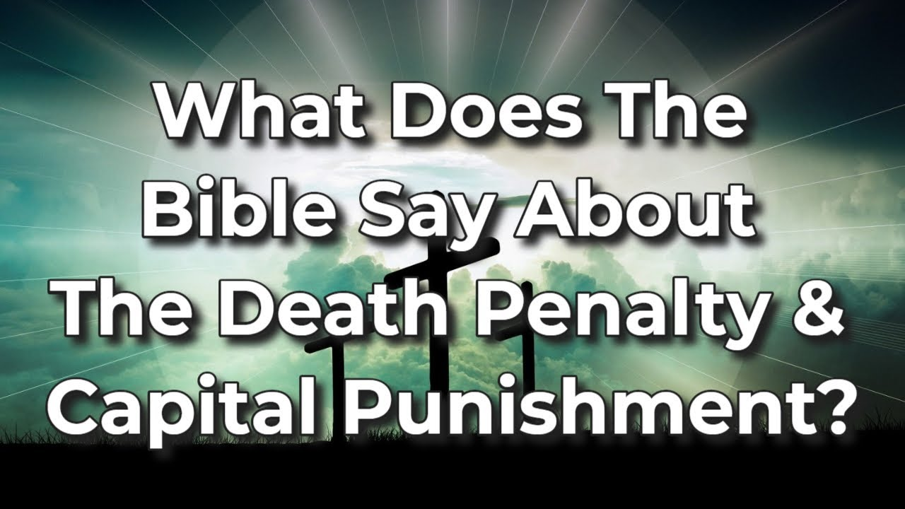

Slide 72
Concerning the death penalty, the Bible says: “Whoever is deserving of death shall be put to death on the testimony of two or three witnesses; he shall not be put to death on the testimony of one witness.” (Deuteronomy 17:6, NKJV)
Concerning treason (a death penalty offense specifically named in the Constitution), the Constitution likewise requires: “No person shall be convicted of treason [and put to death], unless on the testimony of two witnesses to the same overt act” (Article, Section 3, Paragraph 3).
See “Exhibit D: The American Founding and the Federal Era (1785-early-1800s)”

Slide 73
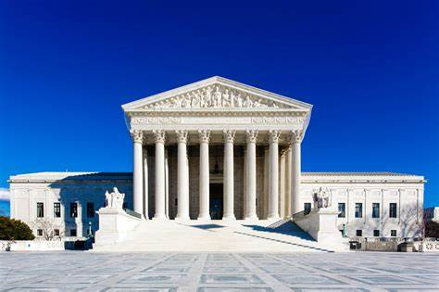
How has the US Supreme Court changed from America’s founding?

Slide 74
How many have heard of Circuit Riding Judges?
Circuit Riding. When Congress created the U.S. circuit courts as the primary trial courts of the federal judiciary, it did not create judgeships assigned exclusively to those courts. Instead, the local U.S. district court judge and two justices of the Supreme Court were to preside in the circuit courts. Under the practice known as "circuit riding," each justice was assigned to one of three geographical circuits and traveled to the designated meeting places within the districts of that circuit.
  Quote courtesy of: https://www.fjc.gov/history/timeline/circuit-riding

Slide 75
How many have heard of Circuit Riding Judges?
James Kent “Father of American Jurisprudence” event noted that America’s circuit riding judges came from the Bible:
  “The Jewish judges rode the circuits and Samuel judged Israel all the days of his life, and he went from year to year in circuit, to Bethel and Gilgal and Mizpeh, and judged Israel in all those places [1st Samuel 7:15-16]
See “Exhibit Z - Memoirs and Letters of James Kent”
See “Exhibit AA - Commentaries on American Law” by James Kent

Slide 76
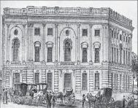
In American history, the US Capitol used to have the largest Church service!
See Exhibit DD: Church in the US Capitol

Slide 77
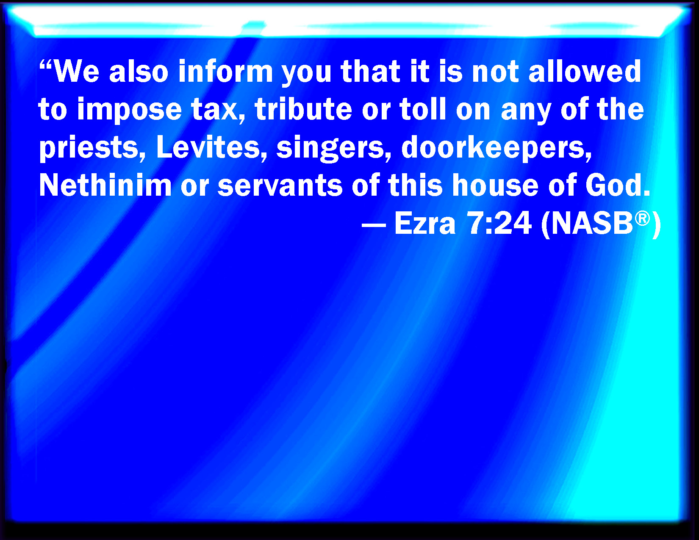
This is the very verse the Founding Fathers used to make our Churches tax exempt.
See “Exhibit D: The American Founding and the Federal Era (1785-early-1800s)”

Slide 78
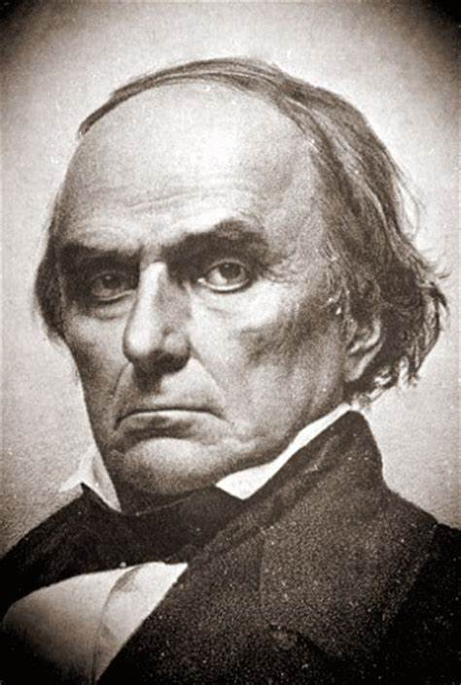
Daniel Webster- The Great Orator, Statesman, and Defender of the Constitution
Daniel Webster was known as The Great Orator and great statesman! When folks heard they were debating him, they didn’t want to.
Where did Daniel Webster get his skills? From reading the Bible!
It was known that Daniel’s voice would thunder as he read from the Book of Job!
See “Exhibit EE - Daniel Webster Defender of the Constitution”
See “Exhibit FF- The Private Life of Daniel Webster”

Slide 79
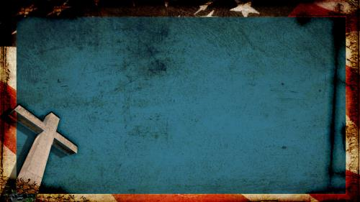
Thank you for attending!!!
To the best of my ability, I tried to do a history series for you about the Bible, and how it influenced America. The Bible is so engrained in our society, that I do not have the time to begin to draft a comprehensive study.
This study was just a cursory review, and didn’t even begin to touch on the rights of conscience, or the Scriptural Bill of Rights, or the heart of higher education in America’s Founding AND SO MUCH MORE!!

Slide 80
Thank you for attending!!!
This study does not even touch how deep the Bible is woven in our society from Good Samaritan Laws, to everyday sayings that are Biblical references that we may not know are Biblical references like: “a birdie told me” or “the writing is on the wall.”
I encourage you to do as our Founding Fathers did – they would read through the Bible in a year.

Slide 81
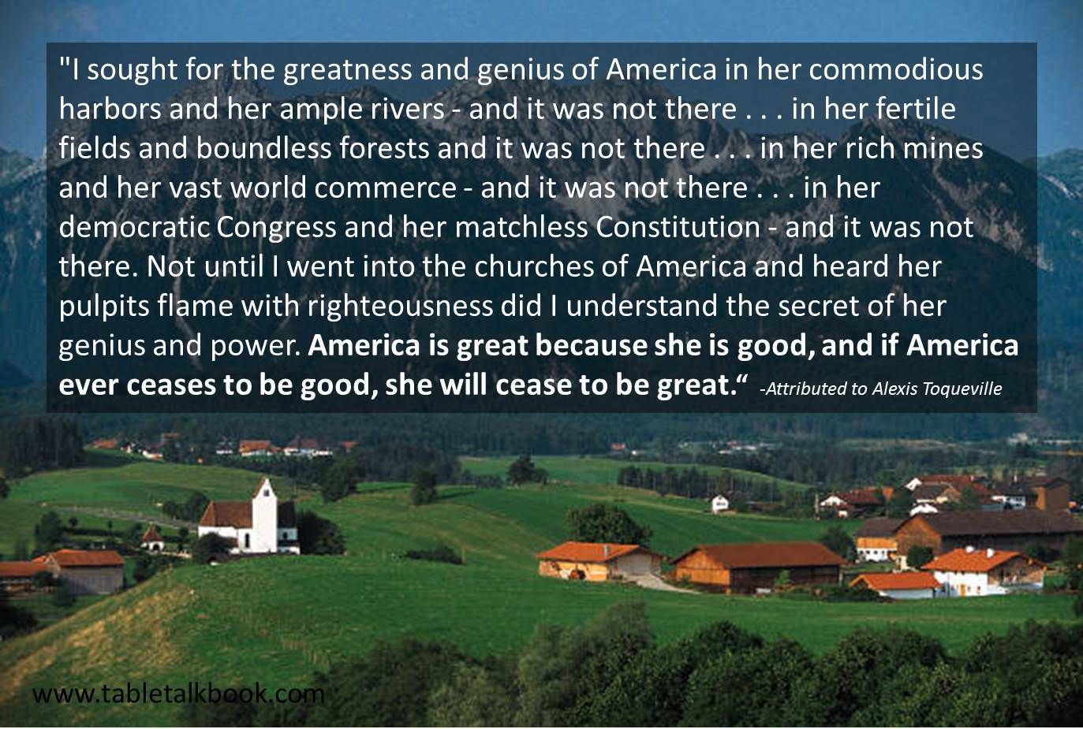
Action Steps – our churches must be ablaze again!
We can’t sit back. Our culture is making our faith political.
See “Exhibit GG – Democracy in America”

Slide 82
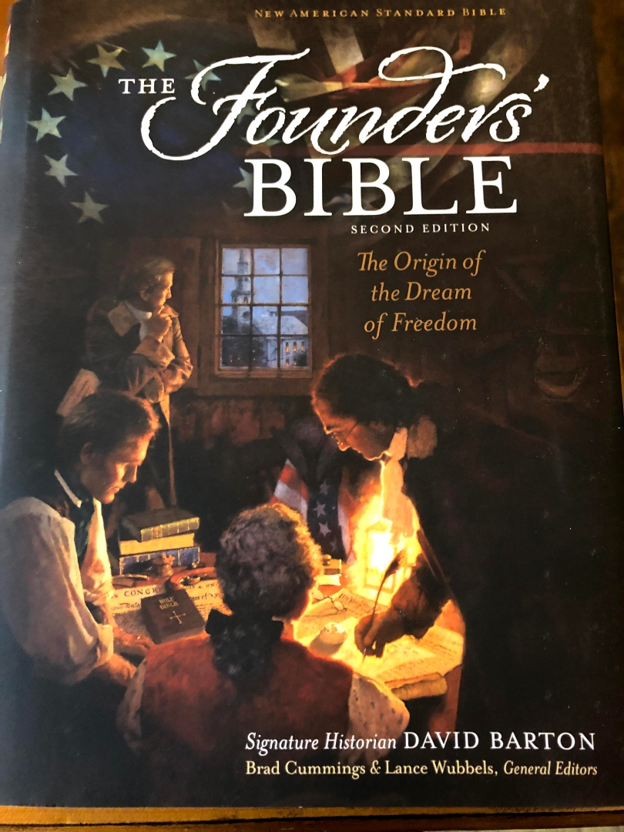
Want to know more on America’s Godly Heritage?
www.wallbuilders.com
www.wallbuilderslive.com
www.wallbuilders.com/fof
www.patriotacademy.com
Purchase a Founder’s Bible

Slide 83
Action Steps
We are in a war for our very souls, our children’s souls, our grandchildren’s souls, and the soul of our country.
Get informed today: marciaalennick.com.wixsite.com/mysite/the-church-and-the-culture
Get a Biblical worldview from the Family Research Council’s Biblical Worldview Institute: www.frc.org/worldview
See the following exhibits:
  BWV Exhibit 1 – Human Sexuality
  BWV Exhibit 2 – Religious Liberty
  BWV Exhibit 3 – Political Engagement
  BWV Exhibit 4 – Pro-life Engagement
  BWV Exhibit 5 – A Parent’s Guide to the Transgender Movement in Education
  BWV Exhibit 6 – Stem Cell Research
  BWV Exhibit 7 – The Biblical Foundation for Christian Zionism
  BWV Exhibit 8 – CRT - Hillsdale

Slide 84

Which one are you? Which one will you be? Remember… “To Whom Much is given, much is expected”

Slide 85
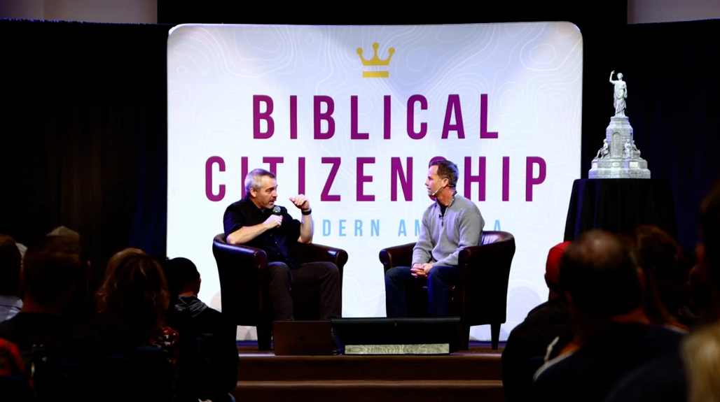
Sign up for a class!
Marciaalennick.wixsite.com/mysite/history-classes
Marciaalennick.wixsite.com/mysite/calendar-and-events
www.biblicalcitizens.com

Slide 86


Slide 87
Pastors must engage!
Coach.patriotacademy.com/pastor
Pastors must be part of the Black Robe Regiment
Wallbuilders.com/no-professor-fea-founders-not-want-
Ministers-stay-politics/

