Slide 1
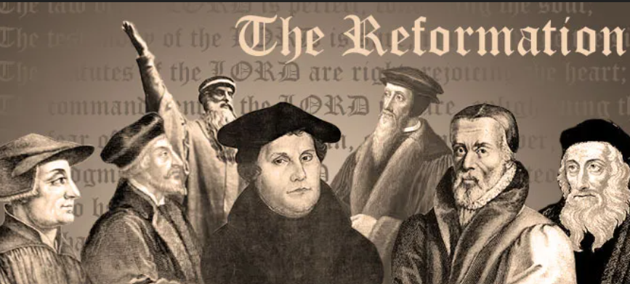
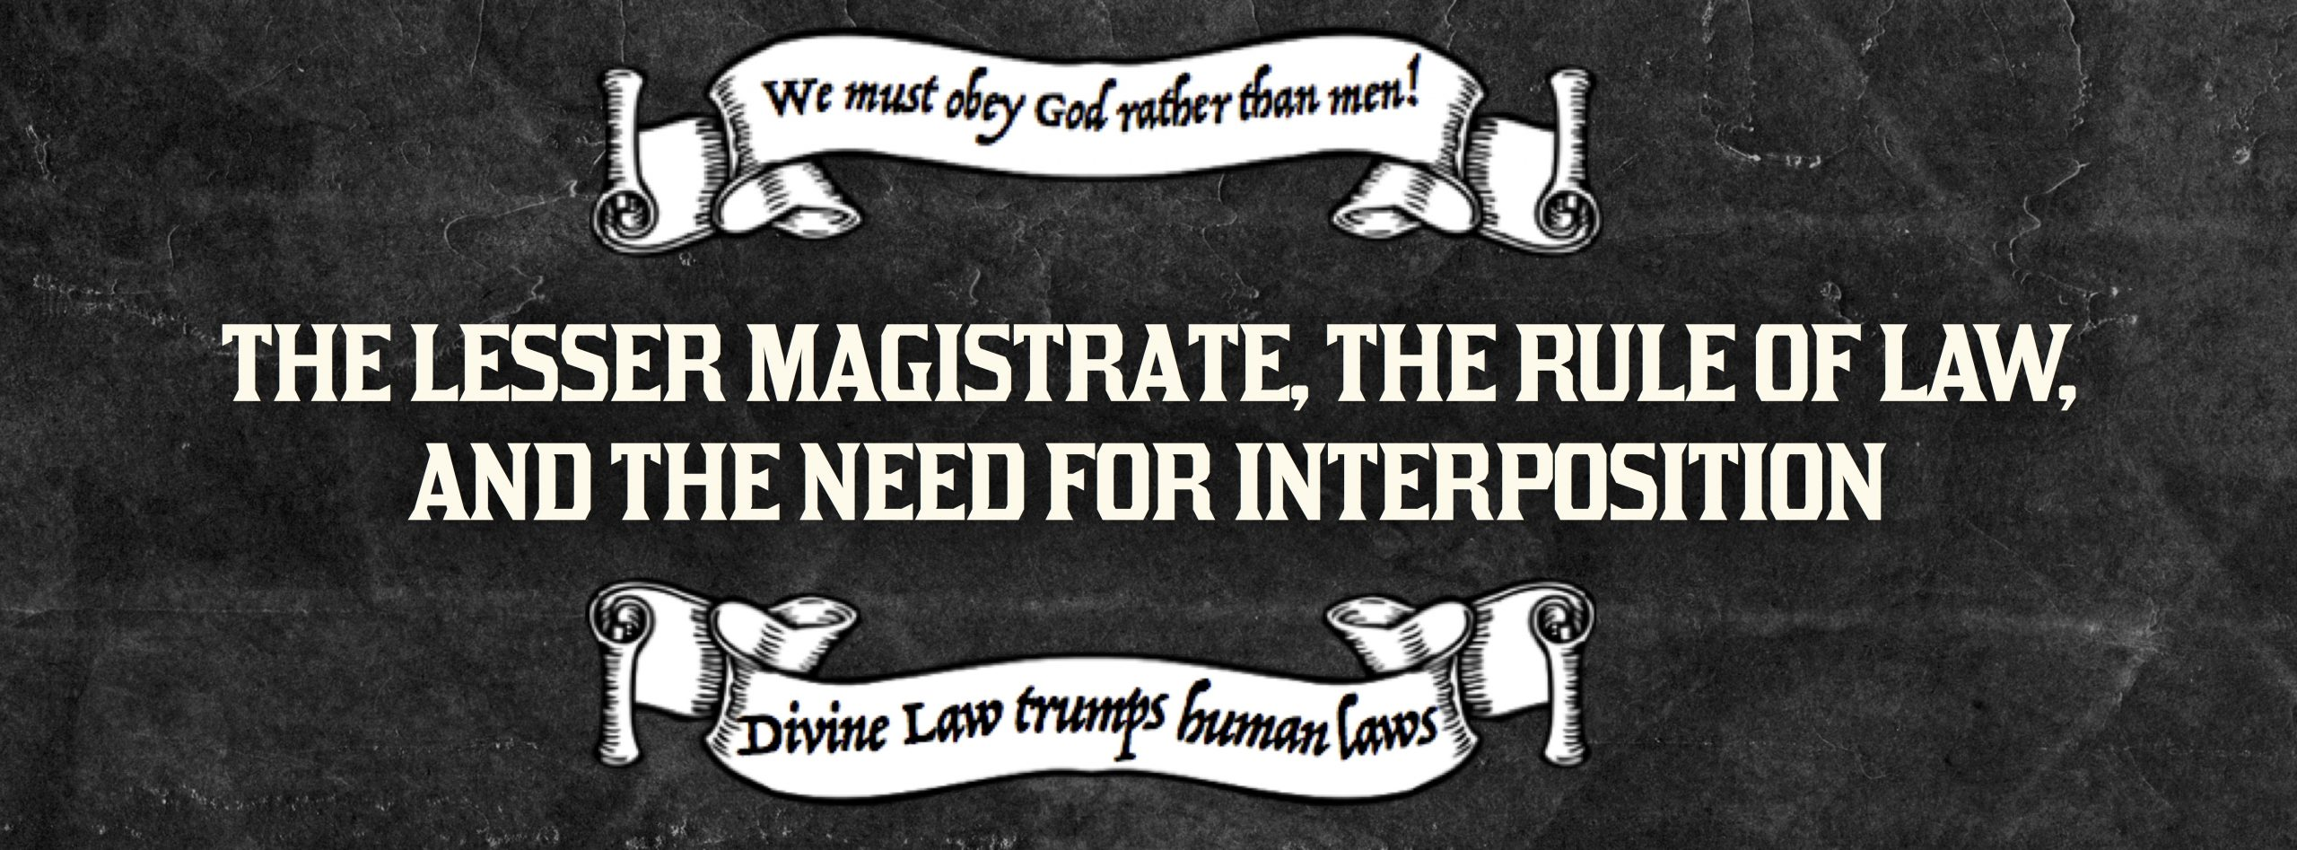
A CRASH COURSE ON THE PROTESTANT REFORMATION AND THE DOCTRINE OF LESSER MAGISTRATES

Slide 2
A CRASH COURSE ON THE PROTESTANT REFORMATION AND THE DOCTRINE OF LESSER MAGISTRATES
Every year, many celebrate Halloween. Why don't we take the time to celebrate the Protestant Reformation? After all, 10/31/1517, the 95 Thesis were nailed by Luther. Did you know the Reformation almost failed 30 years later, but a little town of Magdeburg instituted the Doctrine of Lesser Magistrates.... the lower magistrates told the higher magistrates they were in the wrong and the lower magistrates stood their ground! Once again history proves "Rebellion to Tyrants is Obedience to God".

Slide 5
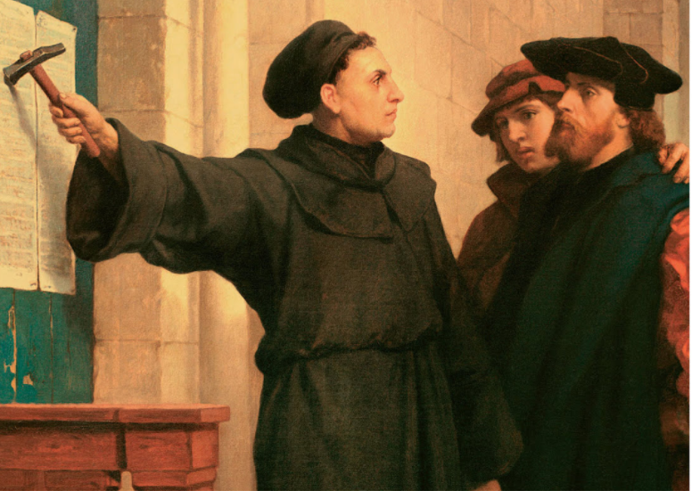

Slide 6
Join Kirk Cameron around the campfire as he guides you through The American Covenant: The Untold Story, the book that millions of people studied while gathered virtually in Kirk’s backyard, starting the movement now known as the American Campfire Revival. Now in quick video lessons designed for group discussion, Kirk is joined around the fire by author Marshall Foster, and together, they will guide you through the miraculous beginnings of America, revealing its life-giving secrets and forgotten covenants, while setting a road map for today to defeat the darkness and stir a passion for liberty! 5 week class. The information on the next few pages is a summary from this class. Go to www.constitutioncoach.com today to find a class.

Slide 7
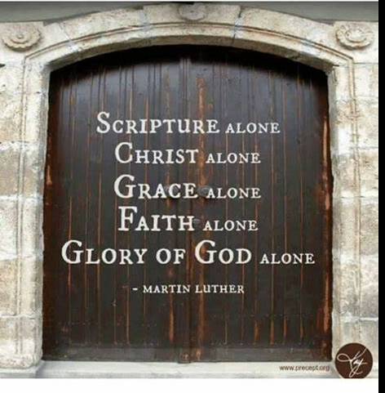
THE PROTESTANT REFORMATION
-1381: SEEDS OF THE REFORMATION WERE PLANTED BY JOHN WyCLIFFE. HE TRANSLATED THE BIBLE FROM LATIN TO ENGLISH
-1436: GUTENBERG PRINTING PRESS INVENTED WHICH WOULD GET THE BIBLE IN THE HANDS OF THE PEOPLE, WHICH WOULD SET THE REFORMATION ABLAZE.
-1492-COLUMBUS SAILS THE OCEAN BLUE
-1517: LUTHER POSTS HIS 95 THESIS
-1525: TYNDALE TRANSLATED THE NEW TESTAMENT FROM GERMANY TO THE ENGLISH OF HIS DAY
-1538 – 1541: KING HENRY THE VIII DISTRIBUTES THE BIBLE AND AT THE SAME TIME LUTHER, CALVIN ZWINGLI AND OTHERS ARE COMING TO THE RISE. WITH THEIR RISE, THEY EXPLAIN IT IS OKAY TO RESIST TYRANNY, WHICH PLANTED THE SEEDS FOR THE PILGRIMS. THE PILGRIMMS WERE KNOWN AS THE SEPARTISTS.

Slide 8
THE PROTESTANT REFORMATION
-1550: THE MAGDEBURG CONFESSION OCCURS – THE FIRST TIME IN WORLD HISTORY WE SEE THE DOCRINE OF LESSER MAGISTRATES.
-1599: GENEVA BIBLE IS CREATED
-1603: KING JAMES TAKES THE THRONE AND WANTS TO KILL PEOPLE AND THE PILGRIMS FLEE TO HOLLAND
-1611: KJV BIBL IS CREATED
-1620: PILGRIMS (SEPARTISTS) LAND WITH THEIR OWN BIBLE (THE GENEVA BIBLE)
-1630: PURITANS ARRIVE IN AMERICA
-I WOULD RECOMMEND THE MOVIE “MONUMENTAL” BY KIRK CAMERON AS HE BREAKS DOWN THE PASTORS OF PILGRIMS

Slide 9
THE PROTESTANT REFORMATION
-1703- THE FAMOUS JONATHAN EDWARDS IS BORN
-1741- THE FAMOUS SERMON TO START THE FIRST GREAT AWAKENING “THE SINNER IN
THE HAND’S OF AN ANGRY GOD” IS PREACHED BY JONATHAN EDWARDS. OTHER GREAT PASTORS TO LOOK UP: JOHN ROBINSON, THOMAS HOOKER, PASTOR JONATHAN MAYHEW, WHITEFIELD, FREDERICK DOUGLASS, JOHN WISE, JONAS CLARK, MUHLENBERG BROTHERS.
-1770’S BOSTON MASSACRE HAPPENS (SOME HISTORIANS POINT TO THIS BEING THE START OF THE AMERICAN REVOLUIONARY WAR), INDEPENDENCE DAY, CONSTITUITON RATIFIED, BILL OF RIGHTS RATIFIED, THE FIRST WAR ON TERROR HAPPENING – TRIPOLI (1805)
-THE SEEDS THE PILGRIMS PLANTED WOULD CONTINUE ON AS IN 1806, THE HAYSTACK PRAYER MEETING WOULD OCCUR, WHICH WAS THE BEGINNING OF THE MODERN MISSIONARY MOVEMENT IN AMERICA.

Slide 10
BY: PASTOR TREWHELLA
Many Americans seem to know that America's founders gave us three boxes through which we can resist tyranny, namely - the ballot box, the jury box, and the cartridge box. But a lesser-known tool which the founders themselves employed is the lesser-magistrate doctrine.
Simply put, the lesser-magistrate doctrine declares that - when a magistrate, who is lower in authority than another higher authority, opposes and/or resists the unjust orders or laws of the higher authority, he is justified in doing so and his actions are morally right, proper, and legitimate (emphasis supplied).

Slide 11
BY: PASTOR TREWHELLA
For example, if Congress or the President makes an unjust or immoral edict, a state legislature or the governor could stand in defiance of their unjust edict and refuse to obey or implement it. They could in fact actively oppose it. Or for that matter, a city council or mayor could act in defiance or opposition of an unjust edict by a higher authority.
The lesser-magistrate doctrine became important to Christian men during the Reformation, though it had been spoken of and practiced prior to that by Christians. For example, the Magna Carta was written by a group of barons (lesser-magistrates) who had the tyrant King John of England sign it in the year 1215 at Runneymede, which is located southwest of London

Slide 12
BY: PASTOR TREWHELLA
This great document which stands in defiance of tyranny and oppression by making clear that the State has limitations and that all are subject to the law – people and state officials alike - was penned by Christian men.
Calvin spoke of the lesser-magistrate doctrine in his Institutes of the Christian Religion. Amazingly, he did not appeal to Scripture in his support of it, rather he appealed to pagan historical examples. But other Reformers did give a Scriptural foundation to the doctrine.

Slide 13
BY: PASTOR TREWHELLA
John Knox for example, in his Appellation written to the nobles of Scotland in 1558, cites many passages to support the doctrine. Knox wrote his appellation (appeal) to the nobles because the Roman church had condemned him and burned him in effigy. He wrote to declare to the nobles, as lesser-magistrates, their responsibility in protecting the innocent and opposing those who had made unjust decrees.
Knox makes it clear that it is the duty of lesser-magistrates to resist the tyranny of chief magistrates when the chief magistrate exceeds his God-given authority or actually makes declarations which are in rebellion to the law of God. (emphasis supplied).

Slide 14
BY: PASTOR TREWHELLA
He exhorts the nobles (lesser-magistrates) in his Appellation, "You are bound to correct and repress whatsoever you know him (the higher magistrate) to attempt expressly repugning to God's word, honor, glory, or what you shall espy him to do against his subjects great or small." Some of the Scripture texts Knox cites to expound on the lesser-magistrate doctrine are Daniel 3; I Kings 12; II Kings 11; and Jeremiah 26:10-16; 36:9-31; 37:11- 21 & 39:7-10.
The lesser-magistrate doctrine had a huge impact upon the thinking of our founders, and upon our nation's people regarding government and law. We however live in the midst of a statist, slave-like people where such thinking has long been forgotten. The magistrates themselves know nothing of this doctrine today because the pulpits have long been silent regarding it. (Emphasis supplied.)

Slide 15
BY: PASTOR TREWHELLA
He exhorts the nobles (lesser-magistrates) in his Appellation, "You are bound to correct and repress whatsoever you know him (the higher magistrate) to attempt expressly repugning to God's word, honor, glory, or what you shall espy him to do against his subjects great or small." Some of the Scripture texts Knox cites to expound on the lesser-magistrate doctrine are Daniel 3; I Kings 12; II Kings 11; and Jeremiah 26:10-16; 36:9-31; 37:11- 21 & 39:7-10.
The lesser-magistrate doctrine had a huge impact upon the thinking of our founders, and upon our nation's people regarding government and law. We however live in the midst of a statist, slave-like people where such thinking has long been forgotten. The magistrates themselves know nothing of this doctrine today because the pulpits have long been silent regarding it. (Emphasis supplied.)

Slide 16
BY: PASTOR TREWHELLA
If ever this nation needs to understand the lesser-magistrate doctrine, it is now. Immoral and unjust edicts are commonplace. The preborn are being murdered, and sodomy is being proliferated.
The assault upon our freedom and liberties is a daily undertaking by those in high office. The attacks upon the law of God are ferocious and relentless. In our nation today, the State has declared good to be evil and evil to be good. The lesser-magistrate has a duty before God to uphold the good regardless of the new definitions created by the State. (Emphasis supplied.)

Slide 17
BY: PASTOR TREWHELLA
We must remember that all authority is delegated. No man who holds State office rules autonomously. The authority he has is delegated to him by God. Hence, all those in positions of authority stand accountable to God. This is why the practice of the church historically has been – when the State commands that which God forbids or forbids that which God commands, we have a duty to obey God rather than man. The Bible clearly teaches this principle.
The lesser-magistrate is to apply this principle to his office as magistrate. When an unjust edict is made by a higher authority, the lesser-magistrate must choose to either join the higher magistrate in his rebellion against God, or stand with God in opposition to the unjust edict.
As our nation sinks more and more into rebellion and depravity, the lesser-magistrate doctrine needs to be taught more than ever. May the Lord grant us the strength and favor to do so.

Slide 18
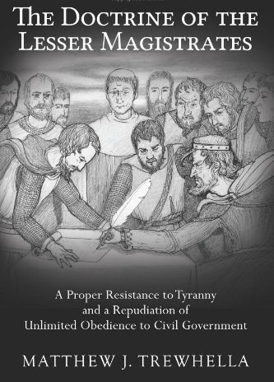

Slide 19
From anywhere in the world, you can stream the Patriot Academy (PA) Online Experience, world-class leadership training specializing in applied civics with a Biblical, historical, and Constitutional foundation. PA students develop leadership skills with an emphasis on character, courage, life purpose, and personal skills, underpinned by a founding fathers’ philosophy of governance. We are the premier political leadership training ground in the nation, with the most realistic simulated-legislative session available. Join us for this entertaining, educational, and inspirational experience. This class is yet TBD.

Slide 20
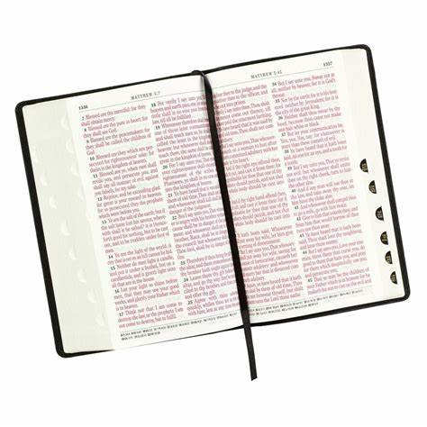
What does the Bible have to say about Biblical Confrontation?

Slide 21
Biblical Confrontation
From Wallbuilders Article
And just as history does not demand the exclusion of ministers, neither does the Bible. Consider how often God sent His ministers to publicly confront civil leaders or expose their wicked policies:
➢ Elijah confronted civil leaders Ahab and Queen Jezebel over issues such as their unjust use of eminent domain, religious persecution, and subornation of perjury (1 Kings 21:1-24, 1 Kings 18:18).
➢ Isaiah confronted civil ruler Hezekiah over national security failures and issues related to the treasury (1 Chronicles 32:27-31, 2 Kings 20:12-19)

Slide 22
Biblical Confrontation
From Wallbuilders Article
➢ Nathan confronted civil leader David over his wicked moral policies and practices (2 Samuel 12),
➢ Eliezer and Jehu confronted King Jehoshaphat over his blunders in foreign relations and ill-advised foreign alliances (2 Chronicles 19:1-2, 2 Chronicles 20:35-37)

Slide 23
Biblical Confrontation
From Wallbuilders Article
➢ John the Baptist confronted civil leaders for their hypocrisy (Matthew 3:7)
➢ Jeremiah confronted King Zedekiah over numerous of his wicked public policies (Jeremiah 34)
➢ John the Baptist confronted King Herod over his divorce and marriage practices (Luke 13:32. Matthew 12:23, 23:33, 23:27)

Slide 24
Biblical Confrontation
From Wallbuilders Article
➢ Samuel confronted King Saul over not fulfilling his assigned responsibilities (1 Samuel 13:1-14, I Samuel 15)
➢ Micaiah regularly confronted King Ahab over his wicked public policies (1 Kings 22:7-18)

Slide 25
Biblical Confrontation
From Wallbuilders Article
➢ Gad confronted King David over wrong-headed public policies stemming from his own pride and arrogance (2 Samuel 24)
➢ Jesus refused to be intimidated by Herod (Luke 13:31-32) and confronted the teachers of the law (Matthew 23)
➢ Daniel confronted Nebuchadnezzar over his pride and arrogance (Daniel 4:1-27), and Belshazzar over his moral debauchery (Daniel 5:17-28)

Slide 26
Biblical Confrontation
From Wallbuilders Article
➢ Azariah (along with eighty other priests) confronted King Uzziah for usurping religious practices through an improper expansion of government powers (2 Chronicles 26:16-21)
And God’s ministers not only called out bad civil leaders and pointed out unbiblical public policies, they also frequently partnered with civil leaders in constructing good public policies and offering sound guidance. For example:
➢ Elisha provided the King of Israel counsel and advice regarding military intelligence and policy (2 Kings 6)

Slide 27
Biblical Confrontation
From Wallbuilders Article
➢ Nathan provided guidance to David on architectural issues (2 Samuel 7:1-13)
➢ Ezra gave strong counsel on marriage policy (Ezra 9-10), and Governor Nehemiah implemented that counsel into public policy (Nehemiah 8:1-6, 13:23-27)
➢ Paul provided civil leaders with guidance during times of impending disaster and natural calamity (Acts 27:9-12)

Slide 28
Biblical Confrontation
From Wallbuilders Article
➢ Jeremiah provided military guidance to King Zedekiah (Jeremiah 21:1-10)
➢ King Joash pursued good policies as long as the priest Jehoiada provided him counsel, but when Joash lost that Godly input, his policies became wicked (2 Chronicles 24:1-2, 15-19)
➢ Isaiah provided guidance on national security issues and foreign policy to King Hezekiah (Isaiah 37)
These Biblical Examples on Confronting Evil came from this article:

Slide 29
www.starsandstripes316.com

