Slide 1
My Day in Court…. Learning some Tactical Civics! Presented by: Marcia A. Lennick 11/16/2022

Slide 2
The Greatest Day of History will ALWAYS be the Cross. After all history is His-Story!

Slide 3
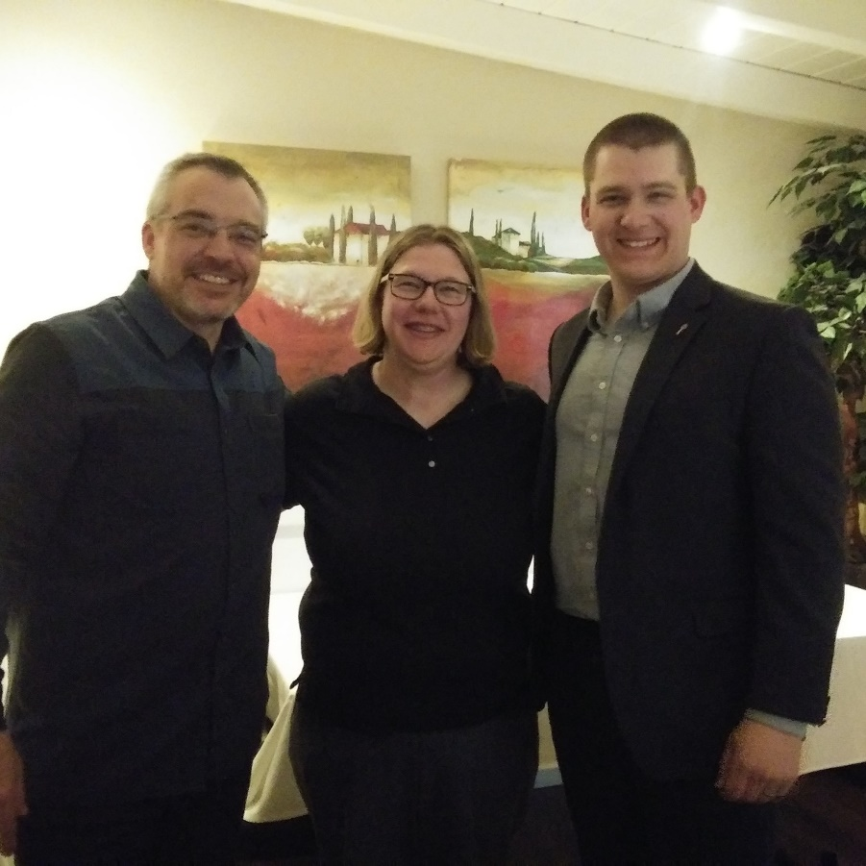
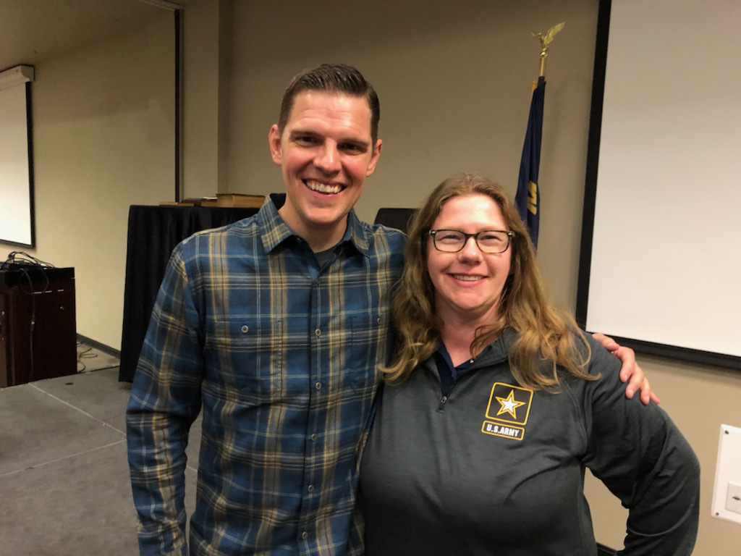
Who I am. My Why!
Notes:
-IN 2008, I WAS ASKED IF AMERICA WAS A CHRISTIAN NATION AND I HAD NO EVIDENCE TO REFUTE OTHERWISE, AND SINCE THEN I HAVE BEEN PUTTING AMERICA ON TRIAL. I STARTED DRATING MY OWN CURRICULUM AND SHARING THE INFORMATION I HAVE GAINED.
-I AM A CONSTIUTION COACH, BIBLICAL CITIZENSHIP COACH, CAMPFIRE COACH, PATRIOT ACADEMY CONSTITUTIONAL DEFENSE GRADUATE.

Slide 4
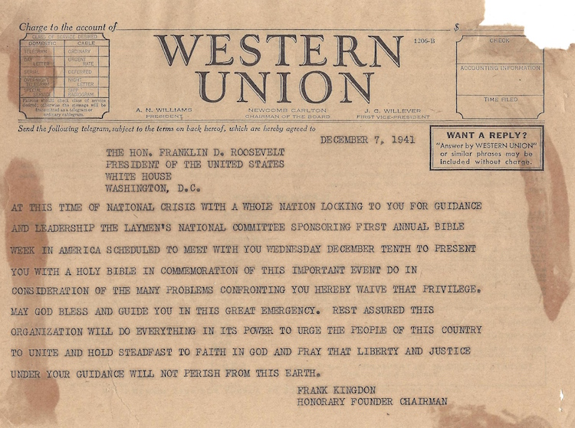

Slide 5
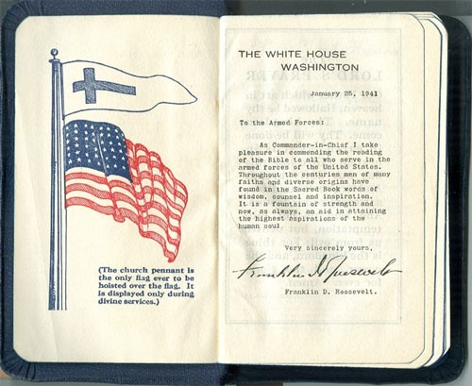
FDR Bible of WWII
Some will get upset that the Christian Flag is above the American Flag. Well, hold on. We have always been a nation of “God, Country, Family.” Our Founding Fathers understood that God is a God of order: In order for our families to be protected, we as a country need to be right with God. So the order God has set for nations is “God, Country, Family.”

Slide 6
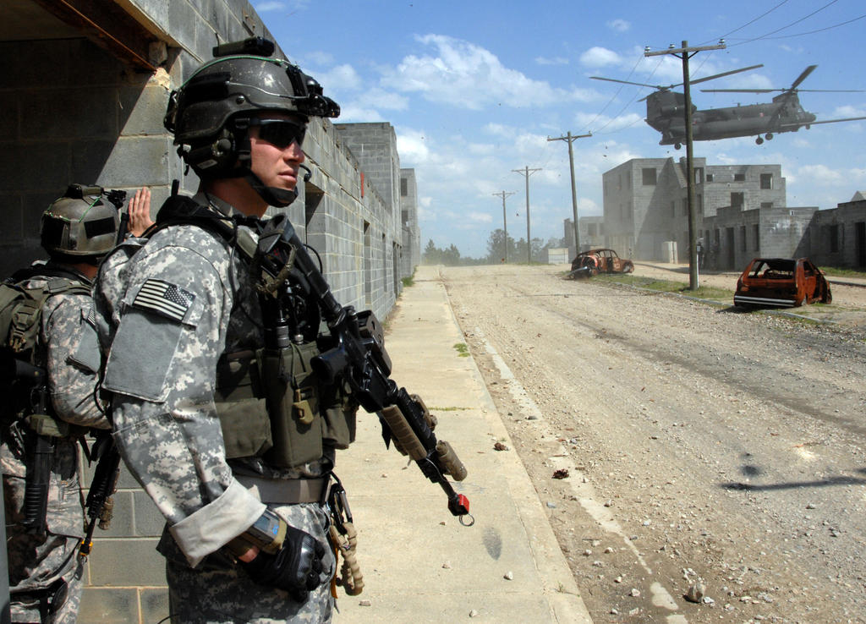
Which guy do you want fighting with you?

Slide 7
Why is it when a Christian person takes a lawsuit to court, they win? Simply put: America’s foundation! Some Tactical Civics I want you to walk away with tonight! -Original thought/ideology from the SCOTUS -Combatting lies of the enemy -American Exceptionalism -America’s Foundation -Tools to leave with Before we dive in to tonight, what is the difference between HISTORY and CIVICS?

Slide 8
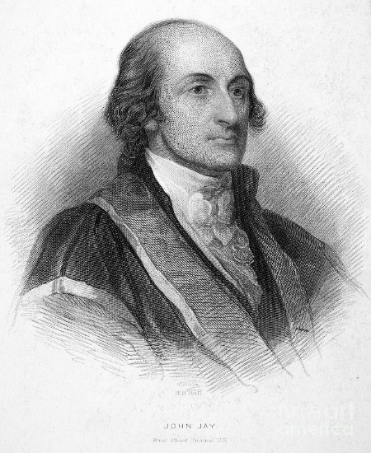
Every member of the State ought diligently to read and to study the constitution of his country, and teach the rising generation to be free. By knowing their rights, they will sooner perceive when they are violated, and be the better prepared to defend and assert them. John Jay – First Chief of the US Supreme Court
**Original thought/ideology from the SCOTUS**

Slide 11
How many of you can name some wins from SCOTUS or any other courts lately? -Bladensburg case -Coach Kennedy -2nd Amendment -Roe V. Wade -Judge in Texas will be able to keep prayer in Court… .why?
**Original thought/ideology from the SCOTUS**

Slide 12
Federalist 51: In republican government, the legislative authority necessarily predominates. Federalist 78: This simple view of the matter suggests several important consequences. It proves incontestably, that the judiciary is beyond comparison the weakest of the three departments of power
**Original thought/ideology from the SCOTUS**

Slide 13
Combatting Lies of the Enemy, Part 1

Slide 14
501(c)(3) training and Duty of the Citizen Cursory Review

Slide 16
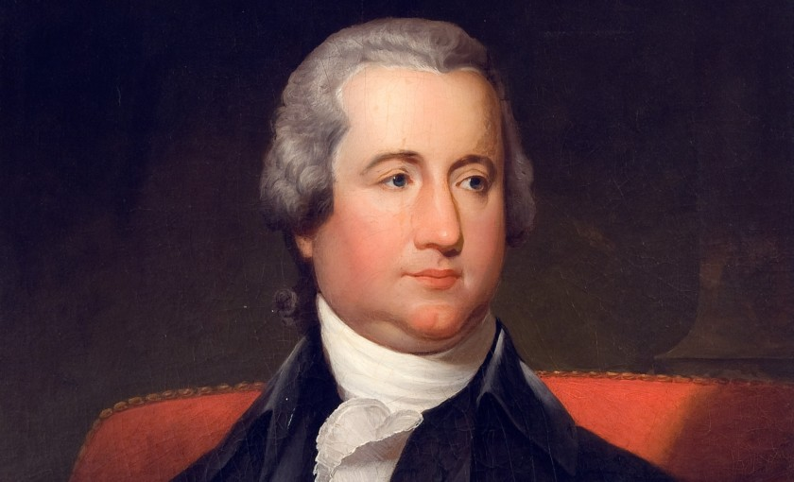
Who helped draft the First Amendment? Frederick Muhlenberg. Understanding the history of these two brothers. On the left Peter Muhlenberg and on the right, Frederick Muhlenberg.

Slide 17
LEGAL DO’S FOR CHURCHES
Do teach on moral issues and civic involvement
Do educate on political process and political/social/ legislative issues
Do distribute candidate surveys and incumbent voting records (avoid editorial opinions and make sure they cover a wide range of issues)
Do encourage members to voice their opinions in favor or in opposition to certain legislation*
Do discuss Biblical instruction pertaining to moral and cultural issues such as abortion, same-sex marriage, etc.

Slide 18
LEGAL DO’S FOR CHURCHES
• Do support or oppose judicial, department, or cabinet appointments
• Do support or oppose other political appointments of non-elected officials
• Do use church facilities by political candidates (as long as all other candidates are allowed or invited)
• Do hold petition drives supporting or opposing legislation
• Do support or oppose legislation unrelated to the church organization*
• Do support or oppose legislation that directly relates to the organization**
• Do engage in voter registration activities that avoid
promoting any one candidate or particular political party

Slide 19
LEGAL DONT’S FOR CHURCHES
• Don’t endorse or oppose political candidates
• Don’t contribute to Political Action Committees
• Don’t have a church bulletin editorial where the pastor or staff member endorses or opposes a candidate
• Don’t campaign for candidates
• Don’t grant use of a name to support a political candidate
• Don’t contribute to political candidates
• Don’t have in-kind and independent expenditures for
or against political candidate

Slide 20
LEGAL DO’S FOR
PASTORS
• Do preach on moral and social issues and encourage civic involvement
• Do engage in voter registration activities that avoid promoting any one candidate or particular political party
• Do distribute educational materials to voters (such as voter guides), but only those that do not favor a particular candidate or party and that cover a wide range of issues
• Do conduct candidate or issues forums where each duly qualified candidate is invited and provided an equal opportunity to address the congregation
• Do Invite candidates or elected officials to speak at
church services

Slide 21
LEGAL DONT’S FOR PASTORS
•Don’t endorse candidates on behalf of the church
•Don’t Use church funds or services (such as mailing lists or office equipment) to contribute directly to candidates or political committees
• Don’t permit the distribution of material on church premises that favors any one candidate or political party
•Don’t Use church funds to pay fees for political events
•Don’t Set up a political committee that would
contribute funds directly to political candidates
• Don’t Allow candidates to solicit funds while
speaking in a church

Slide 22
FYI
“Churches that allow only one candidate or a single party’s candidate to speak can be seen as favoring that candidate or party. No candidate should be prohibited from addressing a church if others running for the same office have been allowed to speak. Exempt from this are candidates or public figures who may speak at a church, but they must refrain from speaking about their candidacy.” Developed by: For Faith & Family Copyright 2007
All this info on legal do’s and don’ts are taken from
The Family Research Council

Slide 23
Combatting Lies of the Enemy, Part 2

Slide 24
We hear this famous Bible Scripture quoted all the time: “Render unto Caesar what is Caesar’s”. My question, should we be rendering unto Caesar what belongs to God? This is how our nation keeps getting messed up. We are of alignment with the boundaries God has ordained.

Slide 25
Combatting Lies of the Enemy, Part 3

Slide 26
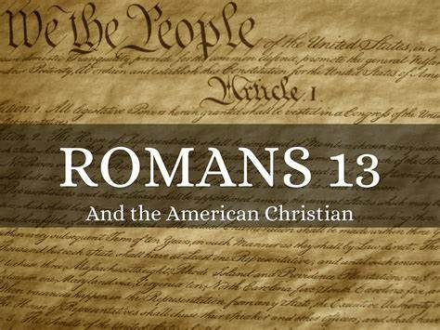
Did the Founding Fathers commit Biblical Rebellion to start the American Revolution? And should we just obey our government when we are a republic?
-Colonel Parker: “Stand your ground. Don’t fire unless fired upon, but if they mean to have a war, let it begin here.” 4/15/1775 – Battle of Lexington and Concord
-Castle Doctrine. –Exodus 22
-Who is in charge of the government in America?
For more information go to: https://marciaalennick.wixsite.com/mysite/interpreting-romans-13

Slide 27
Breaking myths in modern Christianity in America and Duty of the Christian Citizen in Modern America
-All issues are Biblical before political, regardless if our culture has made all issues political. We must still speak Biblical Truth.
-Understanding our Founding Fathers’ Biblical Worldview will help you live out your worldview.
-The Founding Fathers did not commit Biblical Rebellion accordance to Romans 13
-The Founding Fathers viewed that love of country is love of your neighbor because the better off your country is, the better off your neighbor will be
-We need to quit rendering unto Creaser the things that are God’s. In a Constitutional Republic, who is the governing authority?
-Have the heart of the Apostle Paul in Acts 22-26
-Pastor doesn’t lose his First Amendment when walking in to a Church
-Just because modern history says something is law doesn’t mean it is.

Slide 28
Breaking myths in modern Christianity in America and Duty of the Christian Citizen in Modern America
-For more information on these topics, please go to my website:
https://marciaalennick.wixsite.com/mysite/voterregistrationdriveforchurches
-I also have my other lecture series on my website for you. I also have a Church and Culture tab so you can be equipped on how to deal with The 1619 Project, Black Lives Matter, Was Jesus a Socialist, Christian Nationalism, The Dangers of Chrislam (the blending of Christianity and Islam).

Slide 29
Combatting Lies of the Enemy, Part 4

Slide 31
BY: PASTOR TREWHELLA
Many Americans seem to know that America's founders gave us three boxes through which we can resist tyranny, namely - the ballot box, the jury box, and the cartridge box. But a lesser-known tool which the founders themselves employed is the lesser-magistrate doctrine.
Simply put, the lesser-magistrate doctrine declares that - when a magistrate, who is lower in authority than another higher authority, opposes and/or resists the unjust orders or laws of the higher authority, he is justified in doing so and his actions are morally right, proper, and legitimate (emphasis supplied).

Slide 32
BY: PASTOR TREWHELLA
For example, if Congress or the President makes an unjust or immoral edict, a state legislature or the governor could stand in defiance of their unjust edict and refuse to obey or implement it. They could in fact actively oppose it. Or for that matter, a city council or mayor could act in defiance or opposition of an unjust edict by a higher authority.
The lesser-magistrate doctrine became important to Christian men during the Reformation, though it had been spoken of and practiced prior to that by Christians. For example, the Magna Carta was written by a group of barons (lesser-magistrates) who had the tyrant King John of England sign it in the year 1215 at Runneymede, which is located southwest of London

Slide 33
BY: PASTOR TREWHELLA
This great document which stands in defiance of tyranny and oppression by making clear that the State has limitations and that all are subject to the law – people and state officials alike - was penned by Christian men.
Calvin spoke of the lesser-magistrate doctrine in his Institutes of the Christian Religion. Amazingly, he did not appeal to Scripture in his support of it, rather he appealed to pagan historical examples. But other Reformers did give a Scriptural foundation to the doctrine.

Slide 34
BY: PASTOR TREWHELLA
John Knox for example, in his Appellation written to the nobles of Scotland in 1558, cites many passages to support the doctrine. Knox wrote his appellation (appeal) to the nobles because the Roman church had condemned him and burned him in effigy. He wrote to declare to the nobles, as lesser-magistrates, their responsibility in protecting the innocent and opposing those who had made unjust decrees.
Knox makes it clear that it is the duty of lesser-magistrates to resist the tyranny of chief magistrates when the chief magistrate exceeds his God-given authority or actually makes declarations which are in rebellion to the law of God. (emphasis supplied).

Slide 35
BY: PASTOR TREWHELLA
He exhorts the nobles (lesser-magistrates) in his Appellation, "You are bound to correct and repress whatsoever you know him (the higher magistrate) to attempt expressly repugning to God's word, honor, glory, or what you shall espy him to do against his subjects great or small." Some of the Scripture texts Knox cites to expound on the lesser-magistrate doctrine are Daniel 3; I Kings 12; II Kings 11; and Jeremiah 26:10-16; 36:9-31; 37:11- 21 & 39:7-10.
The lesser-magistrate doctrine had a huge impact upon the thinking of our founders, and upon our nation's people regarding government and law. We however live in the midst of a statist, slave-like people where such thinking has long been forgotten. The magistrates themselves know nothing of this doctrine today because the pulpits have long been silent regarding it. (Emphasis supplied.)

Slide 36
BY: PASTOR TREWHELLA
He exhorts the nobles (lesser-magistrates) in his Appellation, "You are bound to correct and repress whatsoever you know him (the higher magistrate) to attempt expressly repugning to God's word, honor, glory, or what you shall espy him to do against his subjects great or small." Some of the Scripture texts Knox cites to expound on the lesser-magistrate doctrine are Daniel 3; I Kings 12; II Kings 11; and Jeremiah 26:10-16; 36:9-31; 37:11- 21 & 39:7-10.
The lesser-magistrate doctrine had a huge impact upon the thinking of our founders, and upon our nation's people regarding government and law. We however live in the midst of a statist, slave-like people where such thinking has long been forgotten. The magistrates themselves know nothing of this doctrine today because the pulpits have long been silent regarding it. (Emphasis supplied.)

Slide 37
BY: PASTOR TREWHELLA
If ever this nation needs to understand the lesser-magistrate doctrine, it is now. Immoral and unjust edicts are commonplace. The preborn are being murdered, and sodomy is being proliferated.
The assault upon our freedom and liberties is a daily undertaking by those in high office. The attacks upon the law of God are ferocious and relentless. In our nation today, the State has declared good to be evil and evil to be good. The lesser-magistrate has a duty before God to uphold the good regardless of the new definitions created by the State. (Emphasis supplied.)

Slide 38
BY: PASTOR TREWHELLA
We must remember that all authority is delegated. No man who holds State office rules autonomously. The authority he has is delegated to him by God. Hence, all those in positions of authority stand accountable to God. This is why the practice of the church historically has been – when the State commands that which God forbids or forbids that which God commands, we have a duty to obey God rather than man. The Bible clearly teaches this principle.
The lesser-magistrate is to apply this principle to his office as magistrate. When an unjust edict is made by a higher authority, the lesser-magistrate must choose to either join the higher magistrate in his rebellion against God, or stand with God in opposition to the unjust edict.
As our nation sinks more and more into rebellion and depravity, the lesser-magistrate doctrine needs to be taught more than ever. May the Lord grant us the strength and favor to do so.

Slide 39
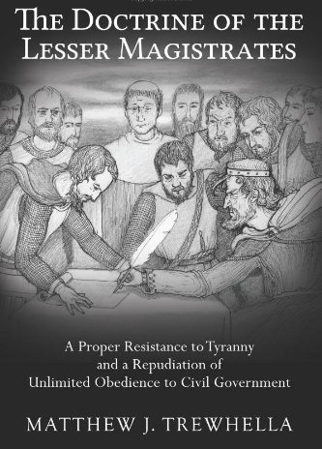

Slide 40
Combatting Lies of the Enemy, Part 5

Slide 41
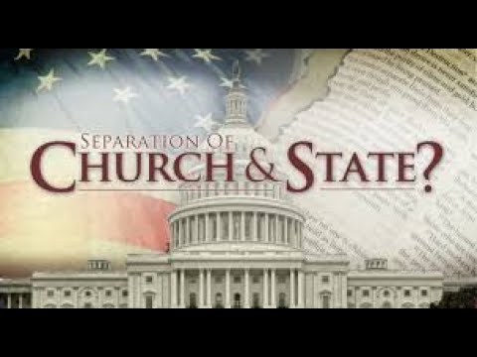
Separation of Church and State
Different types of government:
totalitarianism: communistic/socialistic and led by a dictator or a czar (Emperors – Lk: 2:1; Caesars – Mk 12:17; Pharaohs: Ex:1-14).
monarchy: king or queen get to dictate.
republic and constitutional republic (Ex. 18:21; Deut. 1:15-16; 16:18)
Oligarchy: power is in elite few (Sanhedrin Lk. 22:66).
anarchy or revolutionary: government without laws and power is in each individual and we all do what is right in our own eyes (Deut. 12:8; Judges 17:6; 21:25).
democracy: majority rules (Matt. 27:21).
theocracy: where representatives say they here from God and these are His direct steps – without a proper view of Separation of Church and State. This is the reason why we left Great Britain.

Slide 42
Separation of Church and State
America is Republic form of Government:
Article 4, Section 4, of the US Constitution: The United States shall guarantee to every State in this Union a Republican Form of Government, and shall protect each of them against Invasion; and on Application of the Legislature, or of the Executive (when the Legislature cannot be convened) against domestic Violence.
"When you become entitled to exercise the right of voting for public officers, let it be impressed on your mind that God commands you to choose for rulers just men who will rule in the fear of God. The preservation of a republican government depends on the faithful discharge of this duty”.
Noah Webster, 1832, History of the United States.

Slide 43
Separation of Church and State
Lets talk about Separation of Church and State. It is not what modern folks think it is – that the Church can DOMINATE the government, but it also is not the idea that folks cannot express their religious views in the public square.
We are not a theocracy. We are not an oligarchy or a monarchy or an anarchy. We believe in the people’s right to choose their leaders, and there should not be a special group of people in charge either. Anarchy would be purely scary – so government has a job to establish rule and order.
Deuteronomy 15:11 tells us that the poor will always be among us. God gave certain instructions for the Israelites and how to care of the poor. For example, if the owner of the land gleaned a field, and they forgot certain produce, they were to leave it for the poor to come and get it.

Slide 44
Separation of Church and State
The individual and the Church are responsible to assist the poor with food, clothing, physical effects of this nature. The priest could grant proportional relief to an individual after determining the need of an individual.
Individually: Deuteronomy 15:7-8, 10-11; Matthew 25:34-40.
Church: Leviticus 27:8; Acts 4:34-35.
The government's job is to provide justice to the poor and to maintain the rights of the poor.
Exodus 23:3,6; Leviticus 19:15; Proverbs 29:14.

Slide 45
Separation of Church and State
Truth behind Separation of Church and State
When drafting the First Amendment – and Separation of Church and State:
there is nothing in legislative intent with the journals.
Jefferson paid the Marine Marching band to play hymns.
Jefferson funded Bible Studies.
Jefferson had his own Bibles printed (1804 and 1820 versions).
Jefferson actually attended Church on Capitol Hill two days AFTER drafting Separation of Church of and State letter.

Slide 46
Separation of Church and State
Since this was Jefferson’s view concerning religious expression, in his short and polite reply to the Danbury Baptists on January 1, 1802, he assured them that they need not fear; that the free exercise of religion would never be interfered with by the federal government. As he explained:
“Gentlemen, – The affectionate sentiments of esteem and approbation which you are so good as to express towards me on behalf of the Danbury Baptist Association give me the highest satisfaction. . . . Believing with you that religion is a matter which lies solely between man and his God; that he owes account to none other for his faith or his worship; that the legislative powers of government reach actions only and not opinions, I contemplate with sovereign reverence that act of the whole American people which declared that their legislature should “make no law respecting an establishment of religion or prohibiting the free exercise thereof,” thus building a wall of separation between Church and State. Adhering to this expression of the supreme will of the nation in behalf of the rights of conscience, I shall see with sincere satisfaction the progress of those sentiments which tend to restore to man all his natural rights, convinced he has no natural right in opposition to his social duties. I reciprocate your kind prayers for the protection and blessing of the common Father and Creator of man, and tender you for yourselves and your religious association assurances of my high respect and esteem.”

Slide 47
Separation of Church and State
In 1947, in the case Everson v. Board of Education, the Supreme Court declared, “The First Amendment has erected a wall between church and state. That wall must be kept high and impregnable. We could not approve the slightest breach.” The “separation of church and state” phrase which they invoked, and which has today become so familiar, was taken from an exchange of letters between President Thomas Jefferson and the Baptist Association of Danbury, Connecticut, shortly after Jefferson became President.
-We need to understand Jefferson helped draft the Dec. of Independence (1776), not the Constitution (1787), not the Bill of Rights (1791), Separation of Church and State Letter (1802)
Three separate documents. Not many folks realize these are three separate documents.
When the Constitution was drafted Jefferson was not in the USA.

Slide 48
Separation of Church and State
Some of you might be wondering what can I do about this? Can my child or grandchild pray over his or her meal at lunchtime or a football game? Well, yes.
Catholics for Freedom of Religion is a great organization. Being used in Long Island. Informing people of their rights. Did you know the school can lose their federal funding for not allowing your child or grandchild to not pray?
Inform your local school board.
Live out your freedoms, but protect your liberties.

Slide 49
Separation of Church and State
First Amendment from The Bill of Rights:
Congress shall make no law respecting an establishment of religion, or prohibiting the free exercise thereof; or abridging the freedom of speech, or of the press, or the right of the people peaceably to assemble, and to petition the Government for a redress of grievances.
Our founding fathers never wanted a theocracy (establishment clause). Our founding fathers wanted us to be able to live out our religious faith (free exercise clause).
-Exhibit S– No the Founding Fathers Did Not Want Pastors to Stay out of Politics
-Exhibit T – The FF on the Bible and Jesus
-Exhibit U – Separation of Church and State
All exhibits are from America’s Unknown Known History on this slide

Slide 50
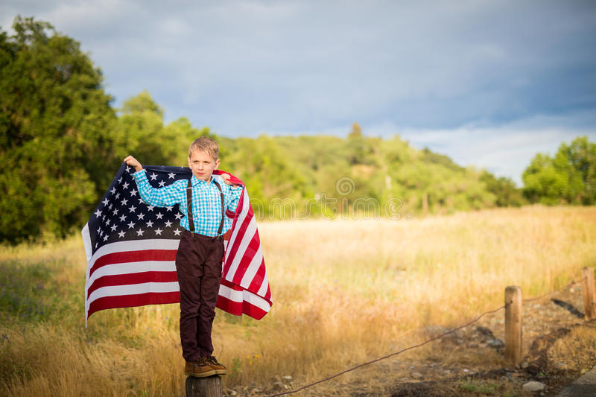
American Exceptionalism
A few questions to ask yourself: 1) can we continue down this moral decay and continue as a nation? 2) can we continue on down this path of financial debt? 3) is our hope in American politics or the God that America was founded upon? 4) can we stop Bible prophecy? 5) is America listed in Bible prophecy?

Slide 51
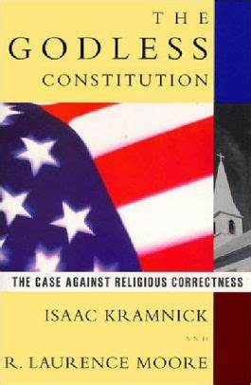
Debunking our Godless Constitution
This book is about ½ inch thick and does not contain footnotes. Can you imagine turning in an essay to your teacher without footnotes?

Slide 52
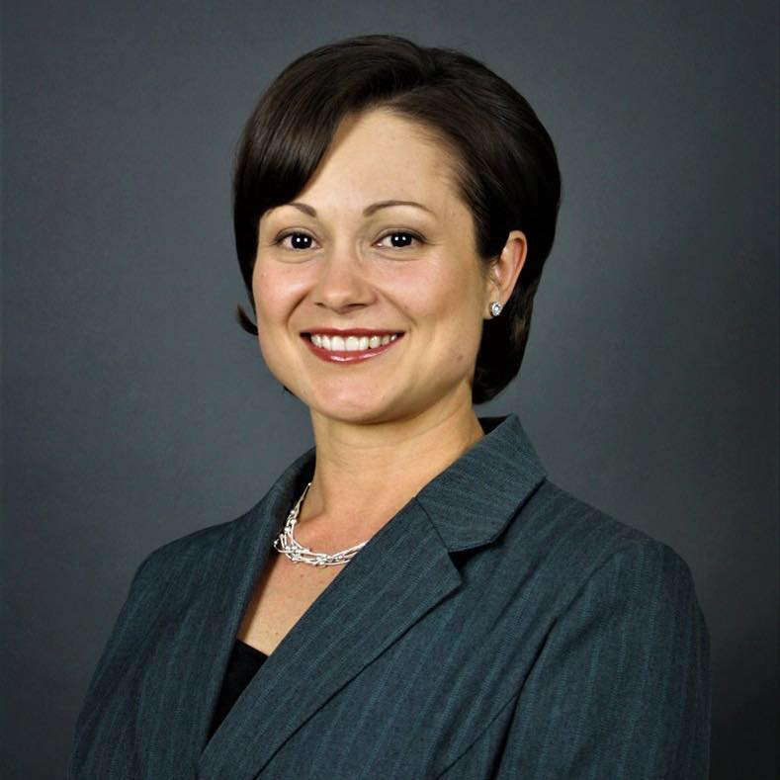
American Exceptionalism
What other country are these three scenarios possible?
Anna – born and raised in the USA, now a missionary in Africa.
Monica – born and raised in socialist Romania and won the American lottery and came to America. Former dental assistant, now realtor, and her family has appeared on the television show: “The Righteous Gemstones.”
Gloire – a legal immigrant from Africa, whose book Grow Up Church was # 1 on Amazon in Church growth.

Slide 53
American Exceptionalism

Slide 54
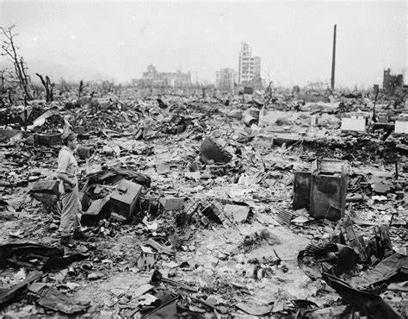
American Exceptionalism
Did you know in WWII, America dropped leaflets on Japan warning them of the bomb?

Slide 55
America’s Foundation, cursory review. I would recommend other lecture series on my website for further study.

Slide 56
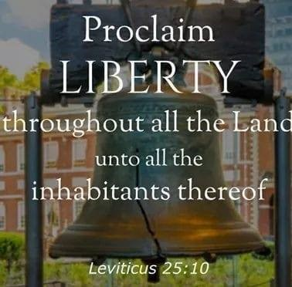
Fun Facts on American History -How the Liberty Bell got its name

Slide 57
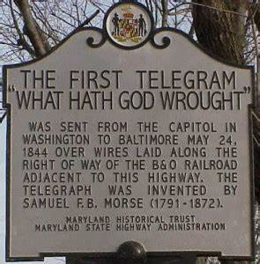
Fun Facts on American History -What was the first sentence sent via Morse Code?
See Exhibit J – Morse Code. This exhibit can be found on my website under America’s Unknown Known History.

Slide 58
Fun Facts on American History -Our Form of Government was inspired by Scripture
Our Republican form of government:
Exodus 18:21-22 (NASB):
²¹ Furthermore, you shall ^{[a]}select out of all the people able men who fear God, men of truth, those who hate dishonest gain; and you shall place these over them as leaders of thousands, ^{[b]}of hundreds, ^{[c]}of fifties and ^{[d]}of tens.
Thousands, hundreds, fifties and of tens are our different levels of government (city, county, state, federal).

Slide 59
Fun Facts on American History -Our Form of Government was inspired by Scripture
Our three branches of government:
Isaiah 33:22 (NASB):
²² For the Lord is our judge, The Lord is our lawgiver, The Lord is our king; He will save us—
Judge (judicial); lawgiver (legislative); king (executive).
Separation of Powers:
Jeremiah 17:9 (NASB):
“The heart is more deceitful than all else And is desperately sick; Who can understand it?
The founders wanted each branch to keep each other accountable because to much power wielded to the wrong person/branch can lead to disaster. The heart is deceitful.

Slide 60
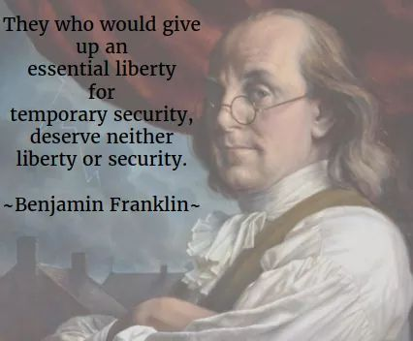
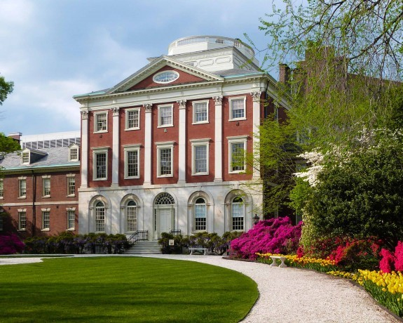
Benjamin Franklin
-Least religious founding father.
-1 of 6 to sign both The Dec. of Independence and The Constitution.
America’s First Hospital.
The Pennsylvania Hospital.
Founded by Benjamin Franklin, 1751.
The Logo was taken from the account of The Good Samaritan and reads: “Luke 10:35 ‘Take care of him and I will repay thee.”

Slide 61
Benjamin Franklin at The Constitutional Convention
Exhibit A: Franklin’s Appeal at the Constitutional Convention (this exhibit can be found on my website under America’s Unknown Known History)
Madison’s Journal originally contained a summary of Franklin’s words. However, in a later revision, he inserted the speech as written in Franklin’s own handwriting. It is the authoritative source concerning the Convention.
There were six signers that signed both The Constitution The Declaration of Independence. Franklin was one of these guys! In the second paragraph of his speech, the least religious founding father is asking for prayer!

Slide 62
Benjamin Franklin at The Constitutional Convention
In this situation of this Assembly, groping as it were in the dark to find political truth, and scarce able to distinguish it when presented to us, how has it happened, Sir, that we have not hitherto once thought of humbly applying to the Father of lights to illuminate our understandings? In the beginning of the Contest with G. Britain, when we were sensible of danger we had daily prayer in this room for the divine protection. ”Our prayers, Sir, were heard, and they were graciously answered. All of us who were engaged in the struggle must have observed frequent instances of a Superintending providence in our favor. To that kind providence we owe this happy opportunity of consulting in peace on the means of establishing our future national felicity. And have we now forgotten that powerful friend? I have lived, Sir, a long time, and the longer I live, the more convincing proofs I see of this truth- that God governs in the affairs of men. And if a sparrow cannot fall to the ground without his notice, is it probable that an empire can rise without his aid? We have been assured, Sir, in the sacred writings, that “except the Lord build the House they labour in vain that build it.”

Slide 63
Benjamin Franklin at The Constitutional Convention
How many Bible references can you choose from this one paragraph?
How many Bible references from the whole speech? I want to say 13 references, if my memory serves me correctly.
There used to be a time in American culture where we had sayings that came from the Bible. Well, today, these sayings exist, but folks may need understand or recognize they come from the Bible like:
“A birdie told me”.
“The writing is on the wall”.
How about the Golden Rule?
Good Samaritan Laws.

Slide 64
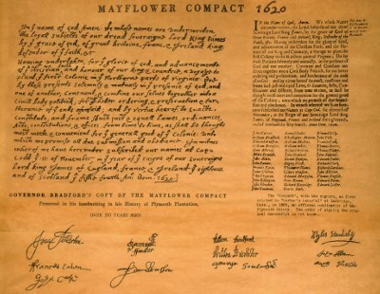
The Mayflower Compact
First governing document in America by 1620.
The reason the Pilgrims came to America was to advance the Christian faith.
Recommend Kirk Cameron’s “The American Covenant” “American Campfire Revival Series”

Slide 65
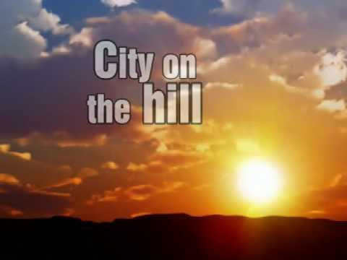
City on a Hill
Throughout America’s history, President’s reference that America will continually be a “City on a Hill.” Where did they get this idea?
Exhibit B – “A Model of Christian Charity”– City on a Hill -1630 (this exhibit can be found on my website under America’s Unknown Known History)

Slide 66
City on a Hill – 1630 – “A Model of Christian Charity”
John Winthrop, first governor of Massachusetts Bay In the spring of 1630, Winthrop sailed for Massachusetts aboard the Arbella. By the end of 1630, seventeen ships in all had carried about 1,100 settlers to the Puritan settlements in and around Boston. In the decades ahead, the “plantation,” as it was known, survived disease, Indian warfare, political and religious dissent, and the return migration of many clergymen and homesick settlers to flourish as a populous and prosperous colony in the slowly expanding empire of British North America. At some point, whether before or during the voyage is not known, Winthrop wrote “A Model of Christian Charity.” Drawing heavily from The Old and New Testaments, he exhorted his fellow colonists to strengthen the “bonds of affection” that would enable the Puritan community to fulfill its divine mandate. He offered them a “model,” or template, after which they ought to pattern their lives as Christian brothers and sisters. The document makes clear that Winthrop thought the stakes of failing to do so were very high. Over the past fifty years, the “Model of Christian Charity” has become one of the most frequently quoted documents in American history. But it remained unpublished from 1630 until 1838 and only gradually thereafter made its way into textbook accounts of America’s origins. No copy of the discourse in Winthrop’s handwriting survives. The earliest manuscript copy, held in the archives of the New York Historical Society, includes a cover page that provides almost all of the evidence we have linking the document to Governor Winthrop and to the Arbella’s voyage.

Slide 67
Thanksgiving!
Does anyone know when Thanksgiving used to be celebrated in America?
Why do we celebrate Thanksgiving?
Please come and see these Thanksgiving Proclamations replicas.
Which President made it an actual Holiday?
Exhibit G – File Folder of various Thanksgiving Proclamations ((this exhibit can be found on my website under America’s Unknown Known History)

Slide 68
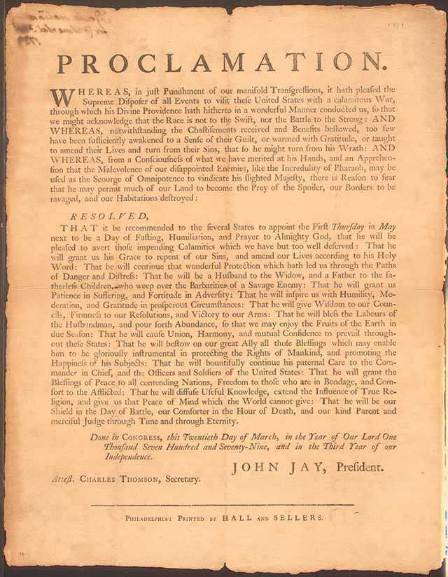

Slide 69
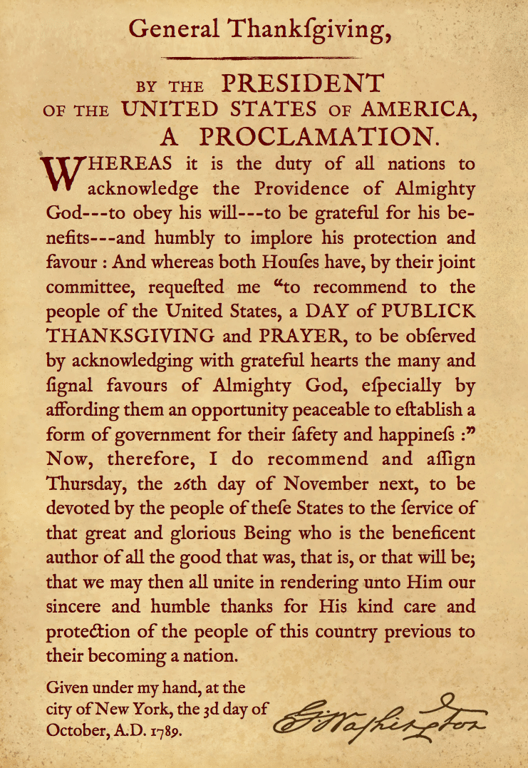

Slide 71
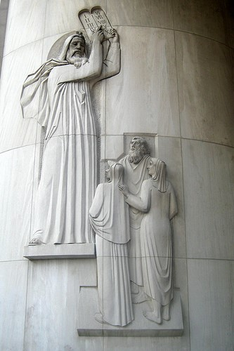
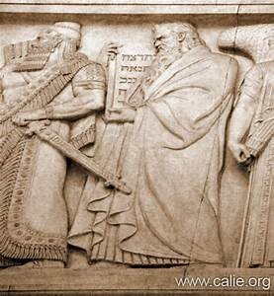
The Ten Commandments
ON THE LEFT;
The Ten Commandments pictured at the US Supreme Court.
ON THE RIGHT:
Moses giving the Israelites the Ten Commandments New York Supreme Court.

Slide 72
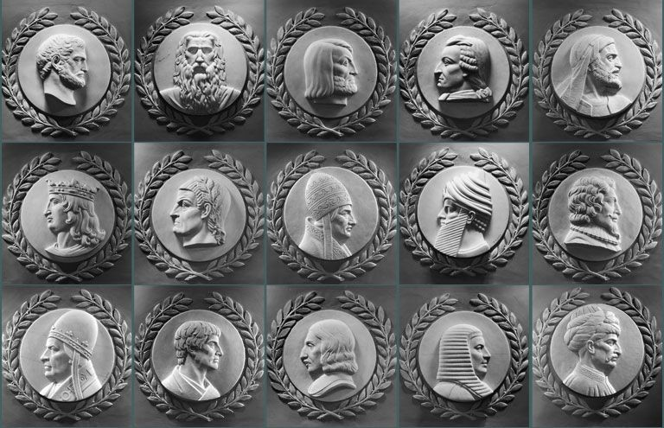
Many great lawgivers throughout time are shown here; however, Moses is the only one facing the Speaker of the House in the rotunda in our nation’s capitol.

Slide 73
Our Constitution Actually Obeys The Sabbath
Sundays Excepted Clause
The US Constitution, 1787, Article 1, Section 7, the President has ten days to sign a law, “Sundays excepted”
Article 1 - The Legislative Branch Section 7 - Revenue Bills, Legislative Process, Presidential Veto
“…If any Bill shall not be returned by the President within ten Days (Sundays excepted) after it shall have been presented to him…”

Slide 74
The Ten Commandments in American History
Honor the Sabbath
During the American Revolution, the Commander in Chief, George Washington ordered the Sabbath be observed: “The Commander in Chief directs that Divine service be performed every Sunday at 11 o’clock … it is expected that officers of all ranks will be their attendance set an example to their men.”
Following the Revolution, the states continued to Honor the Sabbath:
-Vermont, 10 part Sabbath Law, 1787 -Massachusetts, 11 part Sabbath Law, 1794 -Virginia, 8 part Law, written by Thomas Jefferson, 1792 -New Jersey, 21 part Sabbath Law, 1798 -New Hampshire, 14 part Sabbath Law, 1799 -Maine, 13 part Sabbath Law, 1821

Slide 75
The Ten Commandments in American History
Have No Other Gods
-First incorporated into the first written code of laws in America, Virginia Colony 1610, and Massachusetts of 1641, Connecticut 1642.
-If any man after legal conviction shall have or worship any other god but the Lord God, he shall be put to death. Deut. 13:6 & 10; 17:2 & 6; Ex. 22:20.
Have No Idols
-1680 law of New Hampshire.
-It is enacted by ye Assembly and ye authority thereof, yet if any person having had the knowledge of the true God openly and manifestly have or worship any other god but the Lord god, he shall be put to death. Ex: 22:20, Deut. 13:6, 10.

Slide 76
The Ten Commandments in American History
Do Not Murder
Massachusetts, 1641.
“Ex. 21:12, Numbers 35:13,14,30,31. If any person commit any willful murder, which is manslaughter committed upon premeditated malice, hatred, or cruelty not in a man’s necessary and just defense, not by mere casualty against his will, he shall be put to death. Ex. 21:14. If any person shall slay another through guile, either by poisoning or other such devilish practice, he shall be put to death.”

Slide 77
The Ten Commandments in American History
Honor Your Parents
Connecticut, 1642.
“If any child or children above sixteen years old and of sufficient understanding shall curse or smite their normal father or mother; he or they shall be put to death unless it can be sufficiently testified that the parents have been very unchristianly negligent in the education of children, or so provoke them by extreme and cruel correction that they have been forced thereunto to preserve themselves from death or maiming.” Ex. 21:17, Lev. 20, Ex. 20:12.

Slide 78
The Ten Commandments in American History
Do Not Commit Adultery
Massachusetts, 1641.
If any person committeth adultery with a married or espoused wife, the adultery and adulteress shall surely be put to death. Ex. 20:14.
Do Not Perjure Yourself
Connecticut,1642.
If any man rise up by false witness, wittingly and of purpose to take away any man’s life, he shall be put to death. Deut. 19:16, 18, 19.

Slide 79
Some tools to take home

Slide 80
Pastors in the American Revolution
Should Pastors be involved in politics?
Why or why not?
Black Robe Regiment
These were Pastors who would speak up from the pulpit during The American Revolutionary War.
Still exists today. Wallbuilders is trying to rebuild the Black Robe Regiment and inform Pastors on current topics and what to address from the pulpit.

Slide 81
If you want a copy of Alexis de Tocqueville's “Democracy in America” it is under my “Influence of the Bible in America” Exhibit GG

Slide 82
The seeds of Liberty were planted long before The Shot Heard Around the World
Did you know a Pastor helped form the Constitution of Connecticut? You read the right... Pastor Thomas Hooker on May 31st, 1638, would preach from Deuteronomy 1:13 which would establish the Fundamental Orders of Connecticut which would establish the Connecticut Constitution.
Deuteronomy 1:13 “Take you wise men, and understanding, and known among your tribes, and I will make them rulers over you.
Doctrine:
I. That the choice of public magistrates belongs unto the people by God’s own allowance.
II. The privilege of election which belongs unto the people therefore, must not be exercised according to their humors, but according to the blessed will and law of God.
III. They who have power to appoint officers and magistrates, it is their power, also, to set the bounds of the power and place unto which they call them.

Slide 83
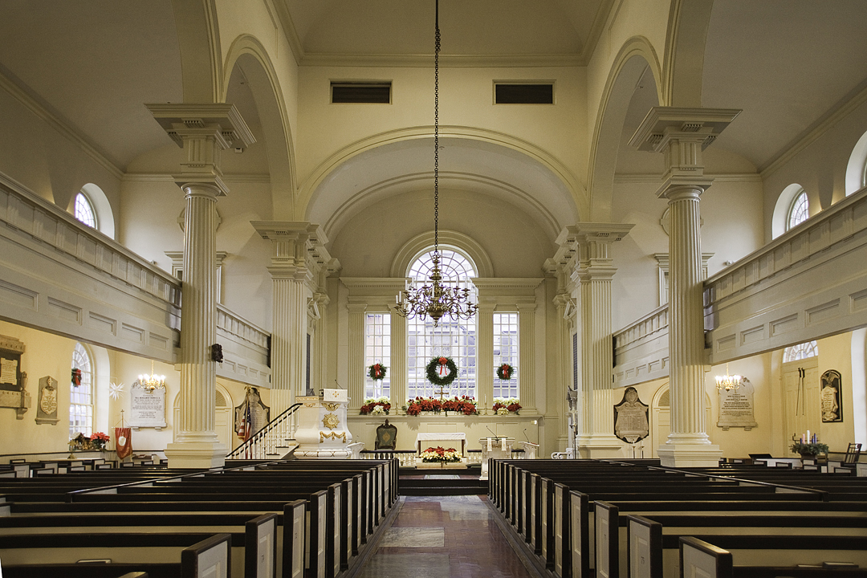
Questions for your Pastor, new Pastor, board member, or potential new board member!

Slide 84
Questions to ask Pastors, new Pastors, potential church board members:
How do you define success? George Barna study showed this is how Pastors define success:
attendance, giving, number of programs, number of staff and square footage.
2) What is your view of Romans 13? Look at the Heroes of the Hall of Faith — all of them defied government.
Revelation 21:8 clearly states the cowards will not inherit the Kingdom of God. Are we cowardly when we are silent.
3) If you are the Shepherd of the sheep, who are the wolves and how do you intend on protecting the sheep? n should we defy government? (A good resource is Lex Rex (it can be purchased here)
4) Are you a theological conservative (actually believing the entire Bible is without error?

Slide 85
5) Do you believe the Bible speaks to all areas of life?
6) Are you willing to preach on all areas of life?
7) How do we make disciples?
8) When should we submit to government and when should we defy government? (A good resource is Lex Rex (it can be purchased here)
9) Why do we render the things unto Caesar that are God’s? Do we know what is God’s or Caesar’s?​
-From Tim Barton of Wallbuilder's when asked "What do I ask a new potential Pastor as I am the search committee as my Senior Pastor is retiring"? 9/24/2022

Slide 87
1- God must be # 1 no matter what. Make the memories. Have breakfast as a family and read the Bible.
2- Teach your kids that faith is not a burden. That going to church isn’t a chore. We get TO DO THIS. We don’t have to do this.
3- Keep perspective. God has called you hear for a time such as this.
4-Thankful heart. Read the Founders and see how they lived and impart that on your children. David Barton was impacted by a writing by Benjamin Rush that he essentially thanked God for the blessings He forget to thank God for.
5-Be intentional. Reaffirm God’s Truth in to your kids.
​
-From Tim Barton of Wallbuilders when asked "How to raise kids Patriotic"? 9/24/2022
A few questions to ask yourself: 1) can we continue down this moral decay and continue as a nation? 2) can we continue on down this path of financial debt? 3) is our hope in American politics or the God that America was founded upon? 4) can we stop Bible prophecy? 5) is America listed in Bible prophecy?

Slide 88
Did you know our Founding Fathers took the stance of being patriotic and loving your country IS loving your neighbor? Why? The better off your country is, the better off your fellow man is!
“Patriotism is as much a virtue as justice, and is as necessary for the support of societies as natural affection is for the support of families. The Amor Patriae love of ones country is both a moral duty and a religious duty. It comprehends not only the love of our neighbors but of millions of our fellow creatures, not only of the present but of future generations. This virtue we find constitutes a part of the first characters of history.”
~ Benjamin Rush, Founding Father, Signer of The Declaration of Independence

Slide 89
Coming 2023!
We will embark on a one year journey in to the Bible. Not just the Bible – The Founder’s Bible where we will embark on the journey to dive in to the minds of our Founding Fathers and see how the Bible influenced America.
Purchase one today: www.thefoundersbible.com

Slide 90
Marciaalennick.wixsite.com/mysite

